Slide 1
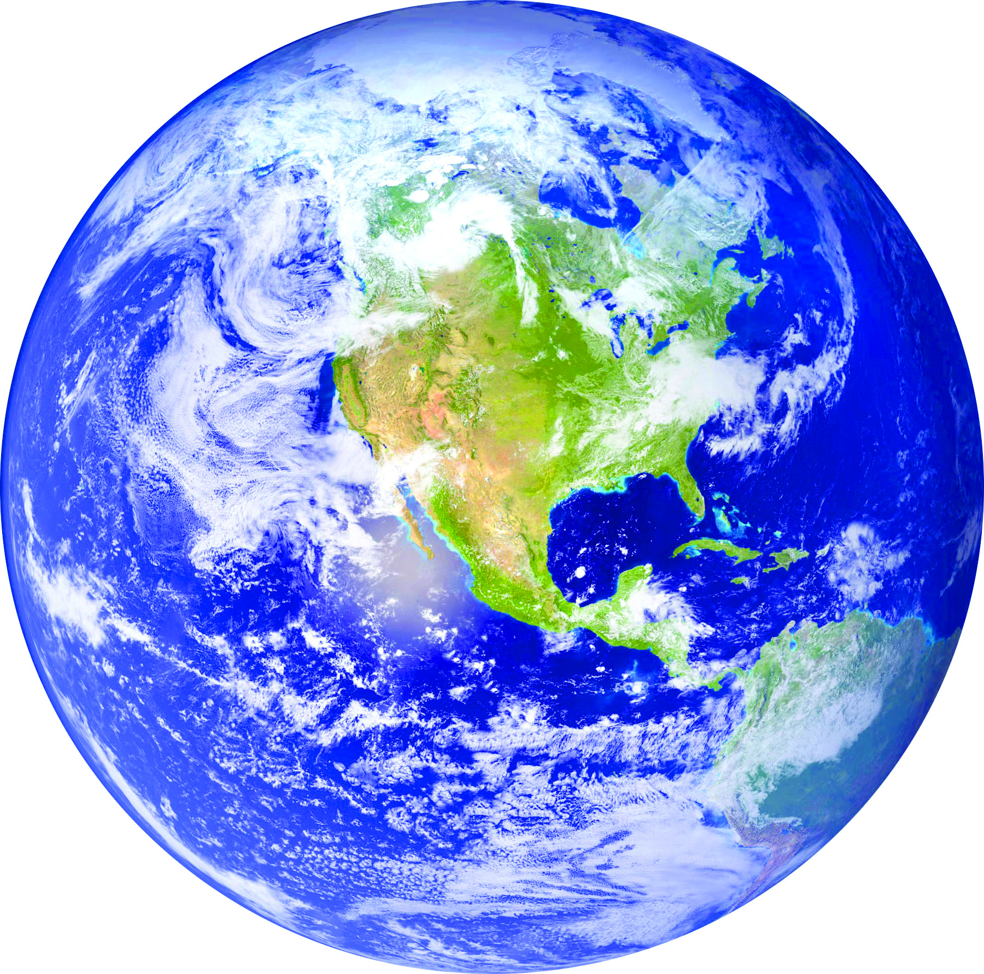
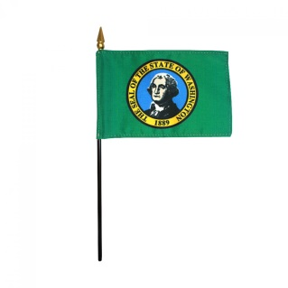
Science Language Arts Social Studies History

Slide 2
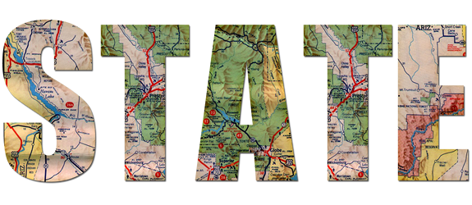
The History of Washington

Slide 3
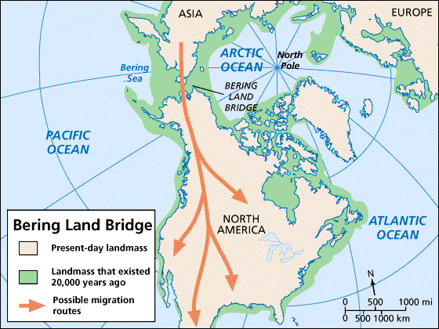
The First People
What information can you gather about early North American migration from the graphic above?
Notes:
Ducksters.com

Slide 4
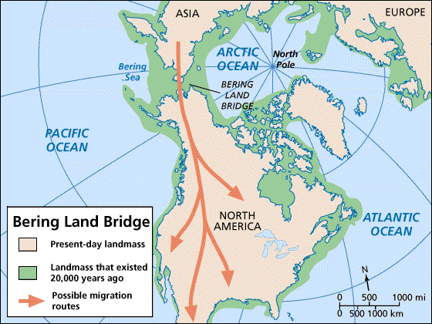
The First People
The first settlers in present-day Washington are thought to be descendants of nomads who came to North America across the Bering Land Bridge between Alaska and Russia. Scientists have found evidence of human settlement in Washington as far back as 12,000 years ago.
Notes:
Ducksters.com

Slide 5
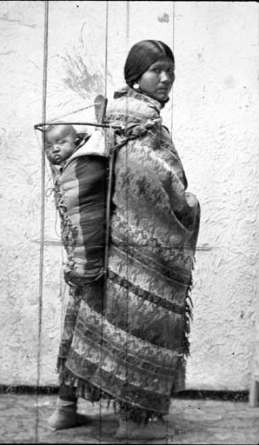
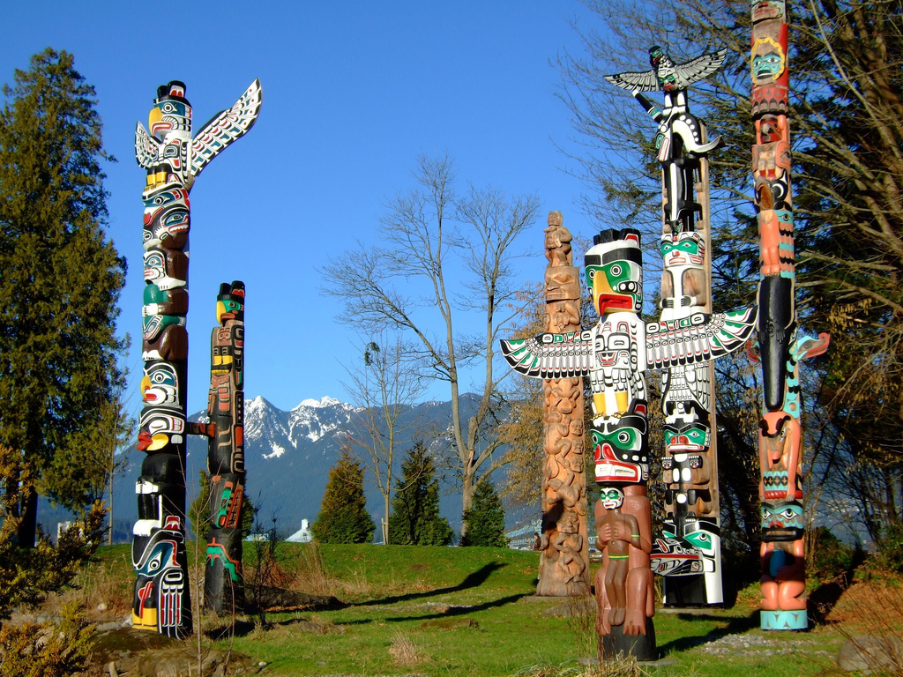
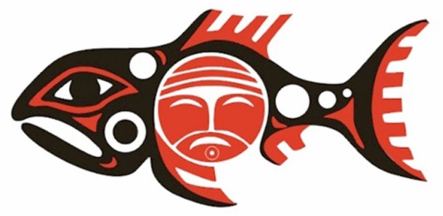
Native Americans
The land of Washington has been inhabited by people for thousands of years. Before the Europeans arrived there were many Native American tribes in the region.
Notes:
Ducksters.com

Slide 6
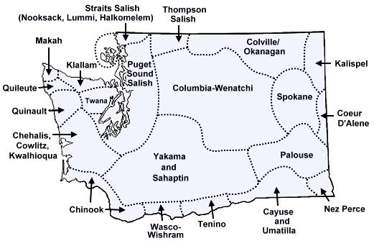
Native Americans
There are many Native American tribes who played a part in the history of the state and whose tribal territories and homelands are located in the present-day state of Washington.

Slide 7
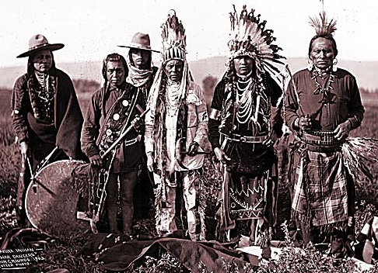
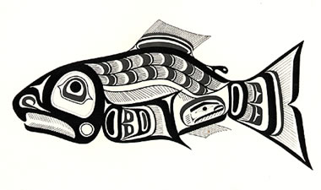
Native Americans
On the eastern side of the Cascade Range, Colville, Okanagan, Spokane, and Yakima are a few of the tribes who lived in the river valleys and on high-desert plateaus. These people also relied on salmon, catching thousands when the fish made their annual journey up the Columbia River and its tributaries.
The whole tribe netted
fish during the salmon run
and dried the catch to
preserve it.

Slide 8
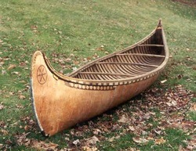
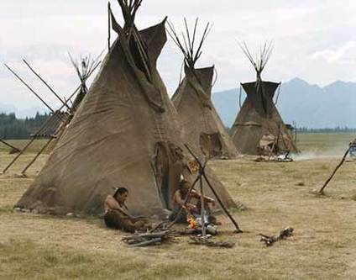
Native Americans
The inland tribes lived in seasonal villages of tepees made of animal hides. They hunted and kept horses. They collected berries and dried them.
They traveled to common prairies to harvest camas root, a starchy vegetable that is sweet and nourishing. But the salmon in the Columbia River system was essential to their diet and to their culture

Slide 9
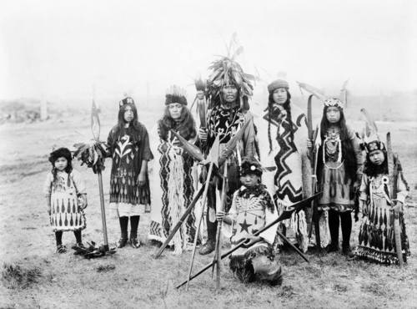
Native Americans
The Salish people lived along the coast. They lived in villages with permanent longhouses made of wood. They fished for salmon, their primary food source; hunted large game; and ate berries and roots. They cut huge cedar logs and made dugout canoes. Some of these canoes were large enough to take onto the ocean, where the Salish hunted whales.
Notes:
"Washington: The First People." America the Beautiful. Grolier Online, 2015. Web. 10 Nov. 2015.

Slide 10
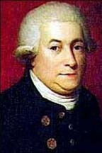
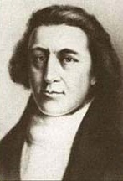
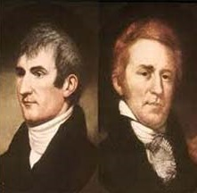
Explorers & Settlers
Before it was a state, Washington territory was visited by Spanish, American, and British explorers.

Slide 11
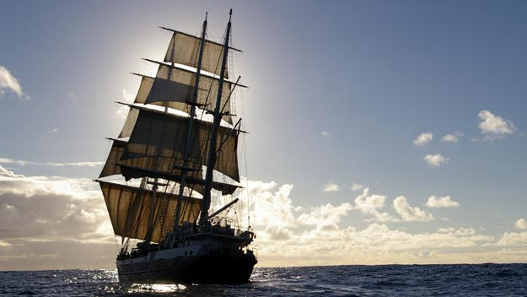
Europeans who first visited the present-day Washington coast were searching for the Northwest Passage, a shortcut from Europe to Asia. At the time, ships had to sail thousands of miles around the tip of South America.
In the 18th century, Europeans were drawn to the west coast because of the valuable sea otter fur.

Slide 12
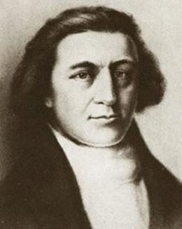
Robert Gray was captain of the first U.S. ship to circumnavigate the globe and explorer of the Columbia River. In 1787, Gray sailed from Boston to the Pacific Northwest on a trading expedition and travelled home around the world, reaching Boston again in August 1790. In May 1792, while on a second voyage in the “Columbia,” he explored Gray’s Harbor and the Columbia River (which is named for his ship), giving the U.S. a claim to the Oregon Territory.
1755 – 1806

Slide 13
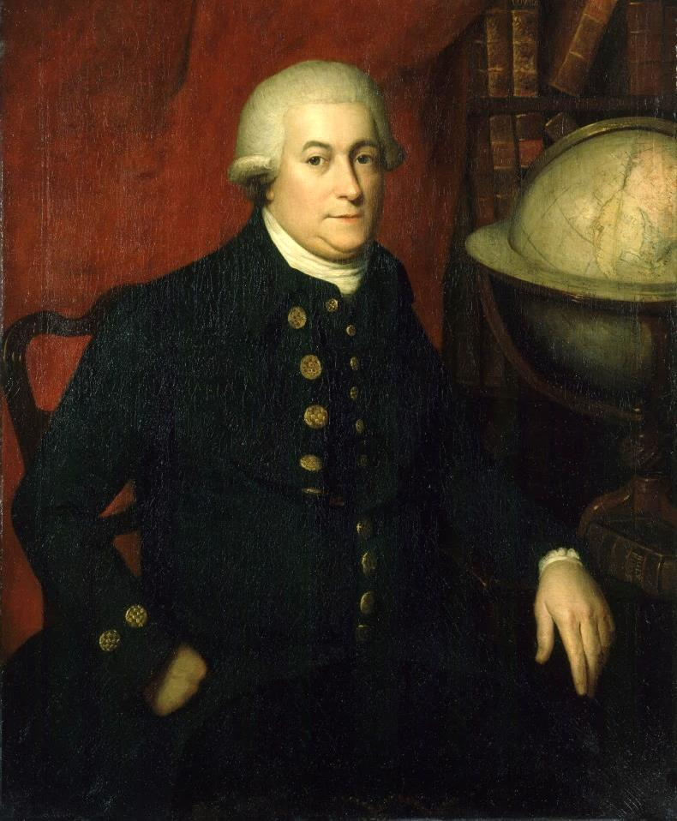
George Vancouver was a British navigator who, among other things, explored Puget Sound. He served for 25 years in the British Navy, and commanded the Discovery on her expedition to the North Pacific. In April 1792, George Vancouver traveled the Strait of Juan de Fuca and into Puget Sound. He named every island, mountain, waterway, and point of land in sight -- 75 in all.
1792–1794

Slide 14
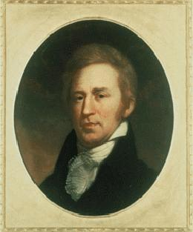
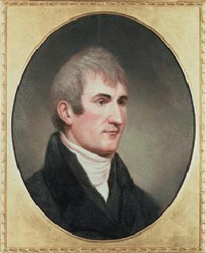
In 1804, Meriwether Lewis and William Clark were asked by President Thomas Jefferson to explore and map the wild west of North America. They traveled across the country to the Pacific Ocean and back again.
Lewis and Clark were instructed by Jefferson to:
Map a new route to the Pacific Ocean
Make contact with the Native Americans
Obtain specimens for further study
Keep a full record of activities during the Expedition

Slide 15
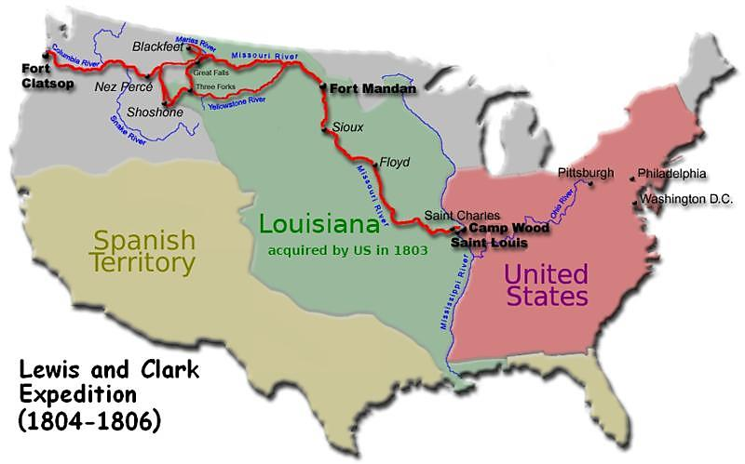
What information can you gather about Lewis & Clark’s journey from the map below?
Lewis & Clark’s Route
Oregon
Territory

Slide 16
What information can you gather about Lewis & Clark’s journey from the map below?
Lewis & Clark’s Route
Oregon
Territory
Lewis and Clark explored the Columbia River region and coastal areas for the U.S. in 1805–1806 and encountered the Yakama tribe during their explorations.

Slide 17
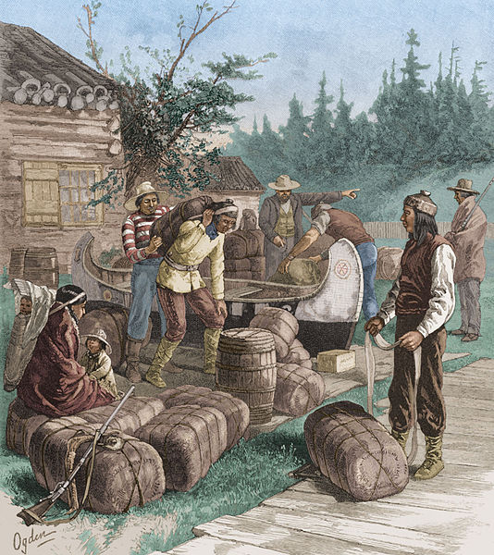
By 1800, British interest had shifted from sea-dwelling furbearers to land animals, particularly the beaver. In 1810, the North West Company, from Canada, built a fur-trading post near present-day Spokane.
This became the first permanent settlement of Europeans in Washington.
Indians trade furs at a Hudson's Bay Company trading post in the 1800's.

Slide 18
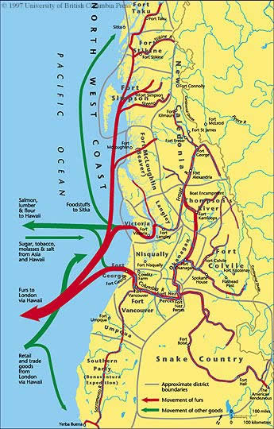
What information can you gather about early trade in Washington from the map?
KEY
Approximate district boundaries
Movement of fur
salmon, lumber & flour to Hawaii
Movement of other goods
sugar, tobacco, molasses & salt from Hawaii
Furs to London via Hawaii
Trade goods from London via Hawaii

Slide 19
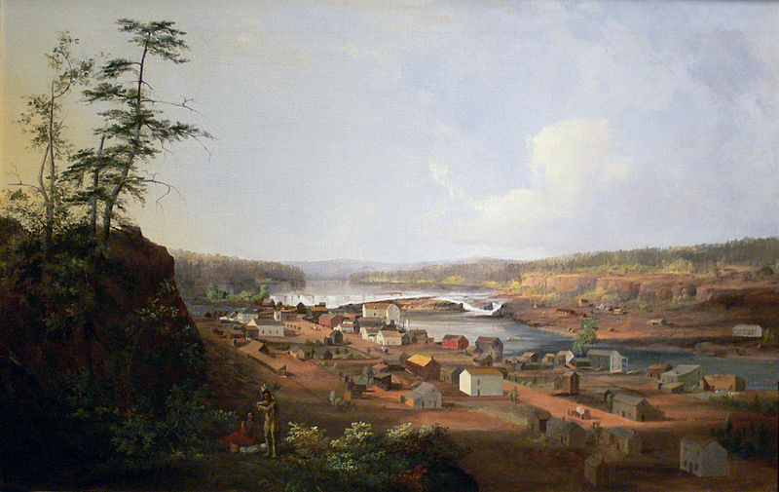
In the early 1800s, small European settlements sprang up along the shore of Puget Sound in western Washington. Since there were no roads or railroads, it took many days to reach these settlements.

Slide 20
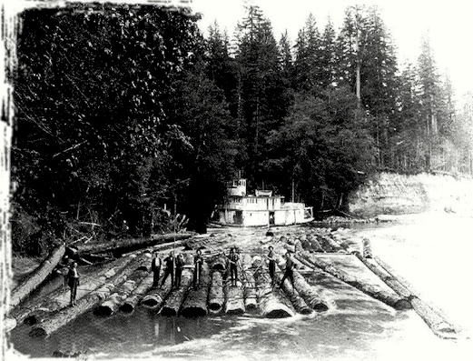
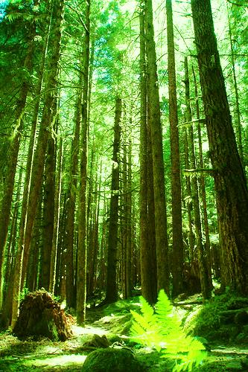
Settlements along western Puget Sound were soon established …
Many of the new settlers went to work in as
lumbermen, harvesting the seemingly unlimited
forests in the region.
Tumwater in 1845
Seattle in 1848
Bellingham in 1852

Slide 21
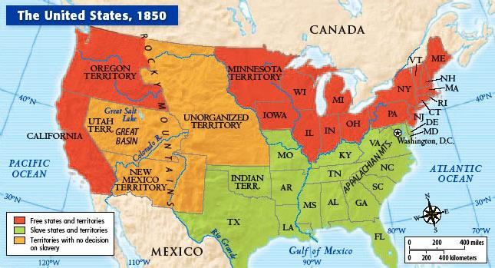
What important information can you gather from this map of the United States in 1850?

Slide 22
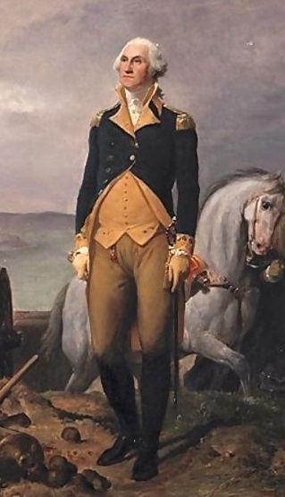
Early settlers requested that a separate territory named Columbia
be divided from Oregon.
Instead, the U.S. Congress named the territory after
George Washington
in 1853.

Slide 23
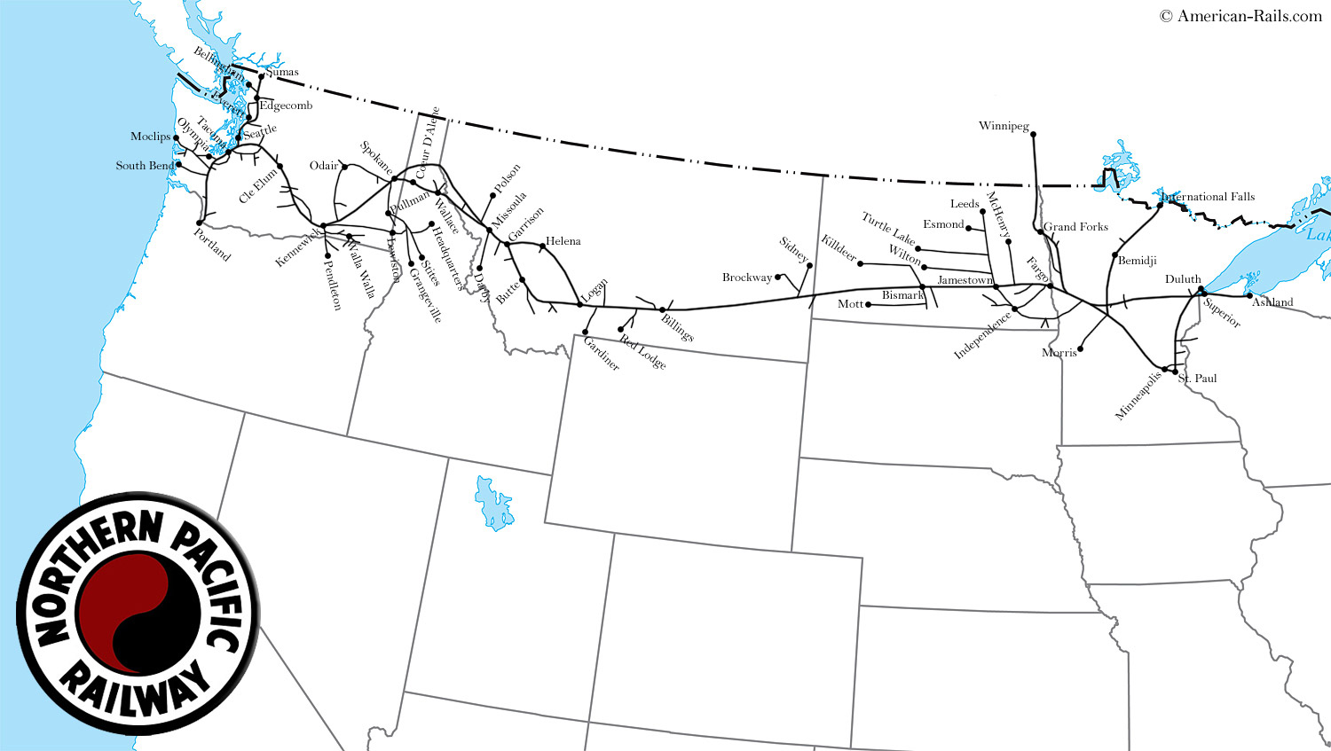
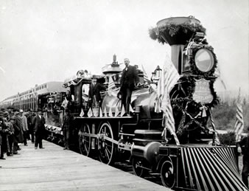
The Washington Territory was connected to the rest of the United States in 1883 with the completion of the Northern Pacific Railway. Now settlers could travel by train rather than by overland wagon.
Notes:
"Washington: The 42nd State." America the Beautiful. Grolier Online, 2015. Web. 13 Nov. 2015.

Slide 24
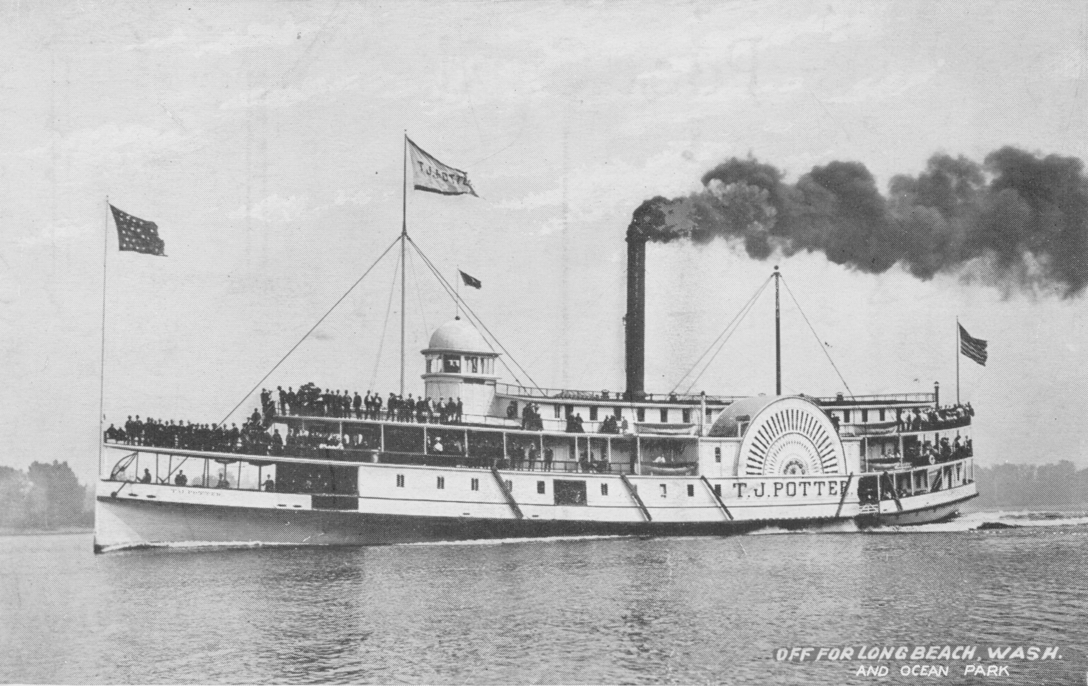
At the same time, improvement in steamships made transportation along the Washington coast and the lower Columbia River safer and faster.

Slide 25
By 1870, the territory had enough people to apply for statehood. However, the U.S. Congress was slow to respond, and Washington waited nearly 20 years to become a state!

Slide 26
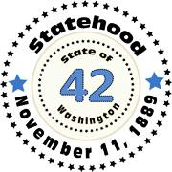
Statehood
In early 1889, Congress passed a bill that granted statehood to four western states. Washington's bill was the last approved, and President Benjamin Harrison signed it on November 11, 1889.
Order | State | Date of Entry into the Union
39 | North Dakota | November 2, 1889
40 | South Dakota | November 2, 1889
41 | Montana | November 8, 1889
42 | Washington | November 11, 1889
President
Benjamin Harrison

Slide 27
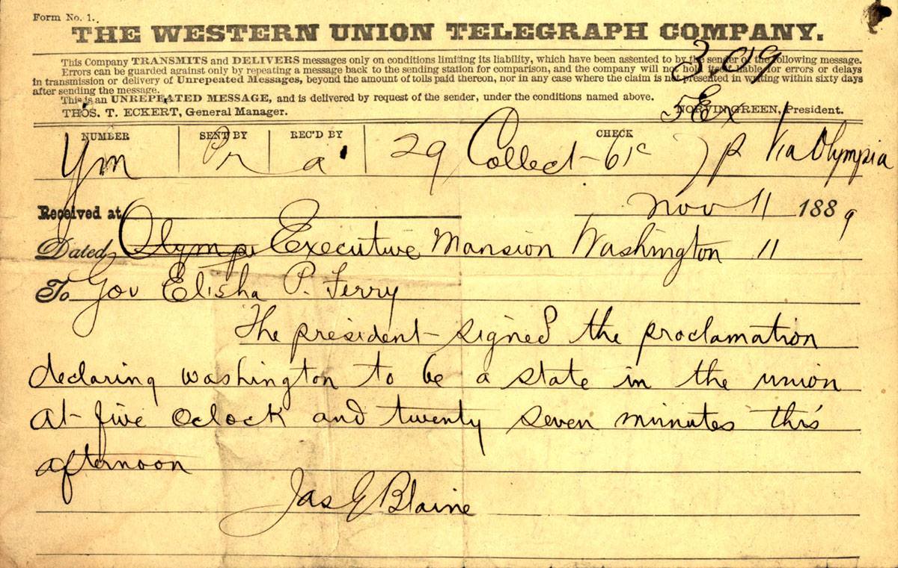

Slide 28
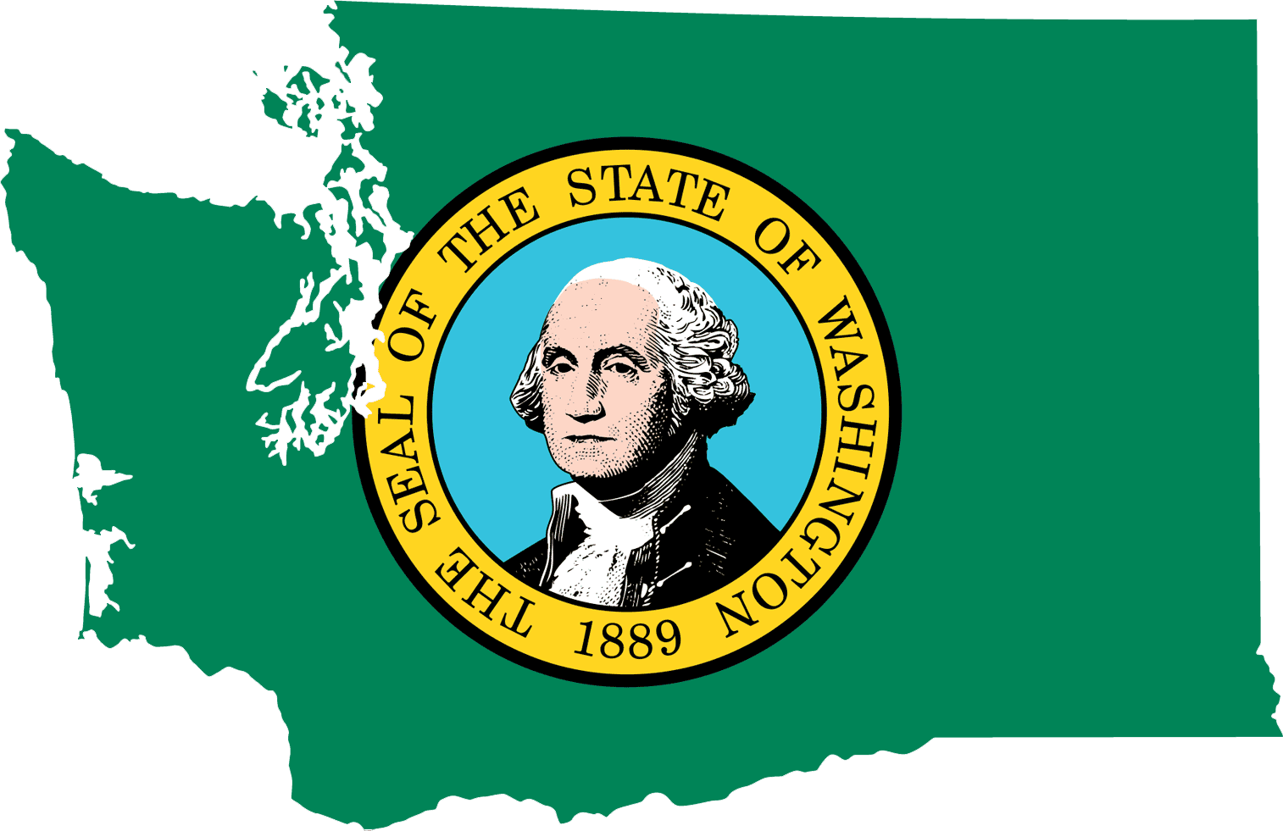
Washington was the
42nd state
to be admitted to the Union.

Slide 29
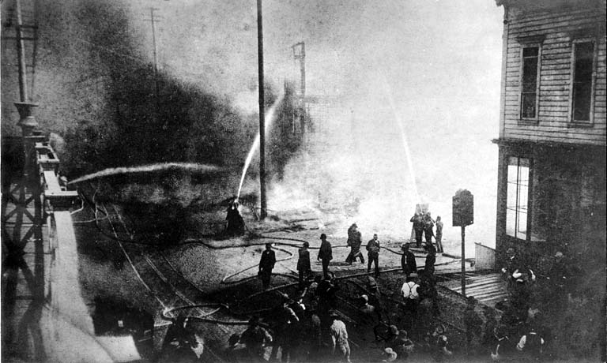
Historical Events
Seattle’s Great Fire, which destroyed 64 acres and many businesses, began on June 6, 1889, after a pot of glue from a cabinet shop burst into flames.

Slide 30
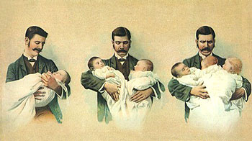
Historical Events
Sonora Smart Dodd’s father was a Civil War veteran who had raised six children by himself after his wife died in childbirth. In an attempt at honoring her father, Sonora garnered support for the first statewide Father’s Day celebration on June 19, 1910 in Spokane, Washington. Afterward, Dodd continued to press for a national observance.
Although the idea was
backed by President
Woodrow Wilson in 1916
and President Calvin
Coolidge in 1924, Father’s
Day did not become a
federal holiday until 1972.
Notes:
http://www.history.com/topics/us-states/washington

Slide 31
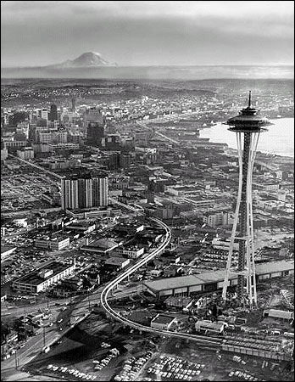
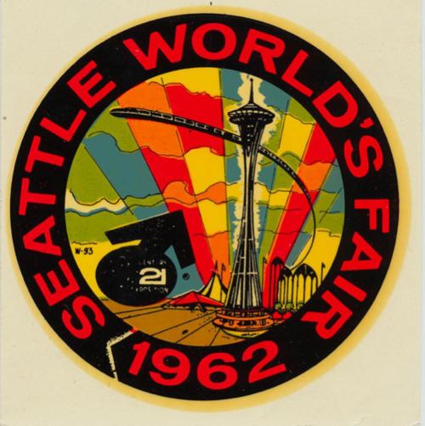
Historical Events
The Seattle Space Needle, built for the 1962 World’s Fair, is an iconic part of the city’s skyline and features a rotating restaurant at the top.

Slide 32
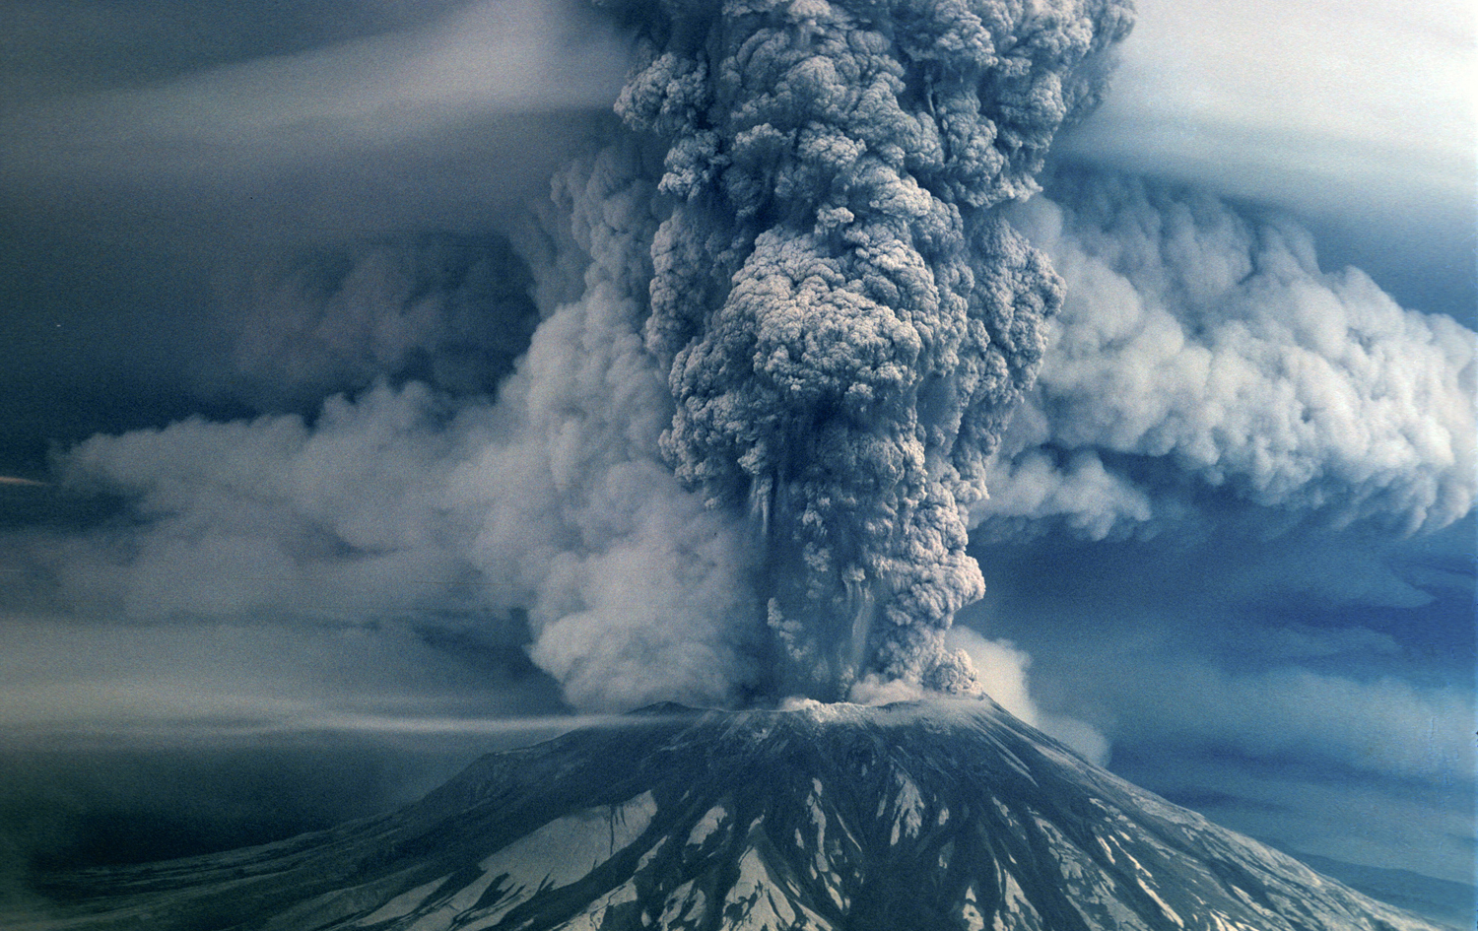
Historical Events
On May 18, 1980 at 8:32 a.m., the earth rumbled underneath Mount St. Helens, a peak in southwestern Washington. Moments later an explosion blasted away a side of the mountain in a major volcanic eruption!
Notes:
http://www.historylink.org/index.cfm?DisplayPage=output.cfm&File_Id=5457

Slide 33
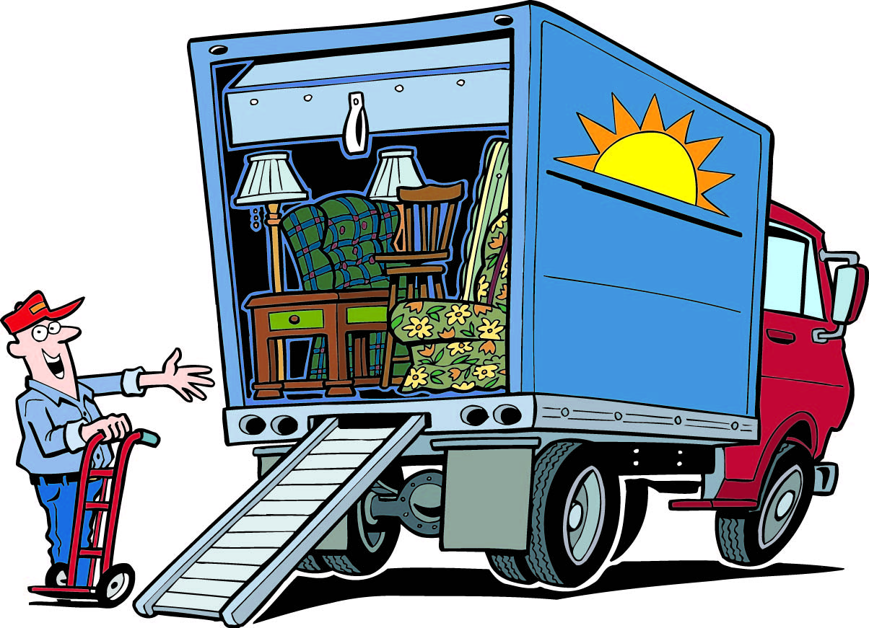
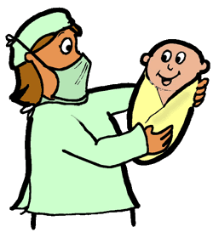
Historical Events
What year did you arrive in
Washington State?

Slide 34
Historical Events
HOW did you arrive?
A
B

Slide 35
Washington History Timeline
When did you come to Washington?
Use information from this lesson and
50 State Guide
http://www.ereferencedesk.com/resources/state-history-timeline/washington.html
To complete your timeline.
Notes:
Timeline: http://www.ereferencedesk.com/resources/state-history-timeline/washington.html

Slide 36
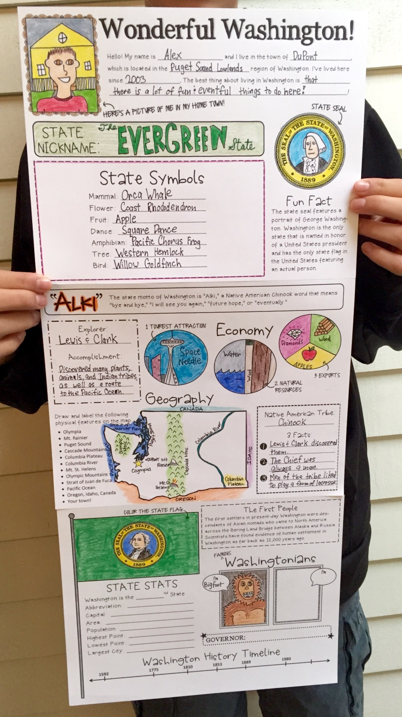
outlined drawings
neatly written
Grading
100 points
correct spelling, capitalization, and mechanics
accurate information
colorful
complete

Slide 37
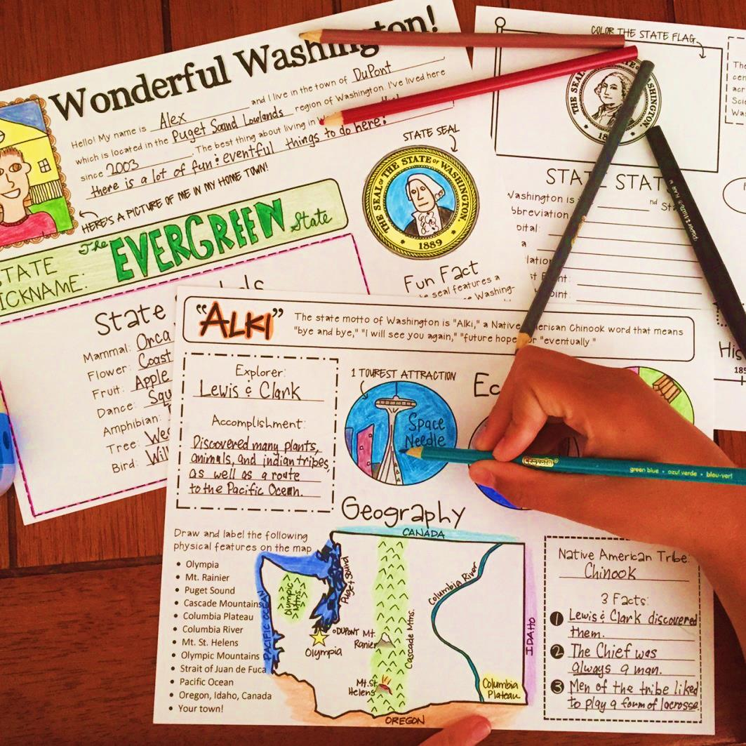
State Report
Add the information in this lesson to your Washington State Report Poster.
Posters are due in December and must be complete, neatly done and colorful!
We will complete a few sections each week.

Slide 38
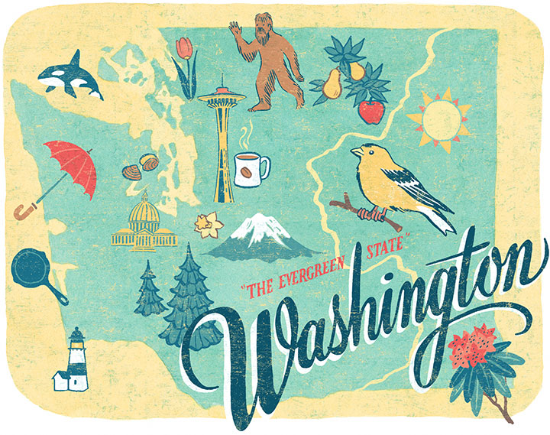
Thanks Washingtonians!

