Slide 1
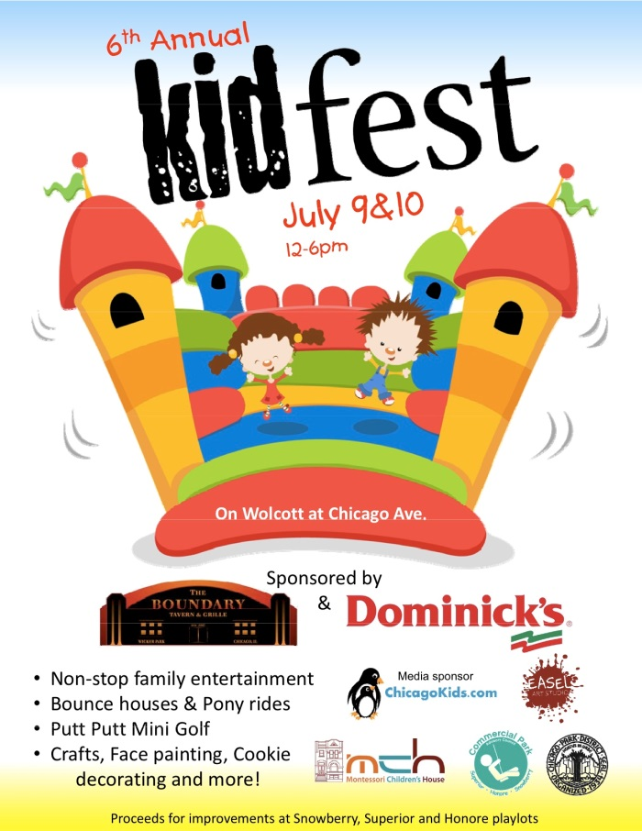
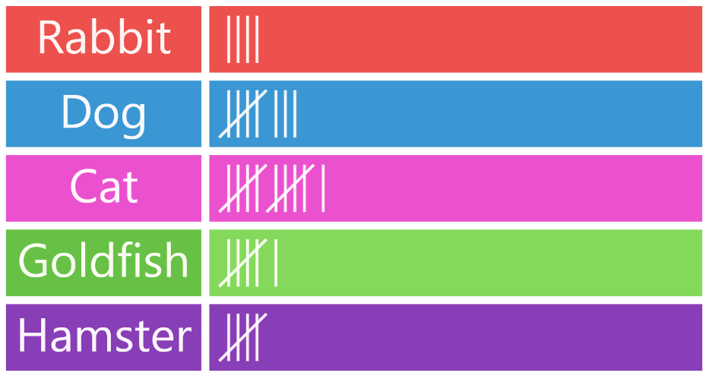
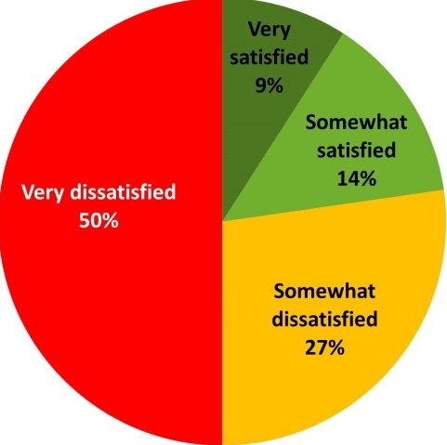
USING A VARIETY
of SOURCES

Slide 2
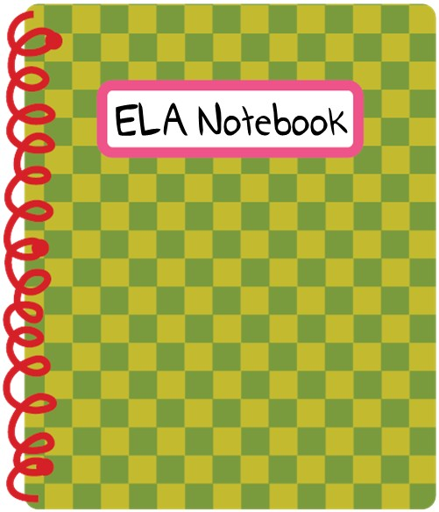
SLASH
Notebook
Bring your spiral to class
each week.
Everything we do will go into your notebook!
Always bring a pencil too!

Slide 3
use a variety of sources to gather information and answer questions completely.

Slide 4
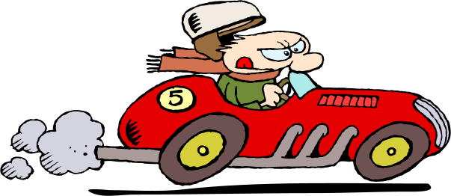
When answering Open-ended questions, always use
R.A.C.E.

Slide 5
When answering Open-ended questions, always use
R.A.C.E.
restate

Slide 6
When answering Open-ended questions, always use
R.A.C.E.
restate
answer

Slide 7
When answering Open-ended questions, always use
R.A.C.E.
restate
answer
cite

Slide 8
When answering Open-ended questions, always use
R.A.C.E.
restate
answer
cite
explain

Slide 10
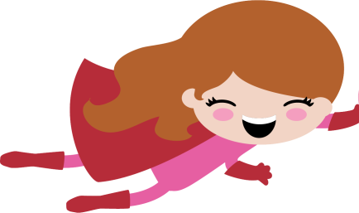
“Ecosystems”
Assignment
Due Today!
SUPER!
Notes:
You can add this to your weekly RACE PPTs - Paste a student response sample from last week’s open-ended question on this slide. Read aloud and find all parts of RACE in the response.

Slide 11
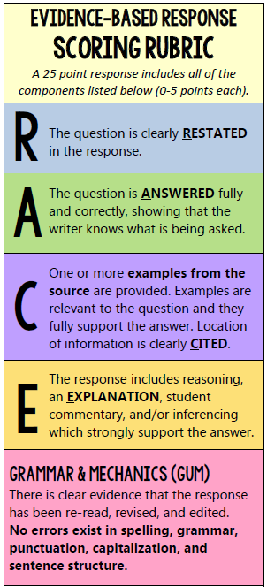
Breakout Room Activity:
individual, partner or group
QUESTION:
According to the text, why does a temperate zone support many varieties of organisms?
Greg Heffley
According to the text the temperate zone supports a variety of organisms because it temperature is moderate throughout the yeer. as stated in paragraph too, "One ecosystem that allows many different kinds of organisms to thrive is a temperate zone. It is an area where the conditions never get too hot or too cold."
SCORE:
How could Greg improve his response?
(0-25)
Notes:
Breakout Room Activity

Slide 12
R.A.C.E.
Let’s try something new!

Slide 13
What is
informational text?

Slide 14
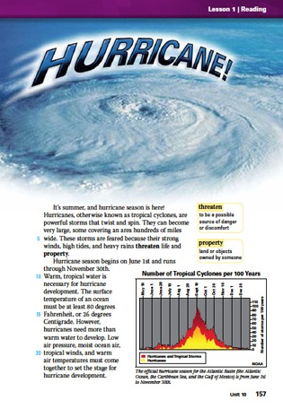
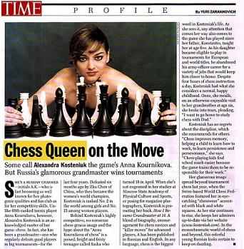
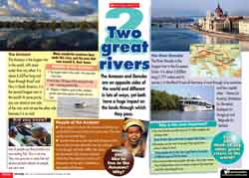
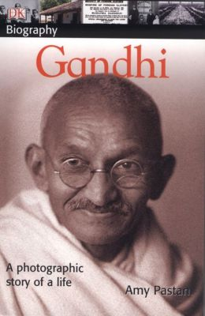
What is
informational text?
Informational text is non-fiction writing, written with the intention of informing the reader about a specific topic.

Slide 15
What are graphic features?

Slide 16
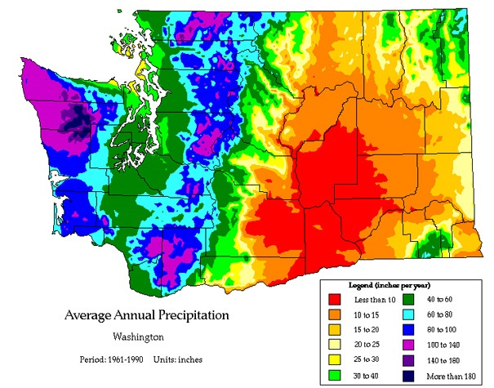
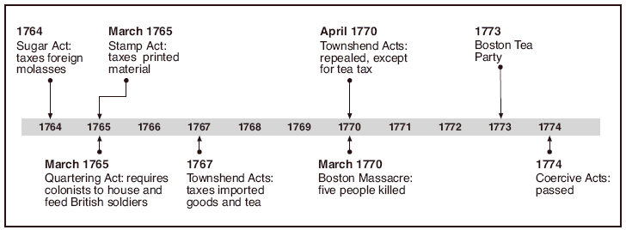
What are
graphic features?
Graphic features provide visual information to help explain the text you are reading or to give information about a specific topic.

Slide 17
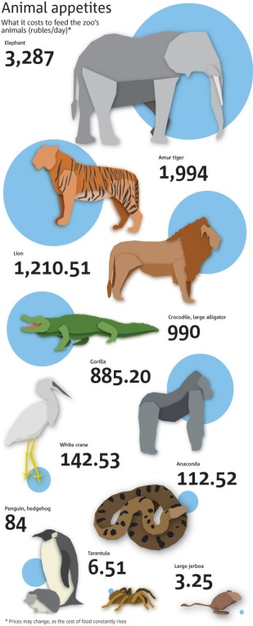
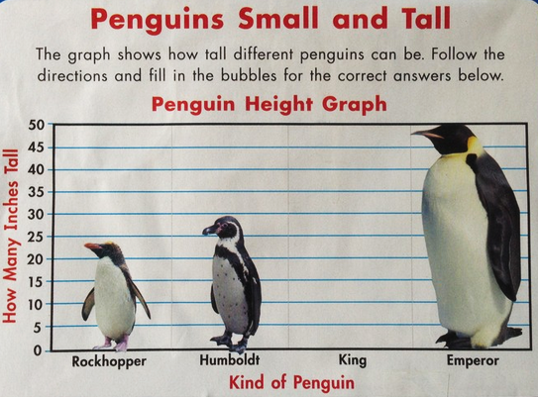
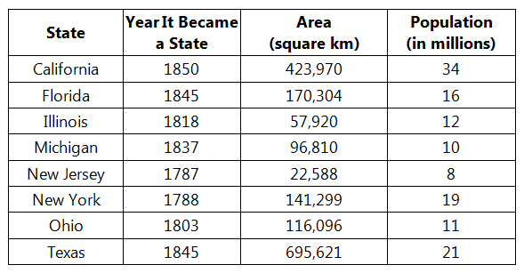
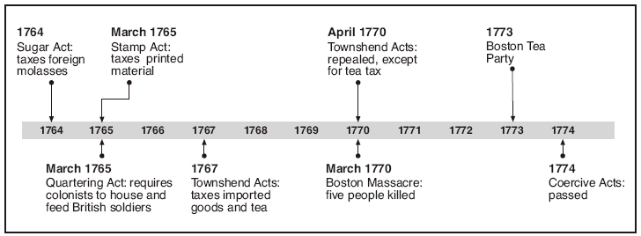
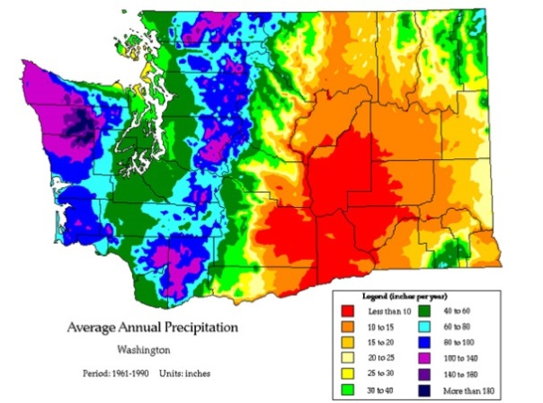
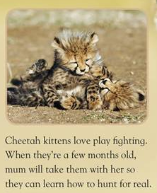
GRAPHIC FEATURES INCLUDE:
infographics
charts
graphs
photos
captions
timelines
maps

Slide 18
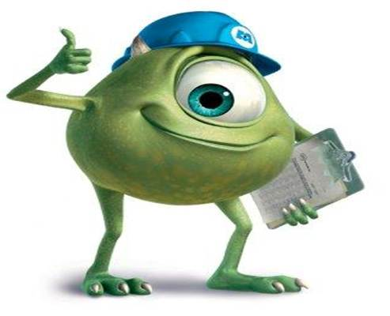
Just like with text, you can “read” and gather information from graphic features.

Slide 19
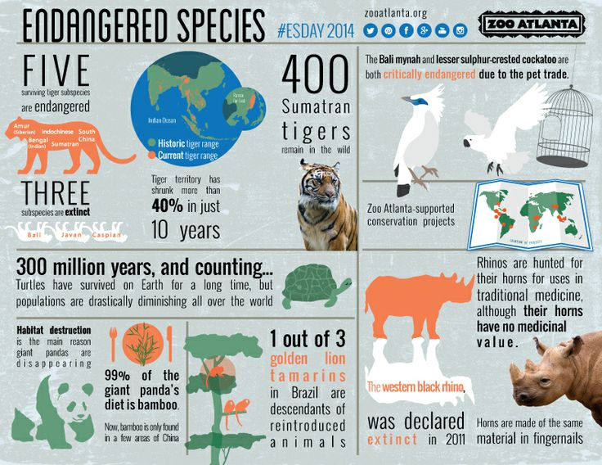
What is the purpose of this graphic?

Slide 20
Name two endangered animals mentioned on the infographic.

Slide 21
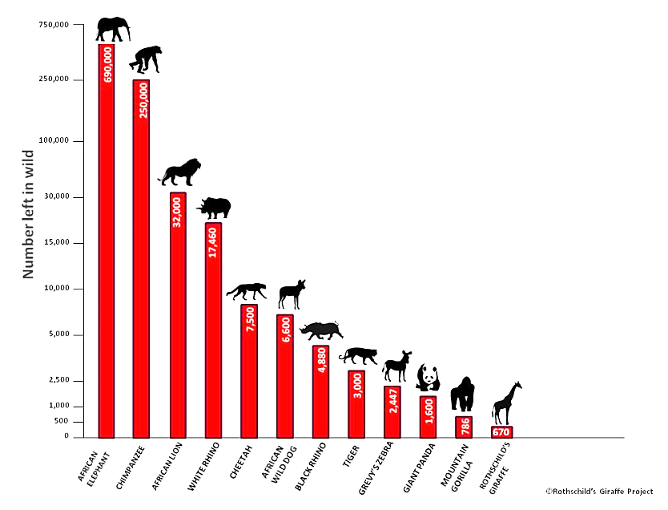
According to the graph, how many Giant Pandas are
left in the wild?

Slide 22
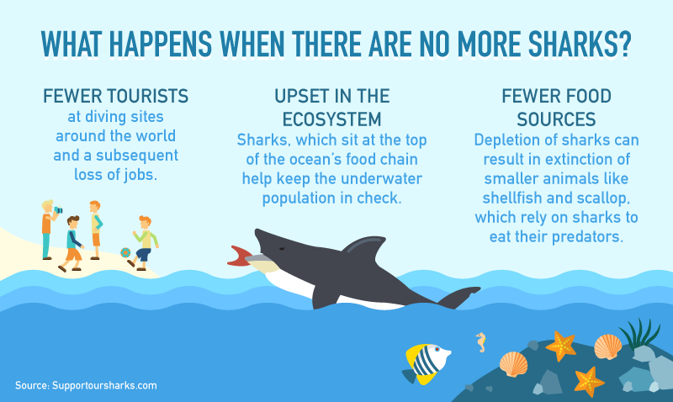
How would a reduction in the shark population
affect the lives of smaller sea animals?

Slide 23
Always use R.A.C.E. to prove your claim is correct…
even if the source
is a graphic!

Slide 24
How would a reduction in the shark population
affect the lives of smaller sea animals?
What’s your claim?
smaller sea animals would become extinct

Slide 25
How would a reduction in the shark population
affect the lives of smaller sea animals?
A reduction in the shark population would affect the lives of smaller sea animals because they would no longer have sharks as a form of protection. According to the graphic, the “depletion of sharks can result in extinction of smaller animals like shellfish and scallop which rely on sharks to eat their predators.” This means that if sharks are not around to eat the predators of smaller creatures, they would be in danger of becoming extinct!

Slide 26
How would a reduction in the shark population
affect the lives of smaller sea animals?
A reduction in the shark population would affect the lives of smaller sea animals because they would no longer have sharks as a form of protection. According to the graphic, the “depletion of sharks can result in extinction of smaller animals like shellfish and scallop which rely on sharks to eat their predators.” This means that if sharks are not around to eat the predators of smaller creatures, they would be in danger of becoming extinct!

Slide 27
How would a reduction in the shark population
affect the lives of smaller sea animals?
A reduction in the shark population would affect the lives of smaller sea animals because they would no longer have sharks as a form of protection. According to the graphic, the “depletion of sharks can result in extinction of smaller animals like shellfish and scallop which rely on sharks to eat their predators.” This means that if sharks are not around to eat the predators of smaller creatures, they would be in danger of becoming extinct!

Slide 28
How would a reduction in the shark population
affect the lives of smaller sea animals?
A reduction in the shark population would affect the lives of smaller sea animals because they would no longer have sharks as a form of protection. According to the graphic, the “depletion of sharks can result in extinction of smaller animals like shellfish and scallop which rely on sharks to eat their predators.” This means that if sharks are not around to eat the predators of smaller creatures, they would be in danger of becoming extinct!

Slide 29
SCIENCE SCHEMA
R.A.C.E.
Let’s learn about food chains…

Slide 30
SCIENCE SCHEMA
Food Chain
A series of organisms interrelated in their feeding habits, the smallest being fed upon by a larger one, which in turn feeds a still larger one, etc.

Slide 31
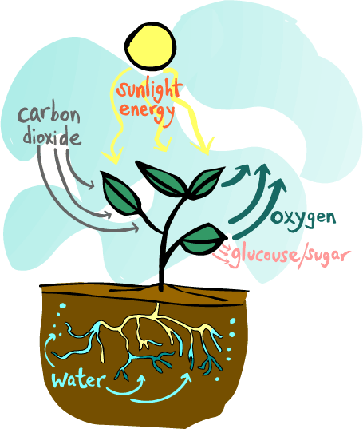
SCIENCE SCHEMA
Producers
Plants are called producers. This is because they produce their own food! They do this by using light energy from the Sun, carbon dioxide from the air and water from the soil to produce food - in the form of glucose/sugar.
The process is called photosynthesis.

Slide 32
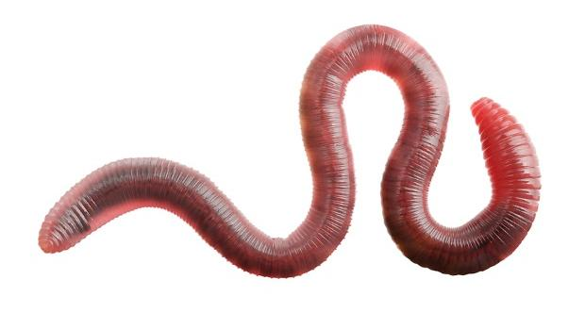
SCIENCE SCHEMA
Decomposers
Bacteria and fungi are decomposers. They eat decaying matter - dead plants and animals and in the process they break them down and decompose them When that happens, they release nutrients and mineral salts back into the soil - which then
will be used by plants!

Slide 33
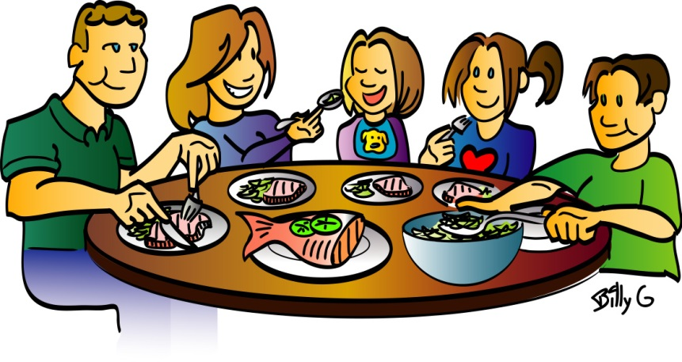
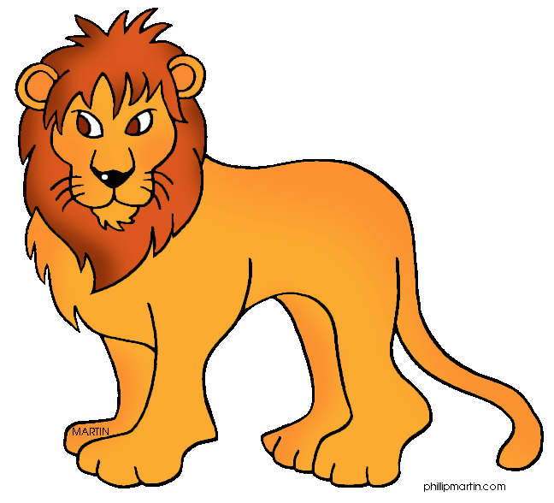
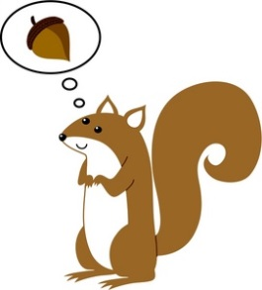
SCIENCE SCHEMA
Consumers
Animals are called consumers. This is because they cannot make their own food, so they need to consume (eat) plants and/or animals.

Slide 34
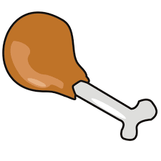
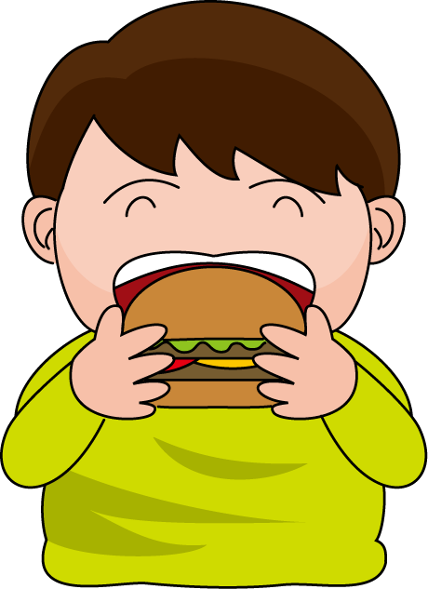
SCIENCE SCHEMA
There are 3 types of consumers:
Carnivores Herbivores Omnivores

Slide 35
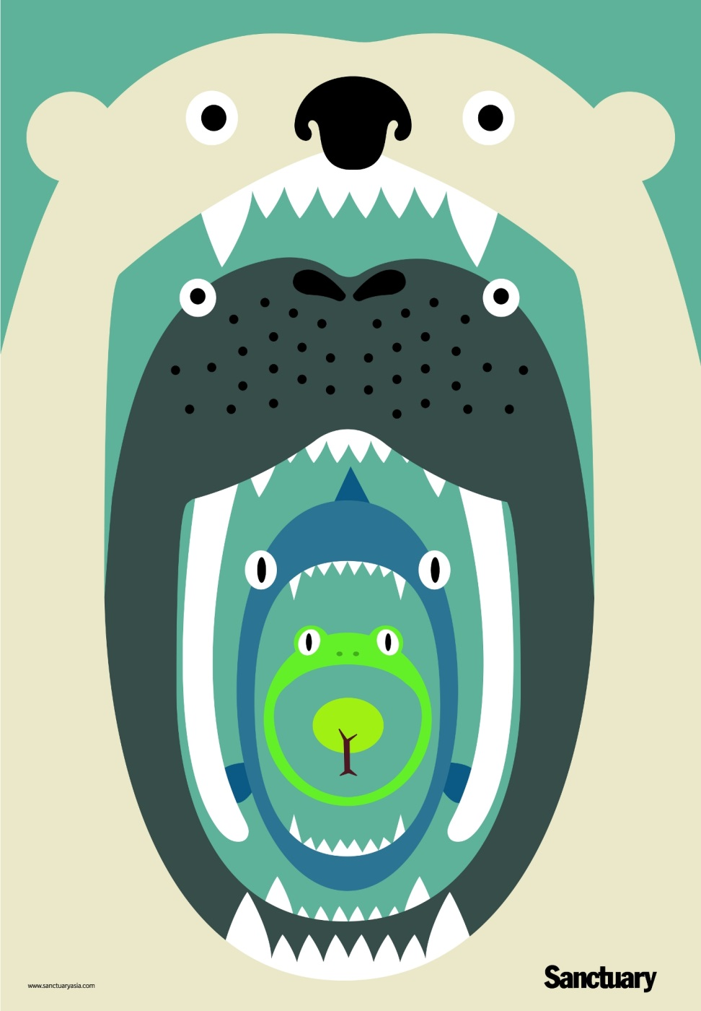
THE FOOD CHAIN
Every organism needs to obtain energy in order to live. For example, plants get energy from the sun, some animals eat plants, and some animals eat other animals.
A food chain is the sequence of who eats whom in a biological community (an ecosystem) to obtain nutrition. A food chain starts with the primary energy source, usually the sun or boiling-hot deep sea vents. The next link in the chain is an organism that make its own food from the primary energy source -- an example is photosynthetic plants that make their own food from sunlight (using a process called photosynthesis) and chemosynthetic bacteria that make their food energy from chemicals in hydrothermal vents. These are called autotrophs or primary producers.

Slide 36
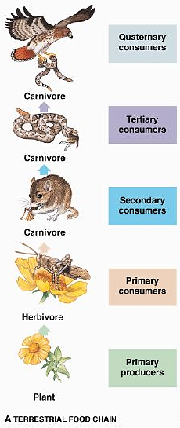
Next come organisms that eat the autotrophs; these organisms are called herbivores or primary consumers. An example is a rabbit that eats grass.
The next link in the chain is animals that eat herbivores. These are called secondary consumers and an example is a snake that eat rabbits.
In turn, these animals are eaten by larger predators . An example is an owl that eats snakes.
The tertiary consumers are eaten by quaternary consumers -- an example is a hawk that eats owls.
Each food chain end with a top predator, and animal with no natural enemies (like an alligator, hawk, or polar bear).
The arrows in a food chain show the flow of energy, from the sun or hydrothermal vent to a top predator. As the energy flows from organism to organism, energy is lost at each step. A network of many food chains is called a food web.

Slide 37
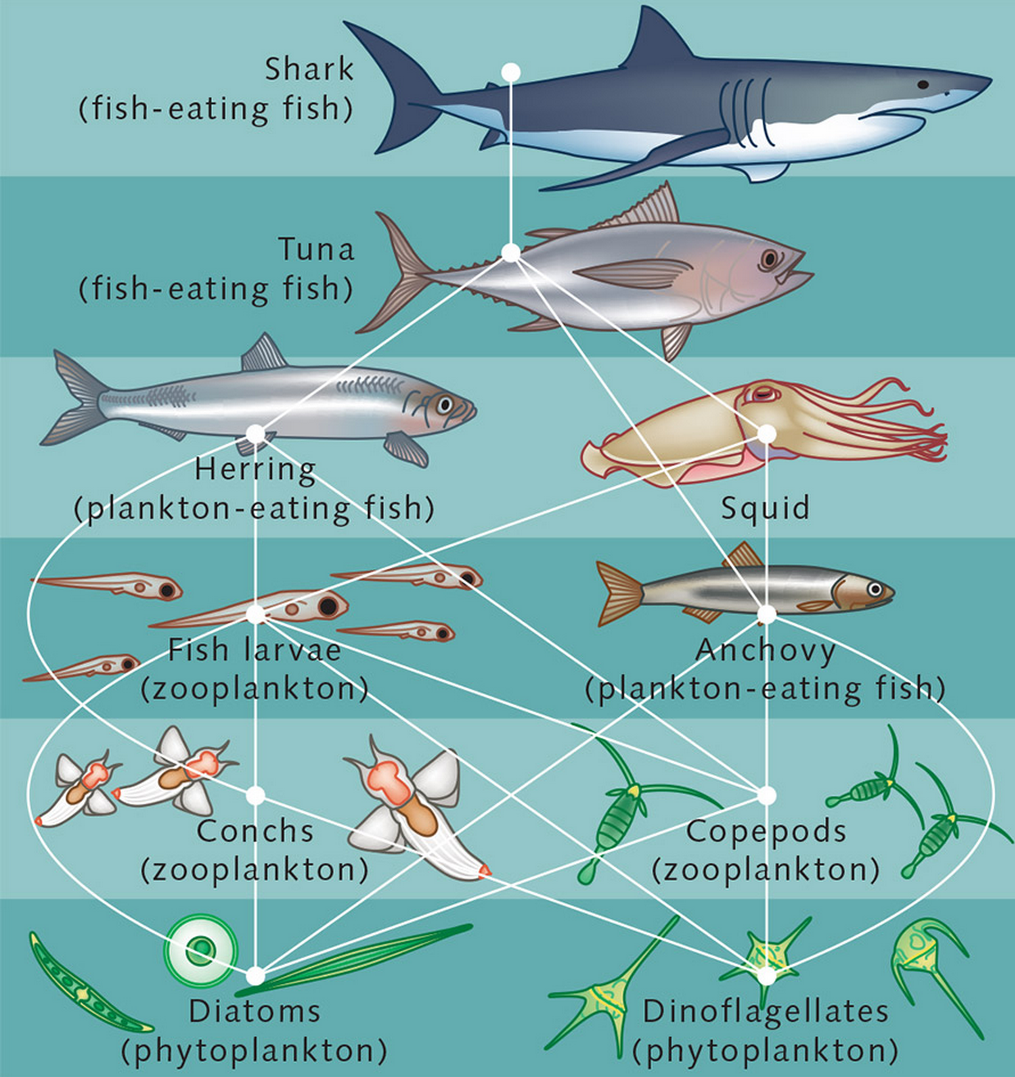
R.A.C.E.
QUESTION:
Based on the information in the “Food Chain” text, what animal would be considered a top predator in this Marine Food Web diagram?
What is a top predator?
For this response, you’ll want to find evidence in the text AND in the graphic!

Slide 38
QUESTION:
Based on the information in the text, what animal would be considered a top predator in this Marine Food Web diagram?
Next come organisms that eat the autotrophs; these organisms are called herbivores or primary consumers. An example is a rabbit that eats grass.
The next link in the chain is animals that eat herbivores. These are called secondary consumers and an example is a snake that eat rabbits.
In turn, these animals are eaten by larger predators. An example is an owl that eats snakes.
The tertiary consumers are eaten by quaternary consumers -- an example is a hawk that eats owls.
Each food chain end with a top predator, and animal with no natural enemies (like an alligator, hawk, or polar bear).
The arrows in a food chain show the flow of energy, from the sun or hydrothermal vent to a top predator. As the energy flows from organism to organism, energy is lost at each step. A network of many food chains is called a food web.
What’s your claim?

Slide 39
QUESTION:
Based on the information in the text, what animal would be considered a top predator in this Marine Food Web diagram?
Next come organisms that eat the autotrophs; these organisms are called herbivores or primary consumers. An example is a rabbit that eats grass.
The next link in the chain is animals that eat herbivores. These are called secondary consumers and an example is a snake that eat rabbits.
In turn, these animals are eaten by larger predators. An example is an owl that eats snakes.
The tertiary consumers are eaten by quaternary consumers -- an example is a hawk that eats owls.
Each food chain end with a top predator, and animal with no natural enemies (like an alligator, hawk, or polar bear).
The arrows in a food chain show the flow of energy, from the sun or hydrothermal vent to a top predator. As the energy flows from organism to organism, energy is lost at each step. A network of many food chains is called a food web.
Where’s your evidence?

Slide 40
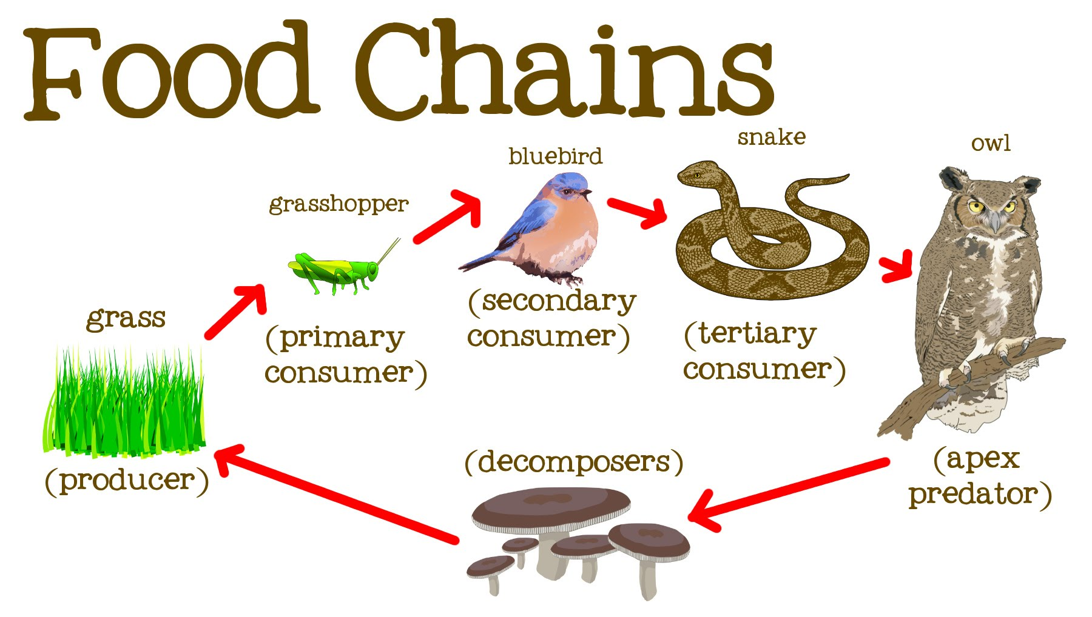
QUESTION:
Based on the information, why is the bluebird considered a secondary consumer in the food chain?

Slide 41
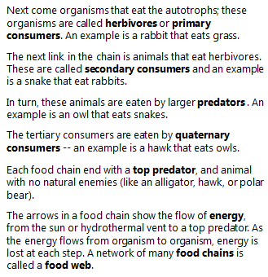
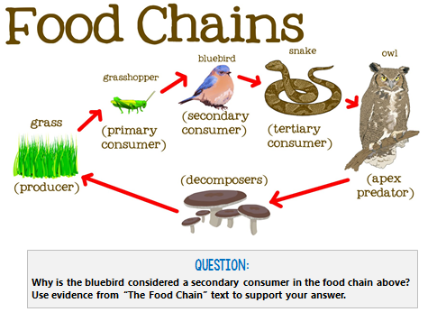
This week’s
R.A.C.E ASSIGNMENT
GOOGLE FORM:
DUE BEFORE OUR NEXT
CLASS ON FEBRUARY 20.
Nice work today!
What is a secondary consumer?
For this response, you’ll want to find evidence in the text AND in the graphic to support
your claim!
Notes:
https://goo.gl/forms/V75tS2Ck9wdqnHd42

Slide 42
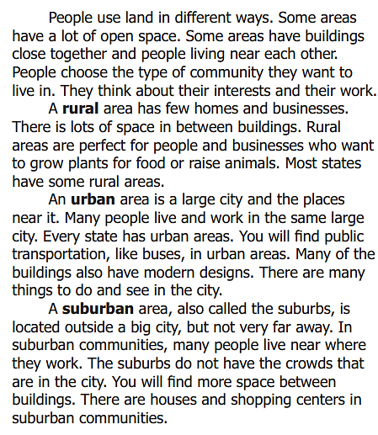
QUESTION:
Do you live in a rural, urban, or suburban area? Give evidence from the text to support your answer.
I live in a rural area. The text states that in rural areas, “There is lots of space in between buildings." My home sits on the edge of the forest with a lot of space between homes. The text also states that "A suburban area, also called the suburbs is located outside a big city, but not very far away." We live at least 60 miles from the nearest big city so I believe that also proves that we are in a rural area.
- Logan
Notes:
http://goo.gl/forms/zCPxbASxEY

Slide 43
QUESTION:
Do you live in a rural, urban, or suburban area? Give evidence from the text to support your answer.
I live in a suburban area. According to the article, the last paragraph states "The suburbs do not have the crowds that are in the city. You will find more space between buildings. There are houses and shopping centers in suburban communities." I think there are a few things in each category that seem to fit where I live, but suburban area seems the closest.
- Gabriel
Notes:
http://goo.gl/forms/zCPxbASxEY

Slide 44
What is the purpose
of this bar graph?

Slide 45
What is the purpose of this graphic?

Slide 46
SCIENCE SCHEMA
Consumers
Animals are called consumers. This is because they cannot make their own food, so they need to consume (eat) plants and/or animals.
There are 3 types of consumers:
Carnivores Herbivores Omnivores

Slide 47
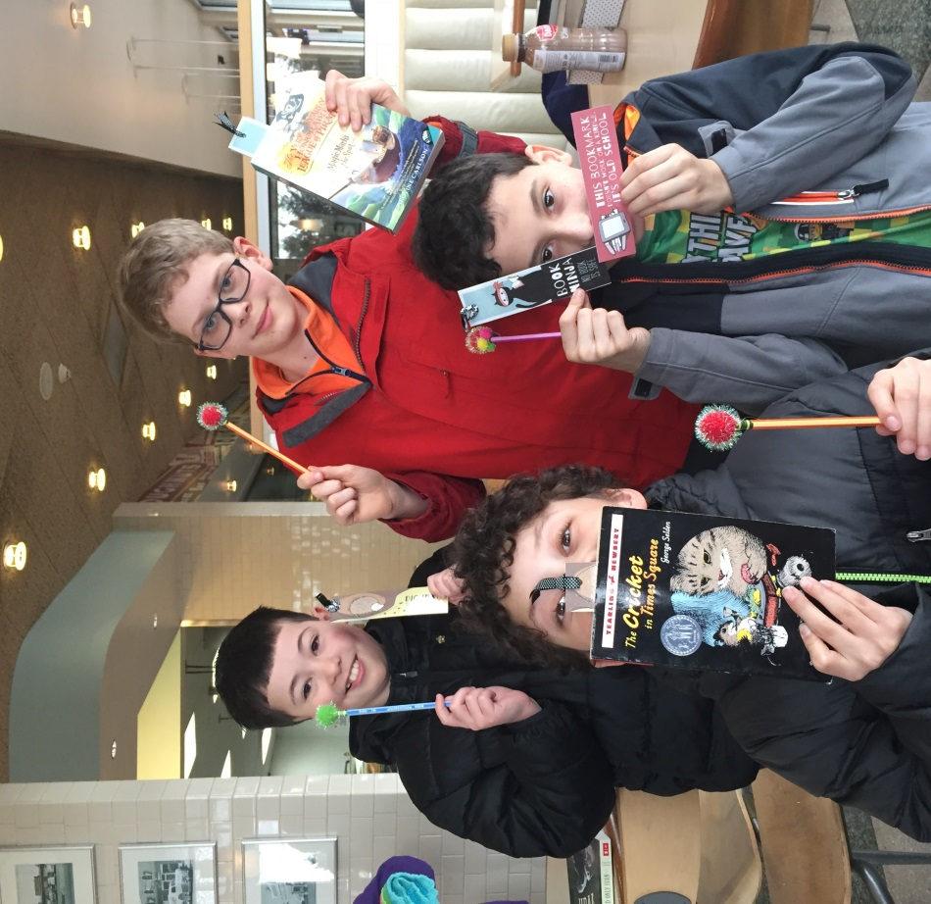
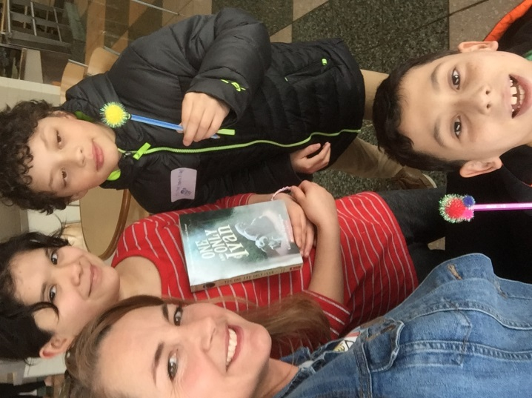
The GREAT Washingtonian
BOOK SWAP!
Next Stop:
DuPont
See you in DuPont on March 22!
Bring a book or two to swap!

