Slide 1
RACE
Review & Practice

Slide 2
SLASH
Notebook
Bring your spiral to class
each week.
Everything we do will go into your notebook!
Always bring a pencil too!

Slide 3
When answering Open-ended questions, always use
R.A.C.E.

Slide 4
When answering Open-ended questions, always use
R.A.C.E.
restate

Slide 5
When answering Open-ended questions, always use
R.A.C.E.
restate
answer

Slide 6
When answering Open-ended questions, always use
R.A.C.E.
restate
answer
cite

Slide 7
When answering Open-ended questions, always use
R.A.C.E.
restate
answer
cite
explain

Slide 8
Restate means:
“to state again in another way”

Slide 9
QUESTION:
What did Mary and Laura collect at the
deserted Indian camp?
At the deserted Indian camp, Mary and Laura collected ________________.
Use the same words to create a statement.

Slide 11
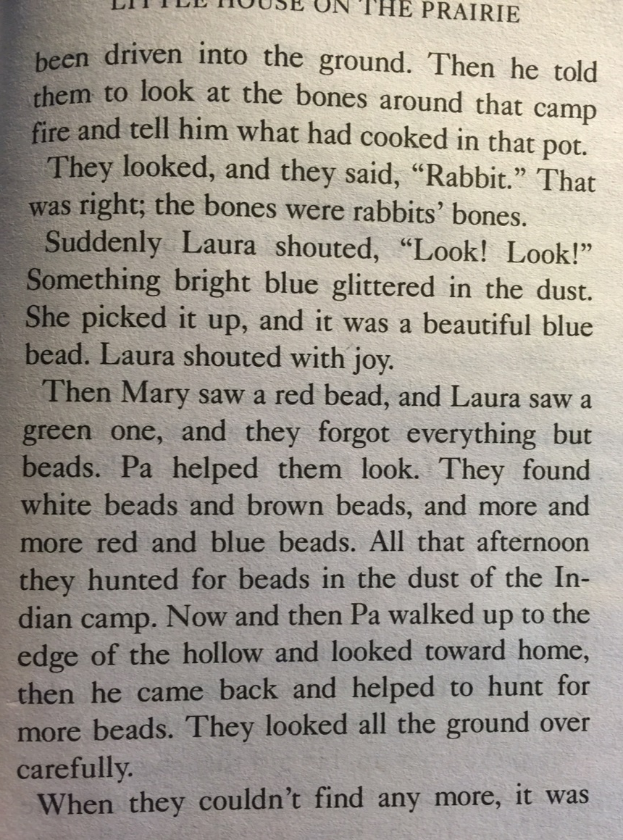
Based on the information given, what’s your claim?
they collected colorful beads
Do you have evidence from the text to back it up?
YES!

Slide 12
Since you are citing from a text, you need a direct quote in your answer.

Slide 13
At the deserted Indian camp, Mary and Laura collected colorful beads. As it states on page 179 of Little House on the Prairie, “They found white beads and brown beads, and more and more red and blue beads. All that afternoon they hunted for beads in the dust of the Indian camp.”
Tell where you found the evidence.
HULK IT UP!
A direct quote is written word for word,
directly from the text…
with QUOTATION MARKS!
Since you are citing from a text,
you need a direct quote in your answer.

Slide 14
Now is your chance to
clarify and enlighten your audience! Explain your evidence and add your thoughts!

Slide 15
This part of your answer can be one sentence
or multiple sentences.
Explain how the quote proves your claim.
Share your own commentary.
Speak from personaL experience.
Add details to clarify why your
claim is evidence-based.
Convince your audience!

Slide 16
SPIDER!
At the deserted Indian camp, Mary and Laura collected colorful beads. As it states on page 179 of Little House on the Prairie, “They found white beads and brown beads, and more and more red and blue beads. All that afternoon they hunted for beads in the dust of the Indian camp.” The novel also explains that when the girls got back home they showed a handkerchief full of beads to Ma. This leads me to believe that Mary and Laura had quite a collection of colorful beads!
SUPER!
SUPER!
SUPER!

Slide 17
R.A.C.E.
Let’s try it!

Slide 18
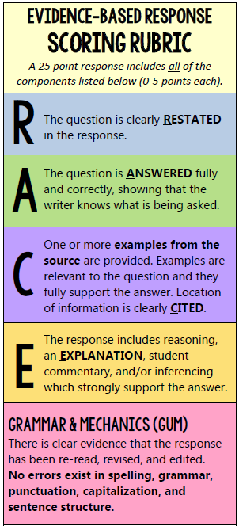
Use these HELPFUL TOOLS!

Slide 20
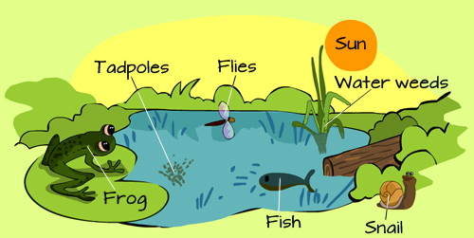
Ecosystem
A system made up of an ecological community of living things interacting with their environment especially under natural conditions.

Slide 21
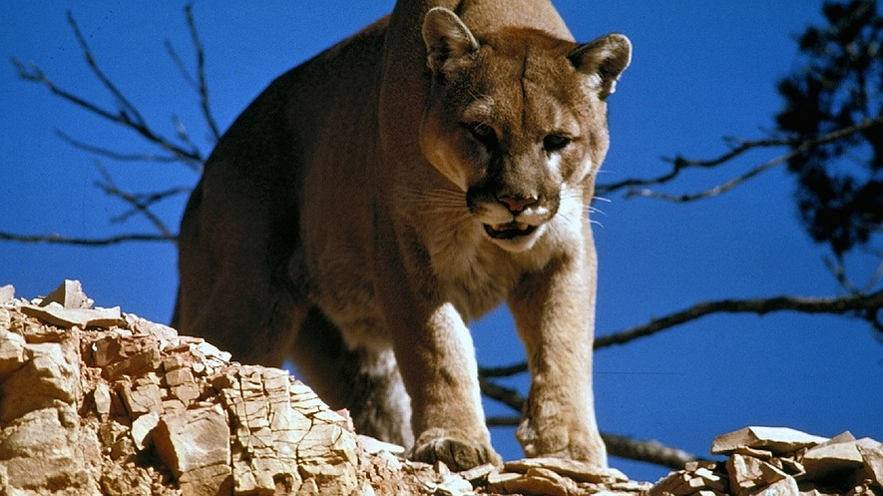
Oh, give me a home, where the mountain lions roam
By Kansas City Star
KANSAS CITY, Mo. — Mountain lions used to roam most of the United States. People called them by many different names. They were known as pumas, cougars and panthers. In the early 1900s, the number of mountain lions dropped suddenly. Many lions had trouble finding other animals to eat. They were also killed by hunters. Now, mountain lion numbers are growing. These big cats are even starting to show up in the Midwest again. People have spotted them in Missouri and Kansas.
Scientists have examined these Midwestern mountain lions. The tests showed that they are related to mountain lions in South Dakota and Nebraska. Still, these mountain lions are not starting any new families in the Midwest. Almost all of them are male. For now, they are simply visitors from the West.
QUESTION:
According to the article, would Kansas or Missouri be a better place for the mountain lions to live?

Slide 22
Matt Peek is a biologist based in Kansas. He says it would be unusual for a female mountain lion to wander that far.
Clay Nielsen studies mountain lions for a group called the Cougar Network. He says young male lions like to spread out. They try to avoid other young males. Nielsen says female lions do not roam as often as males do. They do not travel as far, either. Females like to stay where they will have food, Nielsen said.
Certain laws have made it easier for mountain lions to explore the Midwest. Mountain lions in Missouri are protected from hunters. The state has a law called the Wildlife Code. It says mountain lions can be killed only if they are causing trouble. People can shoot mountain lions that try to hurt people, pets and farm animals. Kansas has a law like that, too. Not as many mountain lions have been spotted there. Missouri has had more than 50 mountain lion sightings since 1994. Kansas reported only 10 sightings during that time. Peek says most of these mountain lions are coming from the Black Hills area. It is located near the border of South Dakota and Wyoming. The lions follow a river across Nebraska and end up in Missouri. Peek says Missouri is a better home for mountain lions than Kansas. He says they need wide open spaces and smaller animals to eat. Kansas has plenty of food, just not in the right areas, Peek says.
“In the places where the land might be right, there would be too many people,” he said.
Jeff Beringer is a scientist in Missouri. He says the state’s 3 million acres of forests are perfect for mountain lions. They are full of raccoons, possums and armadillos -- animals small enough to make suitable prey for mountain lions.
QUESTION:
According to the article, would Kansas or Missouri be a better place for the mountain lions to live?

Slide 23
Certain laws have made it easier for mountain lions to explore the Midwest. Mountain lions in Missouri are protected from hunters. The state has a law called the Wildlife Code. It says mountain lions can be killed only if they are causing trouble. People can shoot mountain lions that try to hurt people, pets and farm animals. Kansas has a law like that, too. Not as many mountain lions have been spotted there. Missouri has had more than 50 mountain lion sightings since 1994. Kansas reported only 10 sightings during that time. Peek says most of these mountain lions are coming from the Black Hills area. It is located near the border of South Dakota and Wyoming. The lions follow a river across Nebraska and end up in Missouri. Peek says Missouri is a better home for mountain lions than Kansas. He says they need wide open spaces and smaller animals to eat. Kansas has plenty of food, just not in the right areas, Peek says.
“In the places where the land might be right, there would be too many people,” he said.
Jeff Beringer is a scientist in Missouri. He says the state’s 3 million acres of forests are perfect for mountain lions. They are full of raccoons, possums and armadillos -- animals small enough to make suitable prey for mountain lions.
QUESTION:
According to the article, would Kansas or Missouri be a better place for the mountain lions to live?
What’s your claim?
KANSAS
MISSOURI
Can you find evidence
in the text to support your claim?

Slide 24
Certain laws have made it easier for mountain lions to explore the Midwest. Mountain lions in Missouri are protected from hunters. The state has a law called the Wildlife Code. It says mountain lions can be killed only if they are causing trouble. People can shoot mountain lions that try to hurt people, pets and farm animals. Kansas has a law like that, too. Not as many mountain lions have been spotted there. Missouri has had more than 50 mountain lion sightings since 1994. Kansas reported only 10 sightings during that time. Peek says most of these mountain lions are coming from the Black Hills area. It is located near the border of South Dakota and Wyoming. The lions follow a river across Nebraska and end up in Missouri. Peek says Missouri is a better home for mountain lions than Kansas. He says they need wide open spaces and smaller animals to eat. Kansas has plenty of food, just not in the right areas, Peek says.
“In the places where the land might be right, there would be too many people,” he said.
Jeff Beringer is a scientist in Missouri. He says the state’s 3 million acres of forests are perfect for mountain lions. They are full of raccoons, possums and armadillos -- animals small enough to make suitable prey for mountain lions.
QUESTION:
According to the article, would Kansas or Missouri be a better place for the mountain lions to live?

Slide 25
Certain laws have made it easier for mountain lions to explore the Midwest. Mountain lions in Missouri are protected from hunters. The state has a law called the Wildlife Code. It says mountain lions can be killed only if they are causing trouble. People can shoot mountain lions that try to hurt people, pets and farm animals. Kansas has a law like that, too. Not as many mountain lions have been spotted there. Missouri has had more than 50 mountain lion sightings since 1994. Kansas reported only 10 sightings during that time. Peek says most of these mountain lions are coming from the Black Hills area. It is located near the border of South Dakota and Wyoming. The lions follow a river across Nebraska and end up in Missouri. Peek says Missouri is a better home for mountain lions than Kansas. He says they need wide open spaces and smaller animals to eat. Kansas has plenty of food, just not in the right areas, Peek says.
“In the places where the land might be right, there would be too many people,” he said.
Jeff Beringer is a scientist in Missouri. He says the state’s 3 million acres of forests are perfect for mountain lions. They are full of raccoons, possums and armadillos -- animals small enough to make suitable prey for mountain lions.
QUESTION:
According to the article, would Kansas or Missouri be a better place for the mountain lions to live?
According to the article, Missouri would be a better place for the mountain lions to live. As Matt Peek, a biologist from Kansas states, “Missouri is a better home for mountain lions than Kansas. He says they need wide open spaces and smaller animals to eat.” The article also mentions that Missouri’s “3 million acres of forests are perfect for mountain lions. They are full of raccoons, possums and armadillos - animals small enough to make suitable prey for mountain lions.” Since mountain lions need abundant space and a lot food, Missouri has a more suitable environment that mountain lions would appreciate!

Slide 26
Certain laws have made it easier for mountain lions to explore the Midwest. Mountain lions in Missouri are protected from hunters. The state has a law called the Wildlife Code. It says mountain lions can be killed only if they are causing trouble. People can shoot mountain lions that try to hurt people, pets and farm animals. Kansas has a law like that, too. Not as many mountain lions have been spotted there. Missouri has had more than 50 mountain lion sightings since 1994. Kansas reported only 10 sightings during that time. Peek says most of these mountain lions are coming from the Black Hills area. It is located near the border of South Dakota and Wyoming. The lions follow a river across Nebraska and end up in Missouri. Peek says Missouri is a better home for mountain lions than Kansas. He says they need wide open spaces and smaller animals to eat. Kansas has plenty of food, just not in the right areas, Peek says.
“In the places where the land might be right, there would be too many people,” he said.
Jeff Beringer is a scientist in Missouri. He says the state’s 3 million acres of forests are perfect for mountain lions. They are full of raccoons, possums and armadillos -- animals small enough to make suitable prey for mountain lions.
QUESTION:
According to the article, would Kansas or Missouri be a better place for the mountain lions to live?
According to the article, Missouri would be a better place for the mountain lions to live. As Matt Peek, a biologist from Kansas states, “Missouri is a better home for mountain lions than Kansas. He says they need wide open spaces and smaller animals to eat.” The article also mentions that Missouri’s “3 million acres of forests are perfect for mountain lions. They are full of raccoons, possums and armadillos - animals small enough to make suitable prey for mountain lions.” Since mountain lions need abundant space and a lot food, Missouri has a more suitable environment that mountain lions would appreciate!

Slide 27
Certain laws have made it easier for mountain lions to explore the Midwest. Mountain lions in Missouri are protected from hunters. The state has a law called the Wildlife Code. It says mountain lions can be killed only if they are causing trouble. People can shoot mountain lions that try to hurt people, pets and farm animals. Kansas has a law like that, too. Not as many mountain lions have been spotted there. Missouri has had more than 50 mountain lion sightings since 1994. Kansas reported only 10 sightings during that time. Peek says most of these mountain lions are coming from the Black Hills area. It is located near the border of South Dakota and Wyoming. The lions follow a river across Nebraska and end up in Missouri. Peek says Missouri is a better home for mountain lions than Kansas. He says they need wide open spaces and smaller animals to eat. Kansas has plenty of food, just not in the right areas, Peek says.
“In the places where the land might be right, there would be too many people,” he said.
Jeff Beringer is a scientist in Missouri. He says the state’s 3 million acres of forests are perfect for mountain lions. They are full of raccoons, possums and armadillos -- animals small enough to make suitable prey for mountain lions.
QUESTION:
According to the article, would Kansas or Missouri be a better place for the mountain lions to live?
According to the article, Missouri would be a better place for the mountain lions to live. As Matt Peek, a biologist from Kansas states, “Missouri is a better home for mountain lions than Kansas. He says they need wide open spaces and smaller animals to eat.” The article also mentions that Missouri’s “3 million acres of forests are perfect for mountain lions. They are full of raccoons, possums and armadillos - animals small enough to make suitable prey for mountain lions.” Since mountain lions need abundant space and a lot food, Missouri has a more suitable environment that mountain lions would appreciate!

Slide 28
Certain laws have made it easier for mountain lions to explore the Midwest. Mountain lions in Missouri are protected from hunters. The state has a law called the Wildlife Code. It says mountain lions can be killed only if they are causing trouble. People can shoot mountain lions that try to hurt people, pets and farm animals. Kansas has a law like that, too. Not as many mountain lions have been spotted there. Missouri has had more than 50 mountain lion sightings since 1994. Kansas reported only 10 sightings during that time. Peek says most of these mountain lions are coming from the Black Hills area. It is located near the border of South Dakota and Wyoming. The lions follow a river across Nebraska and end up in Missouri. Peek says Missouri is a better home for mountain lions than Kansas. He says they need wide open spaces and smaller animals to eat. Kansas has plenty of food, just not in the right areas, Peek says.
“In the places where the land might be right, there would be too many people,” he said.
Jeff Beringer is a scientist in Missouri. He says the state’s 3 million acres of forests are perfect for mountain lions. They are full of raccoons, possums and armadillos -- animals small enough to make suitable prey for mountain lions.
QUESTION:
According to the article, would Kansas or Missouri be a better place for the mountain lions to live?
According to the article, Missouri would be a better place for the mountain lions to live. As Matt Peek, a biologist from Kansas states, “Missouri is a better home for mountain lions than Kansas. He says they need wide open spaces and smaller animals to eat.” The article also mentions that Missouri’s “3 million acres of forests are perfect for mountain lions. They are full of raccoons, possums and armadillos - animals small enough to make suitable prey for mountain lions.” Since mountain lions need abundant space and a lot food, Missouri has a more suitable environment that mountain lions would appreciate!

Slide 29
QUESTION:
According to the article, would Kansas or Missouri be a better place for the mountain lions to live?
According to the article, Missouri would be a better place for the mountain lions to live. As Matt Peek, a biologist from Kansas states, “Missouri is a better home for mountain lions than Kansas. He says they need wide open spaces and smaller animals to eat.” The article also mentions that Missouri’s “3 million acres of forests are perfect for mountain lions. They are full of raccoons, possums and armadillos - animals small enough to make suitable prey for mountain lions.” Since mountain lions need abundant space and a lot food, Missouri has a more suitable environment that mountain lions would appreciate!
SCORE:

Slide 30
Your turn to
R.A.C.E.

Slide 31
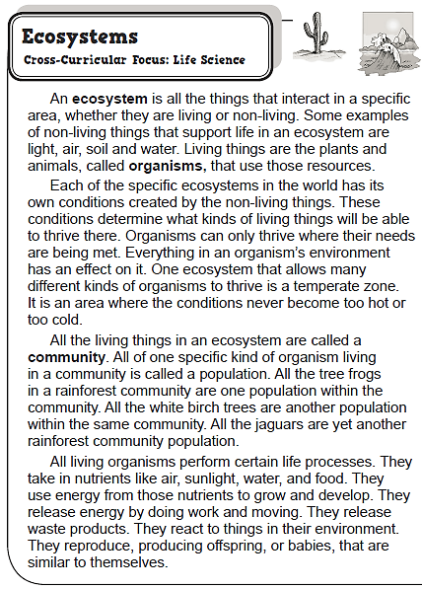
QUESTION:
According to the text, why does a temperate zone support many varieties of organisms?

Slide 32
QUESTION:
According to the text, why does a temperate zone support many varieties of organisms?
Take 7 minutes to write your answer in your notebook.
Then, raise your hand if you would like to share your response.
HULK IT UP!
estate the question
nswer the question
ite evidence (QUOTE!)
xplain your answer

Slide 33
This week’s
R.A.C.E ASSIGNMENT
Check your e-mail for today’s
“Ecosystems” Google link.
Submit your
SUPER RACE RESPONSE
before our next class!

