Slide 1
RACE
Super Response!

Slide 2
SLASH
Notebook
Bring your spiral to class
each week.
Everything we do will go into your notebook!
Always bring a pencil too!

Slide 3
CHOOSE A NOVEL UNIT
Which book are you reading for Unit 15?

Slide 4
Assemble the R.A.C.E. flip book and
keep it into your ELA notebook.

Slide 5
When answering Open-ended questions, always use
R.A.C.E.

Slide 6
When answering Open-ended questions, always use
R.A.C.E.
restate

Slide 7
When answering Open-ended questions, always use
R.A.C.E.
restate
answer

Slide 8
When answering Open-ended questions, always use
R.A.C.E.
restate
answer
cite

Slide 9
When answering Open-ended questions, always use
R.A.C.E.
restate
answer
cite
explain

Slide 10
When answering Open-ended questions, always use
R.A.C.E.
restate
answer
cite
explain

Slide 11
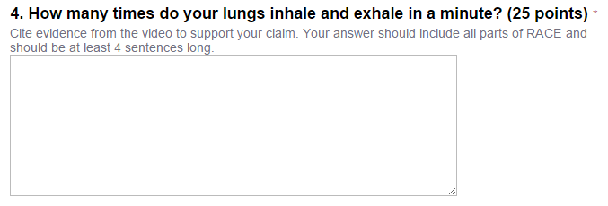
This is what “open-ended” questions
look like:
HINT: Will citing evidence from the source support your answer? Use RACE!
HINT:
Large space to type your answer?
Use RACE!

Slide 12
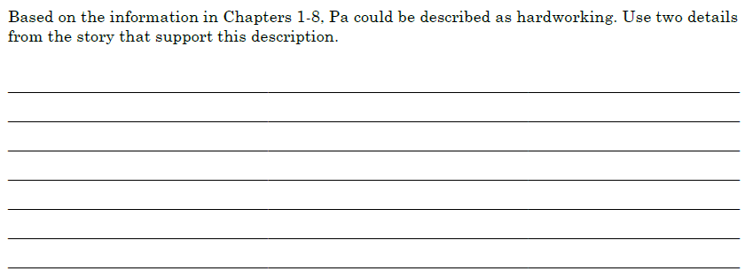
This is what “open-ended” questions
look like:
HINT: Will citing evidence from the text support your answer? Use RACE!
HINT:
Large space to write your answer?
Use RACE!

Slide 14
Restate means:
“to state again in another way”

Slide 15
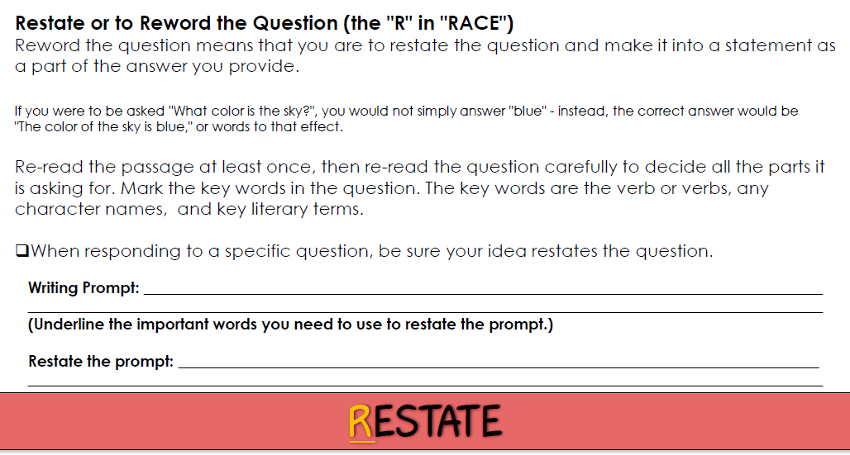

Slide 16
QUESTION:
According to the article, what is the easiest
way to change a tire?
According to the article, the easiest way to change a tire is ________________.
Use the same words to create a statement.

Slide 17
QUESTION:
Why is it important for lions to live in a
pride?
It is important for lions to live in a pride because ________________.
Use the same words to create a statement.

Slide 18
QUESTION:
What did Mary and Laura collect at the
deserted Indian camp?
At the deserted Indian camp, Mary and Laura collected ________________.
Use the same words to create a statement.

Slide 21
Based on the information given,
what’s your claim?
You have to have evidence from
the text to back it up!
At the deserted Indian camp, Mary and Laura collected colorful beads.
Your “claim” is what you think the answer is… based on the text.

Slide 22
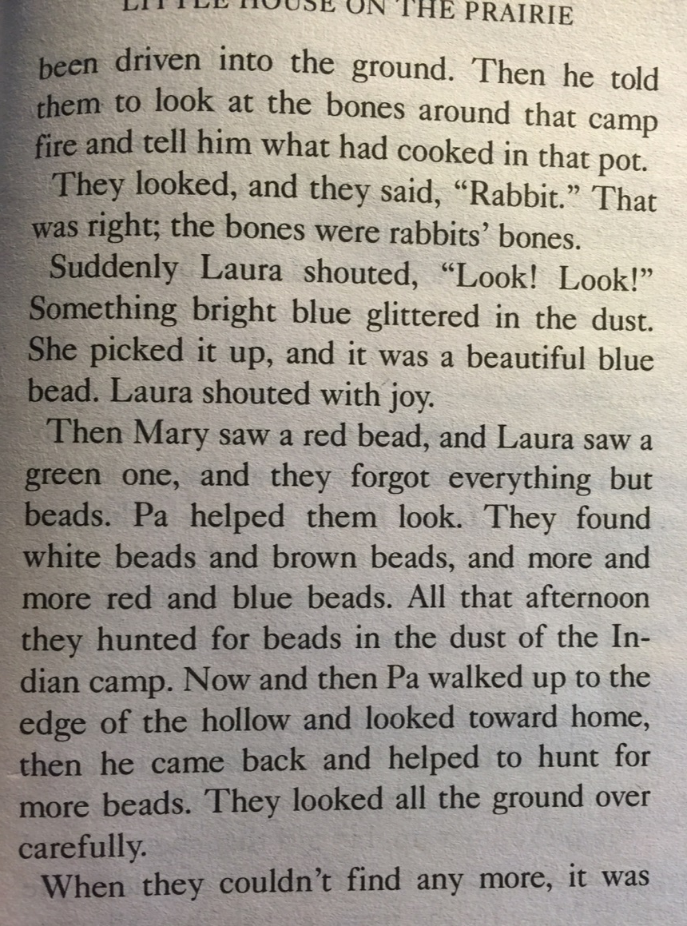
Based on the information given, what’s your claim?
they collected colorful beads
Do you have evidence from the text to back it up?
YES!

Slide 23
Since you are citing from a text, you need a direct quote in your answer.

Slide 25
When proving your claim, find evidence!
There are 2 steps you always take when adding
text evidence to your answer…
Tell where you found the evidence.
Since you are citing from a text, you need a direct quote in your answer.
HULK UP your answer with a QUOTE!
A direct quote is written word for word,
directly from the text…
with QUOTATION MARKS!

Slide 26
At the deserted Indian camp, Mary and Laura collected colorful beads. As it states on page 179 of Little House on the Prairie, “They found white beads and brown beads, and more and more red and blue beads. All that afternoon they hunted for beads in the dust of the Indian camp.”

Slide 27
At the deserted Indian camp, Mary and Laura collected colorful beads. As it states on page 179 of Little House on the Prairie, “They found white beads and brown beads, and more and more red and blue beads. All that afternoon they hunted for beads in the dust of the Indian camp.”
Tell where you found the evidence.
Since you are citing from a text,
you need a direct quote in your answer.

Slide 28
Now is your chance to
clarify and enlighten your audience! Explain your evidence and add your thoughts!

Slide 30
This part of your answer can be one sentence
or multiple sentences.
Explain how the quote proves your claim.
Share your own commentary.
Speak from personaL experience.
Add details to clarify why your
claim is evidence-based.
Convince your audience!

Slide 31
SPIDER!
At the deserted Indian camp, Mary and Laura collected colorful beads. As it states on page 179 of Little House on the Prairie, “They found white beads and brown beads, and more and more red and blue beads. All that afternoon they hunted for beads in the dust of the Indian camp.” The novel also explains that when the girls got back home they showed a handkerchief full of beads to Ma. This leads me to believe that Mary and Laura had quite a collection of colorful beads!
SUPER!
SUPER!
SUPER!

Slide 32
SPIDER!
At the deserted Indian camp, Mary and Laura collected colorful beads. As it states on page 179 of Little House on the Prairie, “They found white beads and brown beads, and more and more red and blue beads. All that afternoon they hunted for beads in the dust of the Indian camp.” The novel also explains that when the girls got back home they showed a handkerchief full of beads to Ma. This leads me to believe that Mary and Laura had quite a collection of colorful beads!
SUPER RESPONSE!
SUPER!
SUPER!
SUPER!

Slide 33
R.A.C.E.
Let’s try it!

Slide 34
The Eskimos are a people who live near the Arctic. It is very cold there. For thousands of years, the Eskimos found ways to live in the cold. Most of them lived near the sea. The sea gave them food. They hunted seals and whales. They caught fish. On land, they hunted a kind of deer called the caribou.
The Eskimos made clothing from the skins of animals they hunted. In summer most Eskimos made tents of animal skins. They sailed in boats made of animal skins. In winter, most Eskimos lived in houses made of snow or sod. In the coldest places, some Eskimos lived in houses made of snow all year long.
Eskimo life began to change in the 1800s. People from Europe started hunting for whales where the Eskimos lived. Fur traders arrived. The Eskimos worked with the whalers and fur traders. Soon many of the animals that the Eskimos needed were almost gone.
Today most Eskimos live in towns. They live in modern houses. They buy food at stores. But they always remember the old ways.
According to the article, why did life change for the Eskimos in the 1800s?

Slide 35
The Eskimos are a people who live near the Arctic. It is very cold there. For thousands of years, the Eskimos found ways to live in the cold. Most of them lived near the sea. The sea gave them food. They hunted seals and whales. They caught fish. On land, they hunted a kind of deer called the caribou.
The Eskimos made clothing from the skins of animals they hunted. In summer most Eskimos made tents of animal skins. They sailed in boats made of animal skins. In winter, most Eskimos lived in houses made of snow or sod. In the coldest places, some Eskimos lived in houses made of snow all year long.
Eskimo life began to change in the 1800s. People from Europe started hunting for whales where the Eskimos lived. Fur traders arrived. The Eskimos worked with the whalers and fur traders. Soon many of the animals that the Eskimos needed were almost gone.
Today most Eskimos live in towns. They live in modern houses. They buy food at stores. But they always remember the old ways.
According to the article, why did life change for the Eskimos in the 1800s?
Can you find evidence in the text?

Slide 36
The Eskimos are a people who live near the Arctic. It is very cold there. For thousands of years, the Eskimos found ways to live in the cold. Most of them lived near the sea. The sea gave them food. They hunted seals and whales. They caught fish. On land, they hunted a kind of deer called the caribou.
The Eskimos made clothing from the skins of animals they hunted. In summer most Eskimos made tents of animal skins. They sailed in boats made of animal skins. In winter, most Eskimos lived in houses made of snow or sod. In the coldest places, some Eskimos lived in houses made of snow all year long.
Eskimo life began to change in the 1800s. People from Europe started hunting for whales where the Eskimos lived. Fur traders arrived. The Eskimos worked with the whalers and fur traders. Soon many of the animals that the Eskimos needed were almost gone.
Today most Eskimos live in towns. They live in modern houses. They buy food at stores. But they always remember the old ways.
According to the article, why did life change for the Eskimos in the 1800s?
According to the article, Eskimo life changed in the 1800s when

Slide 37
The Eskimos are a people who live near the Arctic. It is very cold there. For thousands of years, the Eskimos found ways to live in the cold. Most of them lived near the sea. The sea gave them food. They hunted seals and whales. They caught fish. On land, they hunted a kind of deer called the caribou.
The Eskimos made clothing from the skins of animals they hunted. In summer most Eskimos made tents of animal skins. They sailed in boats made of animal skins. In winter, most Eskimos lived in houses made of snow or sod. In the coldest places, some Eskimos lived in houses made of snow all year long.
Eskimo life began to change in the 1800s. People from Europe started hunting for whales where the Eskimos lived. Fur traders arrived. The Eskimos worked with the whalers and fur traders. Soon many of the animals that the Eskimos needed were almost gone.
Today most Eskimos live in towns. They live in modern houses. They buy food at stores. But they always remember the old ways.
According to the article, why did life change for the Eskimos in the 1800s?
According to the article, Eskimo life changed in the 1800s when Europeans began hunting in the Arctic.

Slide 38
The Eskimos are a people who live near the Arctic. It is very cold there. For thousands of years, the Eskimos found ways to live in the cold. Most of them lived near the sea. The sea gave them food. They hunted seals and whales. They caught fish. On land, they hunted a kind of deer called the caribou.
The Eskimos made clothing from the skins of animals they hunted. In summer most Eskimos made tents of animal skins. They sailed in boats made of animal skins. In winter, most Eskimos lived in houses made of snow or sod. In the coldest places, some Eskimos lived in houses made of snow all year long.
Eskimo life began to change in the 1800s. People from Europe started hunting for whales where the Eskimos lived. Fur traders arrived. The Eskimos worked with the whalers and fur traders. Soon many of the animals that the Eskimos needed were almost gone.
Today most Eskimos live in towns. They live in modern houses. They buy food at stores. But they always remember the old ways.
According to the article, why did life change for the Eskimos in the 1800s?
According to the article, Eskimo life changed in the 1800s when Europeans began hunting in the Arctic. In the third paragraph the author says that “People from Europe started hunting for whales where the Eskimos lived. Fur traders arrived. The Eskimos worked with the whalers and fur traders.”

Slide 39
The Eskimos are a people who live near the Arctic. It is very cold there. For thousands of years, the Eskimos found ways to live in the cold. Most of them lived near the sea. The sea gave them food. They hunted seals and whales. They caught fish. On land, they hunted a kind of deer called the caribou.
The Eskimos made clothing from the skins of animals they hunted. In summer most Eskimos made tents of animal skins. They sailed in boats made of animal skins. In winter, most Eskimos lived in houses made of snow or sod. In the coldest places, some Eskimos lived in houses made of snow all year long.
Eskimo life began to change in the 1800s. People from Europe started hunting for whales where the Eskimos lived. Fur traders arrived. The Eskimos worked with the whalers and fur traders. Soon many of the animals that the Eskimos needed were almost gone.
Today most Eskimos live in towns. They live in modern houses. They buy food at stores. But they always remember the old ways.
According to the article, why did life change for the Eskimos in the 1800s?
Eskimo life changed in the 1800s when Europeans began hunting in the Arctic. In the third paragraph the author says that “People from Europe started hunting for whales where the Eskimos lived. Fur traders arrived. The Eskimos worked with the whalers and fur traders.” Eskimos began sharing their resources and many of the animals were disappearing. I believe the arrival of European hunters forever changed the way Eskimos live their lives.

Slide 40
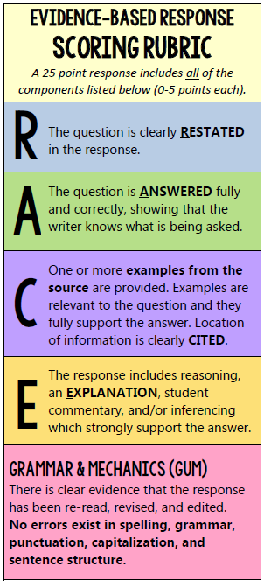
According to the article, why did life change for the Eskimos in the 1800s?
According to the article, Eskimo life changed in the 1800s when Europeans began hunting in the Arctic. In the third paragraph the author says that “People from Europe started hunting for whales where the Eskimos lived. Fur traders arrived. The Eskimos worked with the whalers and fur traders.” Eskimos began sharing their resources and many of the animals were disappearing. I believe the arrival of European hunters forever changed the way Eskimos live their lives.
+5
+5
+5
+5
+25
+5
Notes:
Paste a student response sample from last week’s open-ended question on this slide. Read aloud and find all parts of RACE in the response.

Slide 41
According to the article, why did life change for the Eskimos in the 1800s?
According to the article, Eskimo life changed in the 1800s when Europeans began hunting in the Arctic. In the third paragraph the author says that “People from Europe started hunting for whales where the Eskimos lived. Fur traders arrived. The Eskimos worked with the whalers and fur traders.” Eskimos began sharing their resources and many of the animals were disappearing. I believe the arrival of European hunters forever changed the way Eskimos live their lives.
+5
+5
+5
SUPER RESPONSE!
+5
+5
Notes:
Paste a student response sample from last week’s open-ended question on this slide. Read aloud and find all parts of RACE in the response.

Slide 43
Do the three branches of government have to work together for the United States government to be successful? Why or why not?

Slide 44
Super
Response!
SUPER!
The three branches of government do have to work together for the United States government to be successful because each branch must make sure that all branches have an equal amount of powers. In paragraph 2 of "The Three Branches of Government" article by Susan LaBella it clearly states "Each branch has its own responsibilities. The branches work together, but they also check each other to make sure no branch has too much power."
I believe that the three branches of government must work together for the United States government to work.
-TYRUS
Notes:
You can add this to your weekly RACE PPTs - Paste a student response sample from last week’s open-ended question on this slide. Read aloud and find all parts of RACE in the response.

Slide 45
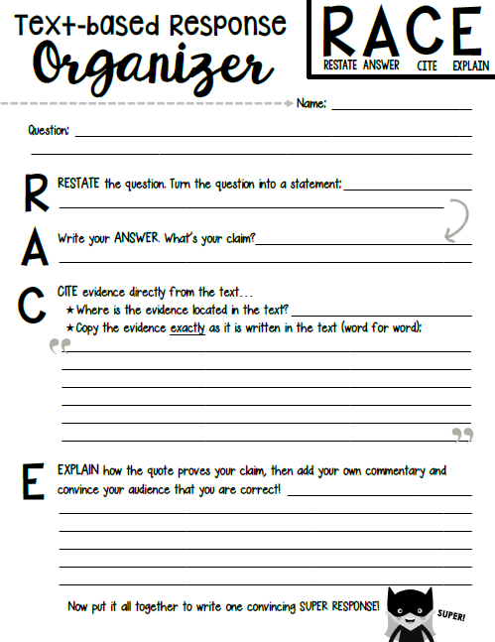
Use these HELPFUL TOOLS!

Slide 47
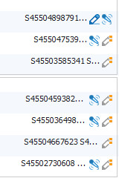
This week’s ASSIGNMENT
R.A.C.E
Work together to answer the text-based question completely.
When you have a 25 point SUPER RESPONSE
you can log out of Class Connect.
SPIDER!
Group!
Share!
Think!

Slide 48
Don’t forget to HULK UP your answer
with a quote from the text!
Names: _________________________
A Perfectly Sticky Idea
By Linda Ruggieri
Sometimes accidents turn into inventions. Post-it Notes are a good example. Post-its are those little sticky papers perfect for marking your place on a book page.
Two researchers, Spencer Silver and Arthur Fry, accidentally invented Post-it Notes. At the time, they were working for a company called 3M. Silver and Fry were both trying to develop extra-strong glue. But the glue they produced was weak. It did not seem useful at all. One day, Fry had an idea. He put the glue on a piece of paper and used the paper as a bookmark. Fry saw that this bookmark would stay on a page. He could remove it and stick it onto another page. The paper did not fall off. Researchers worked to improve the glue. They made sure the glue stayed on the piece of paper and not on the page.
In 1980, the company named the product Post-it Notes. The product was a great success! Today, Post-it Notes are one of the most popular office products in the world. They come in different sizes and many colors. Have you ever used Post-it Notes? What do you think of this invention?
How are Post-It Notes an accident that turned into a useful invention? Support your answer with information from the text.

Slide 49
Use this handy RACE Rubric to make sure you have a…
25-point SUPER RESPONSE!
HULK UP
your answer with a direct QUOTE!
A direct quote is written
word for word,
directly from the text…
with QUOTATION MARKS!
Notes:
Paste a student response sample from last week’s open-ended question on this slide. Read aloud and find all parts of RACE in the response.

