Slide 1
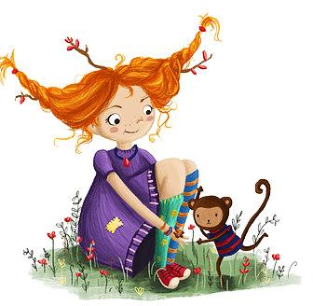
Chapter 5-6

Slide 2
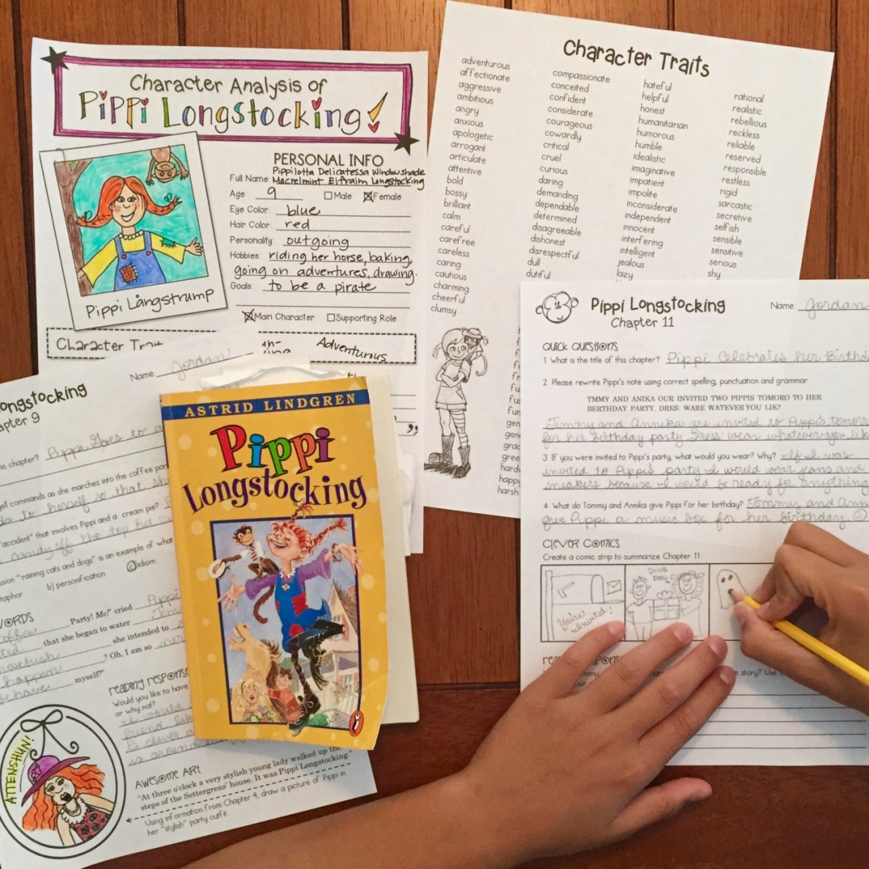
BOOK
STUDY GUIDE
PENCIL
Something to correct with!

Slide 3
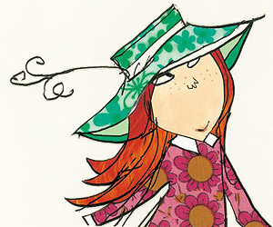
Super RACE Response
Notes:
CCSS I Can Statement

Slide 5
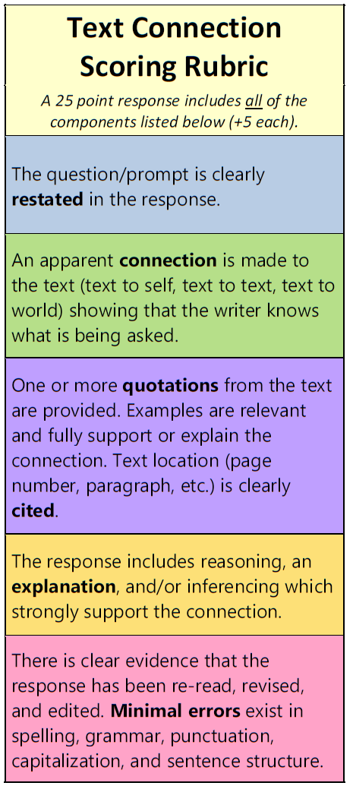
Use this handy RACE Rubric to make sure you have a…
SUPER RESPONSE!
+5
+5
+5
+5
+5
Notes:
Paste a student response sample from last week’s open-ended question on this slide. Read aloud and find all parts of RACE in the response.

Slide 6
Reading Response
What connection did you make with an event or character in Chapter 3? Use text evidence to support your answer.
THINKING CAP CHALLENGE!
Let’s practice our text connection response skills by scoring a few student samples.
EXAMPLE PROMPT:
What connection did you make with an event or character in Chapter 5? Use text evidence to support your answer.
Notes:
Cut & paste student samples here.

Slide 7
When I read chapter 5, I made a connection with the children playing in a hollow tree. Pippi describes the tree on page 71 by saying, “I’m inside the tree. It is hollow clear down to the ground.” One summer, I went camping in the redwood forest in Northern California. We found a few trees that had been burned on the inside. My cousin and I snuck in through a hole in one of the redwoods and pretended it was our house!
SCORE:
(0-25)
Notes:
Cut & paste student samples here.

Slide 8
When I read chapter 5, I made a connection with the children playing in a hollow tree. Pippi describes the tree on page 71 by saying, “I’m inside the tree. It is hollow clear down to the ground.” One summer, I went camping in the redwood forest in Northern California. We found a few trees that had been burned on the inside. My cousin and I snuck in through a hole in one of the redwoods and pretended it was our house!
SCORE:
+25
MINIMAL ERRORS?
(0-25)
Notes:
Cut & paste student samples here.

Slide 9
Reading Response
What connection did you make with an event or character in Chapter 3? Use text evidence to support your answer.
I made a connection to Annika.
SCORE:
(0-25)
Notes:
Cut & paste student samples here.

Slide 10
Reading Response
What connection did you make with an event or character in Chapter 3? Use text evidence to support your answer.
In chapter 5, I made a connection to Tommy and Annika when they were drinking coffee with pippi. On page 69 the text says, “Tommy and Annika thought coffee had never tasted so good before. They were not allowed to drink it everyday, only when they were at a party.” Like tommy and annika, I am not allowed to drink soda unless we are at a special party or event.
SCORE:
(0-25)
Notes:
Cut & paste student samples here.

Slide 11
Reading Response
What connection did you make with an event or character in Chapter 3? Use text evidence to support your answer.
i made a number of conexions to the caricters in chapter five i like to play outside like they do, i also like piknics
SCORE:
(0-25)
Notes:
Cut & paste student samples here.

Slide 12
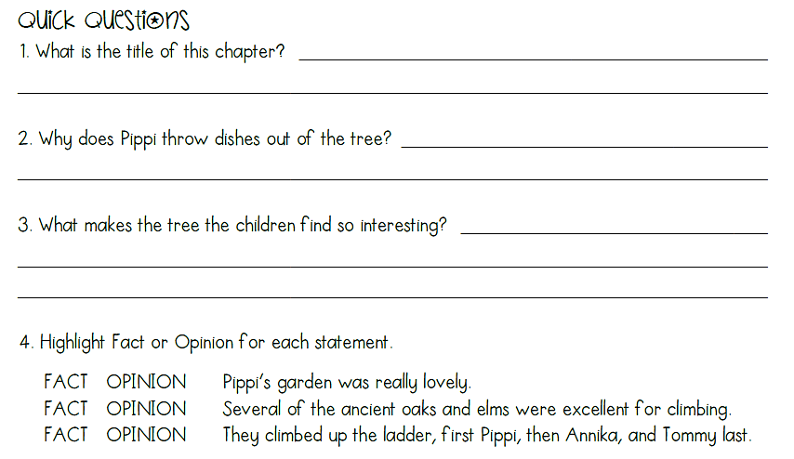
CHAPTER 5 STUDY GUIDE SHARE
Share in chat, on your mic, or on webcam!
Notes:
Cut & paste previous week’s study guide questions/activities here.

Slide 13
STUDY GUIDE SHARE
Share on your webcam!
Notes:
Cut & paste previous week’s study guide questions/activities here.

Slide 14
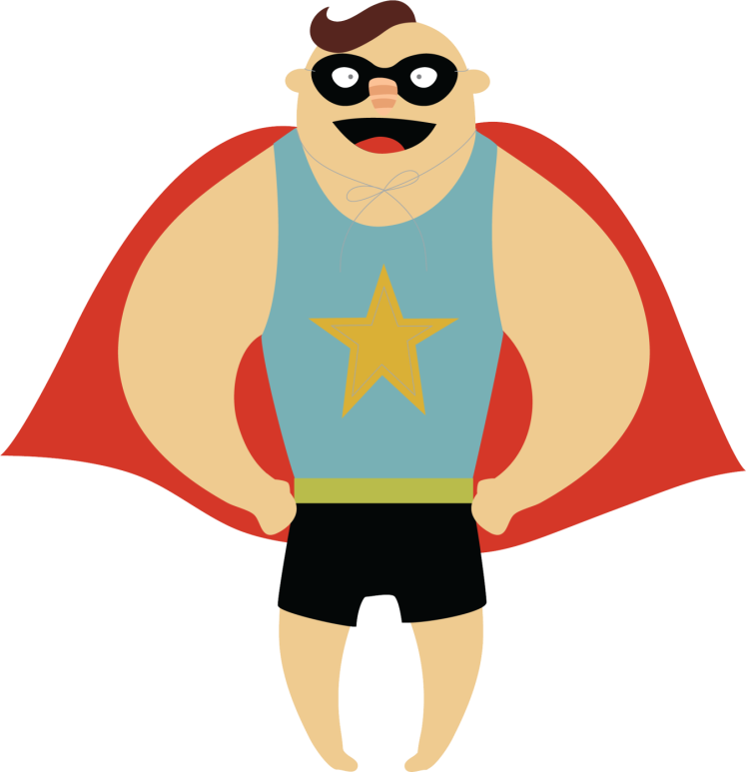
Reading Response
What connection did you make with an event or character in Chapter 3? Use text evidence to support your answer.
Reading Response
What is another book you have read or a movie you have seen that has something in common with Pippi Longstocking? Explain how they compare.
Notes:
Cut & paste student samples here.

Slide 15
Reading Response
What connection did you make with an event or character in Chapter 3? Use text evidence to support your answer.
SUPER TEXT CONNECTIONS!
Another book I have read that has something in common with Pippi Longstocking is the story of Pinocchio. Pippi and Pinocchio are both children. Also Pippi's father is still alive. In chapter 1 paragraph 2 it says, "Once upon a time Pippi had a father of whom she was extremely fond.” Pinocchio's father was alive too. Also, both of them didn't have a mom. Pippi and Pinocchio also LIE A LOT. -Melissa
Notes:
Cut & paste student samples here.

Slide 16
what movie or book reminds you of pippi longstocking?
Use your typing tool.
Notes:
Cut & paste student samples here.

Slide 17
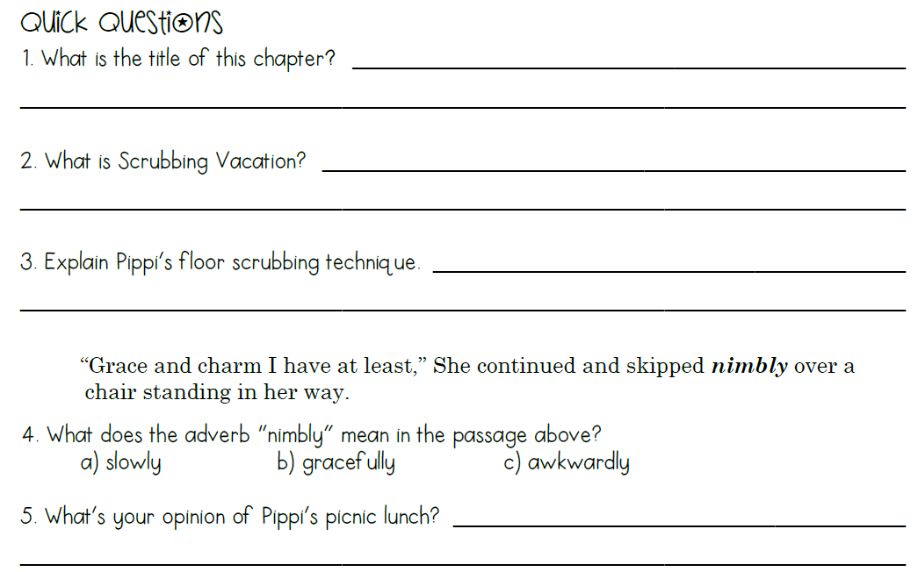
CHAPTER 6 STUDY GUIDE SHARE
Notes:
Cut & paste previous week’s study guide questions/activities here.

Slide 18
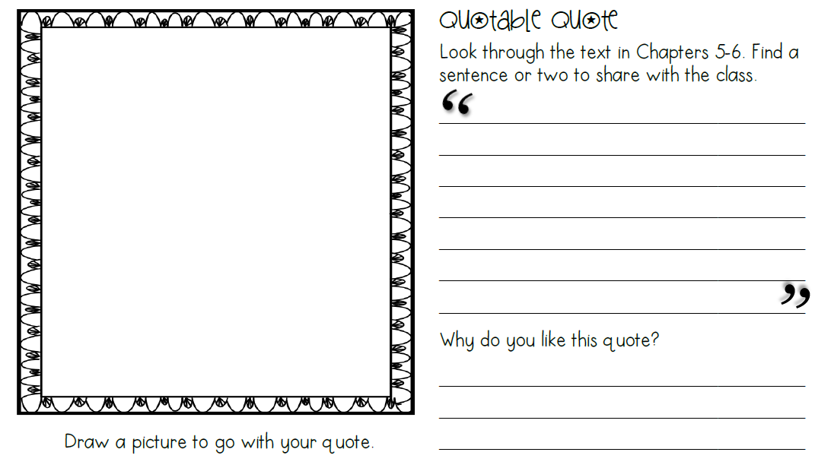
STUDY GUIDE SHARE
Share your drawing on your webcam!
Share your quote in chat or on your mic.
Notes:
Cut & paste previous week’s study guide questions/activities here.

Slide 19
Let’s talk about
Notes:
CCSS I Can Statement

Slide 20
I CAN…
describe characters in a story, including their traits, motivations, and feelings.
Notes:
CCSS I Can Statement

Slide 21
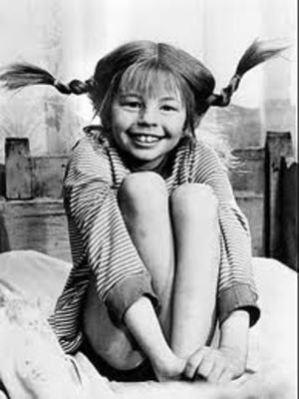
A character trait describes the way a person or a character acts.
Notes:
New ELA concept/lesson

Slide 22
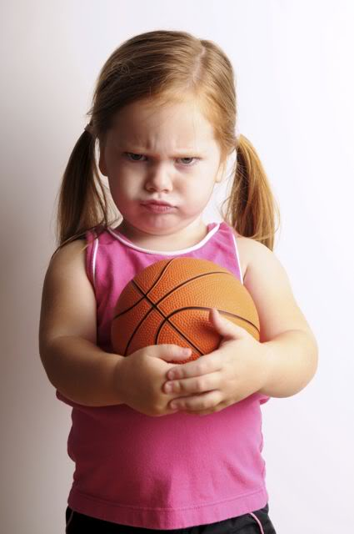
A character trait is not a feeling or an emotion that can come and go.
Notes:
New ELA concept/lesson

Slide 23
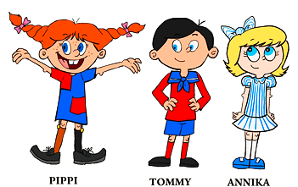
carefree
curious
cautious
A character trait describes a person’s usual personality or nature.
Notes:
New ELA concept/lesson

Slide 24
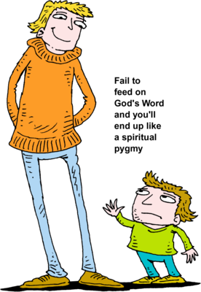
A character trait does not describe the way a person looks. That’s called a physical trait.
“Tall” is a
physical trait.
Notes:
New ELA concept/lesson

Slide 25
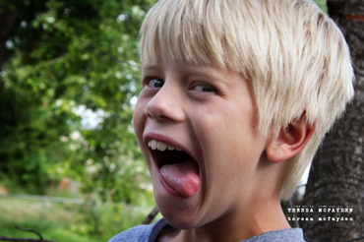
A character trait focuses on a character's personality.
“Silly” is a character trait.
Notes:
New ELA concept/lesson

Slide 26
I CAN…
draw conclusions about characters based on what they say, feel, think and do.
Notes:
New ELA concept/lesson

Slide 27
You can discover characters’ traits by what they say and how they act in the story.
Notes:
New ELA concept/lesson

Slide 28
Authors give us clues about a character’s personality by telling us what a character says and does.
Notes:
New ELA concept/lesson

Slide 29
Tommy was wild to go down. It was difficult to climb to the hole, because it was so high up, but Tommy was brave. And he wasn't afraid to climb down into the dark hollow in the trunk.
Underline the word in the passage that describes Tommy’s character.
Notes:
New ELA concept/lesson

Slide 30
With trembling legs Annika climbed up in the tree again, and Pippi helped her with the last hard bit. She drew back a little when she saw how dark it was in the tree trunk, but Pippi held her hand and kept encouraging her.
Based on the information in the text, what character trait would you use to describe Pippi?
Notes:
New ELA concept/lesson

Slide 31
Tommy had cried a little. He had a cut on one arm, but Annika had bandaged it with her handkerchief so that it no longer hurt.
Based on the information in the text, what character trait would you use to describe Annika?
Notes:
New ELA concept/lesson

Slide 32
She galloped wildly into the schoolyard, jumped off the horse, tied him to a
tree, and burst into the schoolroom with such a noise and a clatter that Tommy and Annika and all their classmates jumped in their seats.
Based on the information in the text, what character trait would you use to describe Pippi?
Notes:
New ELA concept/lesson

Slide 33
brave
wise
bossy
helpful
shy
Notes:
What other character traits can you think of?

Slide 34
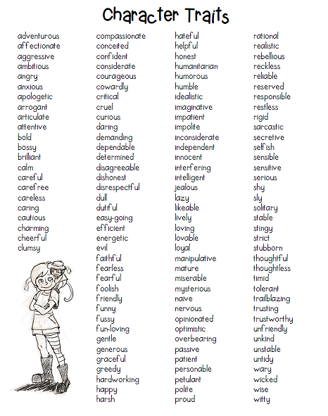
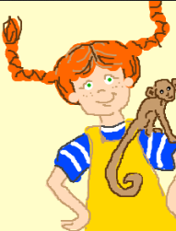
Use your list.
What are 3 of Pippi’s character traits?
Notes:
New ELA concept/lesson

Slide 35
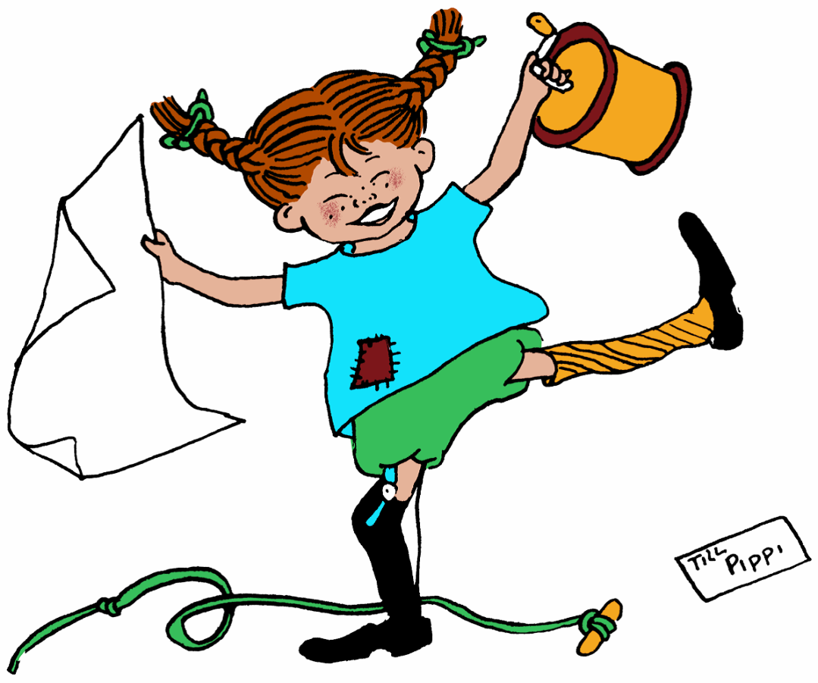

Slide 36
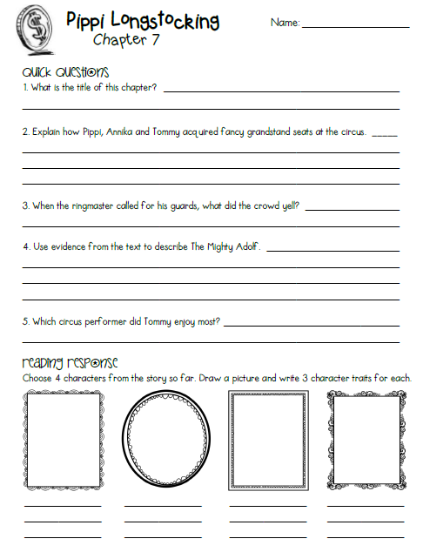
ASSIGNMENT
Read Chapter 7 and complete the study guide before our next class.
Notes:
New ELA concept/lesson

Slide 37
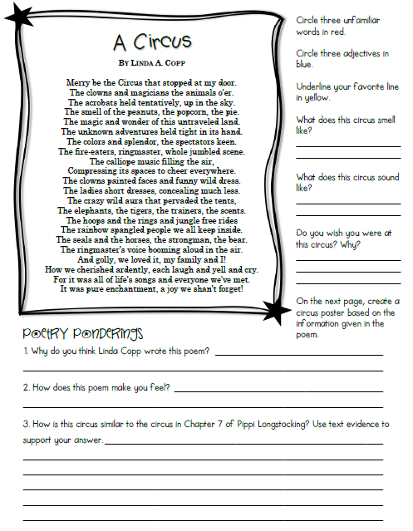
GRADED ASSIGNMENT
Complete the
“Poetry Connection” Google form for points in the gradebook!
Notes:
http://goo.gl/forms/47m4G37mJz

Slide 38
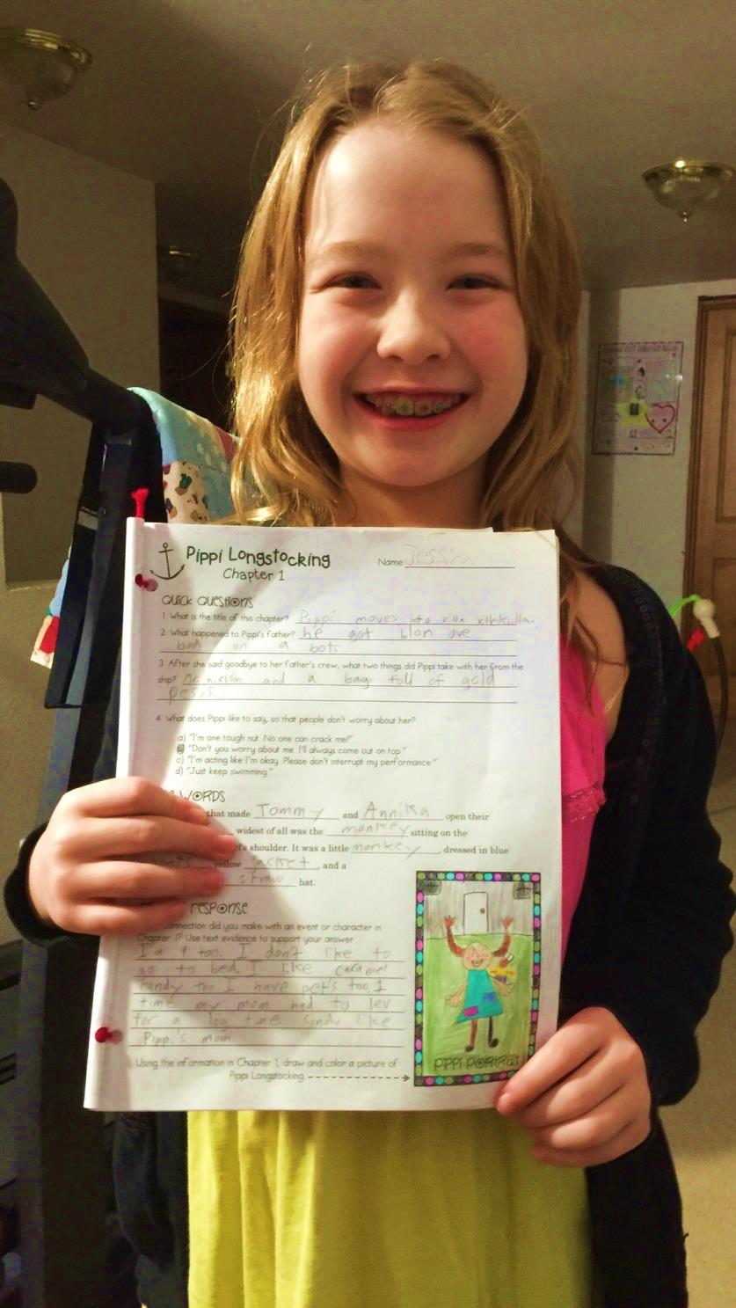
EXTRA! EXTRA!
Extra credit points if you send me a picture of you and your completed study guide!
Notes:
New ELA concept/lesson

Slide 39
And now for a sneak peek at Ch. 7…
“Pippi Goes to the Circus”
A circus had come to the little town, and all the children were begging their mothers and fathers for permission to go. Of course Tommy and Annika asked to go too, and their kind father immediately gave them some money.
Clutching it tightly in their hands, they rushed over to Pippi's. She was on the porch with her horse, braiding his tail into tiny pigtails and tying each one with
red ribbon.
"I think it's his birthday today," she announced, "so he has to be all dressed up."
Notes:
https://docs.google.com/forms/d/1v74I9Jf2LFlqaQBDLDNd6xyWrQZL97WYnspFENCNqak/viewform?usp=send_form

Slide 40
"Pippi," said Tommy, all out of breath because they had been running so fast, "Pippi, do you want to go with us to the circus?"
"I can go with you most anywhere," answered Pippi, "but whether I can go to the surkus or not I don't know, because I don't know what a surkus is. Does it hurt?"
"Silly! said Tommy. "Of course it doesn't hurt; it's fun. Horses and clowns and pretty ladies that walk the tightrope."
"But it costs money," said Annika, opening her small fist to see if the shiny half-dollar and the quarters were still there.
"I'm rich as a troll," said Pippi, "so I guess I can buy a surkus all right. But it'll be crowded here if I have more horses. The clowns and the pretty ladies I could keep in the laundry, but it's harder to know what to do with the horses."
Notes:
New ELA concept/lesson

Slide 41
Please help Mrs. Sol score a student response in your breakout room.

Slide 42
What connection did you make with an event or character in Chapter 5? Use text evidence to support your answer.
Name:_________________________
when the children were climing trees in chapter 5, it reminded me of the trees in my grandmother’s backyard. on page 73 it says, “A few feet above the ground the oak divided into two branches, and right there was a place just like a little room.” one of my grandma’s trees has a seat at the top of the trunk, where the big branches are. i like to sit in that spot and read for hours!
Ronda Brandt
Name::
COMMENTS: What did this student do well? How can she improve her response?
SCORE:
(0-25)
Notes:
Cut & paste student samples here.

