Slide 1
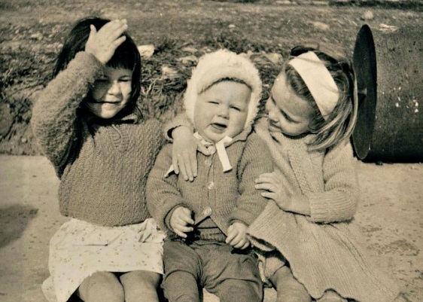
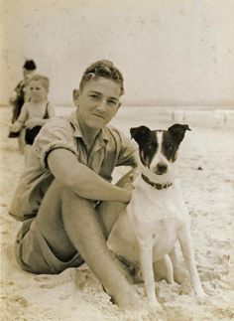
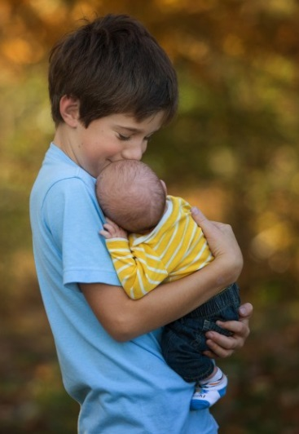
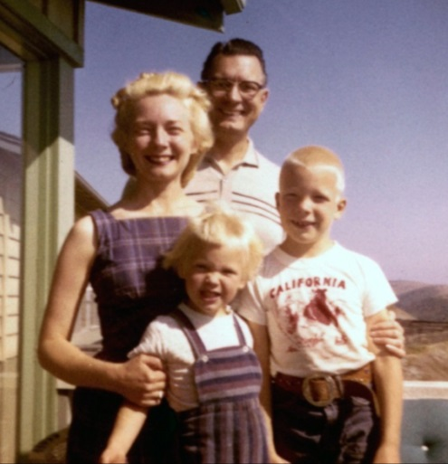
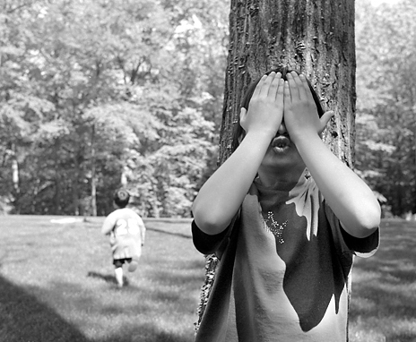
How to Write a
Memoir
You need your memoir rough draft and a microphone today.

Slide 2
Audio Setup Wizard
While you’re waiting, check your audio…
Is your microphone working?
Are your speakers on?

Slide 3
Mic Check!
Today, you will read your memoir aloud in CC.
That means…
everyone needs a working microphone.

Slide 4
“I read all of my books aloud before they were published.”
- Beverly Cleary

Slide 5
“I read all of my books aloud before they were published.”
- Beverly Cleary
Why do you think she read them aloud?

Slide 6
What is a memoir?

Slide 7
What is a memoir?
memory

Slide 8
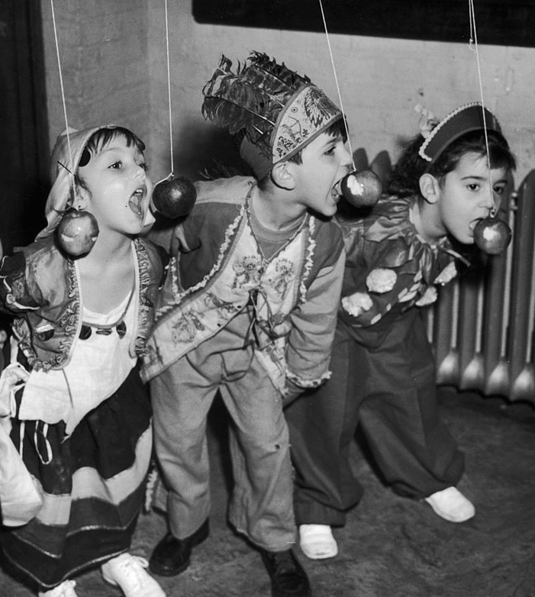
You are the only person who can write your memoir!
(because you lived it)

Slide 9
Let’s listen to a short memoir written by
Ralph Fletcher.
Notes:
“Jonathan Miller” By Ralph Fletcher

Slide 10
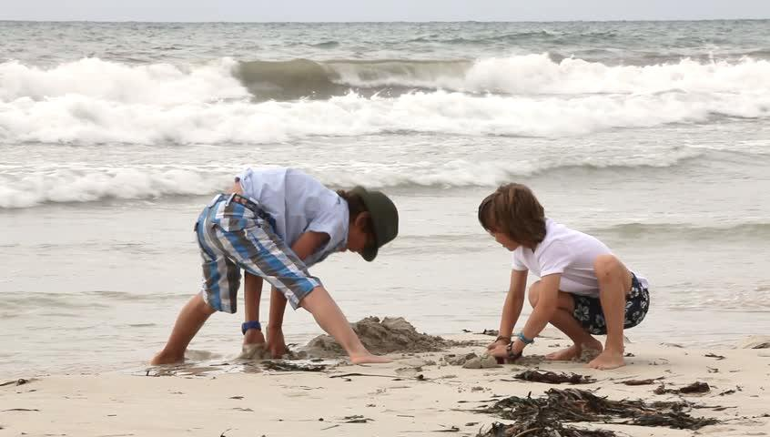
Notes:
“Jonathan Miller” By Ralph Fletcher

Slide 11
Today, you will share your memoir rough draft with your peers.
A “peer” is someone at your own level, like a classmate.

Slide 12
Together you will find ways to improve your writing.
This is called peer editing.

Slide 13
An author’s job is to engage the reader so that he wants to keep reading!

Slide 14
You can strengthen your memoir rough draft by:
Hooking the reader in the first sentence.
Adding dialog.
Using descriptive language to help the reader become part of the story.
Giving a detailed picture of what’s happening with strong verbs.
Including metaphors and similes to add some “color” or “zest” to the story.

Slide 15
AUTHOR: _______________________
PEER: _________________________
AUTHOR: _______________________
PEER: _________________________
Listen quietly as your partner reads his/her memoir aloud. Answer these questions and give your peer feedback.
What is the memoir about?
Does the story have a beginning, a middle, and an end?
Does the story include dialog?
What lesson did the author learn from this event?
What is your favorite part of the story?
Then, work together to make the memoir more engaging by using descriptive language.
Listen quietly as your partner reads his/her memoir aloud. Answer these questions and give your peer feedback.
What is the memoir about?
Does the story have a beginning, a middle, and an end?
Does the story include dialog?
What lesson did the author learn from this event?
What is your favorite part of the story?
Then, work together to make the memoir more engaging by using descriptive language.
Add 1 metaphor or simile.
Make 3 verbs stronger.
Choose words to use other than “said”
(only 1 “said” is allowed in your memoir).
Add 1 metaphor or simile.
Make 3 verbs stronger.
Choose words to use other than “said”
(only 1 “said” is allowed in your memoir).

Slide 16
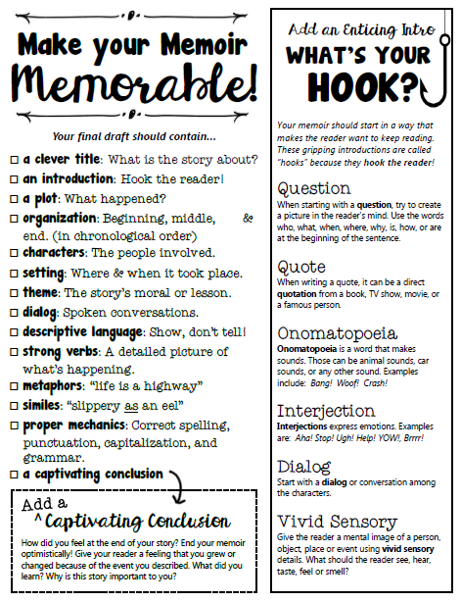
Your Final Draft
is due on
October 20
Use this notebook page and your peer feedback to
AWESOME-IZE
your memoir!

Slide 17
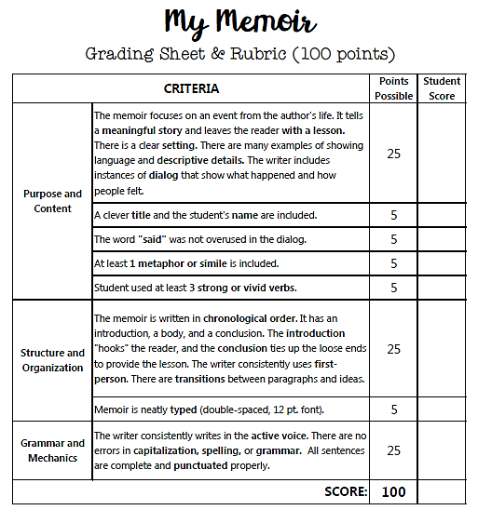
Use this rubric to make sure your memoir final draft is complete!

Slide 18
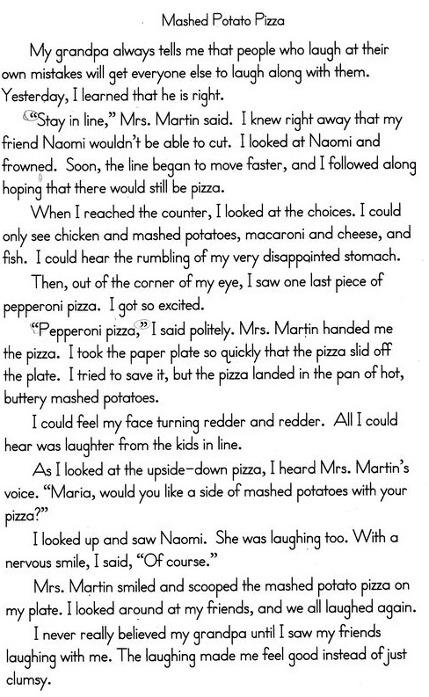
Ralph Macchio
10-15-16
Type up your final draft* and send it to Mrs. Sol.
*Adults can help with typing and formatting.

Slide 19
Ralph Macchio
10-15-16
Make sure your name is on your paper and in the file name.
Type up your final draft* and email it to Mrs. Sol.
*Adults can help with typing and formatting.

Slide 20
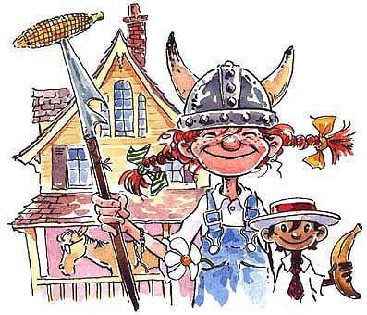
Next week we will begin reading Pippi Longstocking by Astrid Lindgren.
BONUS!
We’ll complete Literature Unit 7
together as a class.

Slide 21
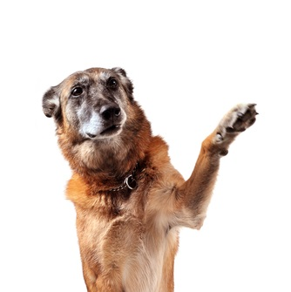
ANY QUESTIONS?

Slide 22
Now it’s time for…
Peer Editing!
Work with your partner to
AWESOME-IZE
your memoir!

Slide 23
AUTHOR: _______________________
PEER: _________________________
AUTHOR: _______________________
PEER: _________________________
Listen quietly as your partner reads his/her memoir aloud. Answer these questions and give your peer feedback.
What is the memoir about?
Does the story have a beginning, a middle, and an end?
Does the story include dialog?
What lesson did the author learn from this event?
What is your favorite part of the story?
Then, work together to make the memoir more engaging by using descriptive language.
Listen quietly as your partner reads his/her memoir aloud. Answer these questions and give your peer feedback.
What is the memoir about?
Does the story have a beginning, a middle, and an end?
Does the story include dialog?
What lesson did the author learn from this event?
What is your favorite part of the story?
Then, work together to make the memoir more engaging by using descriptive language.
Add 1 metaphor or simile.
Make 3 verbs stronger.
Choose words to use other than “said”
(only 1 “said” is allowed in your memoir).
Add 1 metaphor or simile.
Make 3 verbs stronger.
Choose words to use other than “said”
(only 1 “said” is allowed in your memoir).

Slide 24
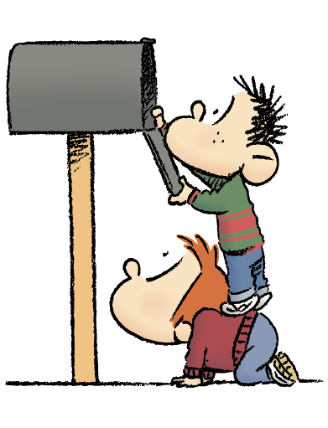
YOU’VE GOT MAIL!
(or you will soon)

