Slide 1
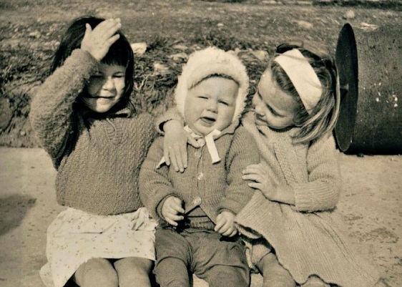
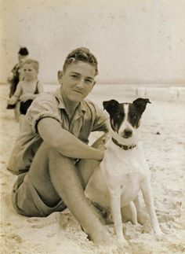
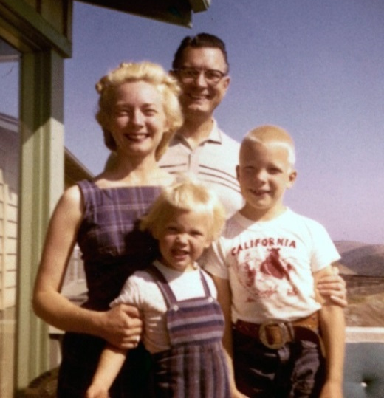
How to Write a
Memoir

Slide 2
Audio Setup Wizard
While you’re waiting, check your audio…
Is your microphone working?
Are your speakers on?

Slide 3
Mic Check!
Next week, you will read your memoir aloud in CC.
That means…
everyone needs a working microphone.

Slide 4
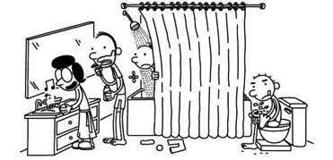
“I think if everyone would write down the funny stories from their own childhoods, the world would be a better place.”
- Jeff Kinney

Slide 5
What is a memoir?

Slide 6
What is a memoir?
A memoir is an account of your
personal life and experiences.

Slide 7
You are the only person who can write your memoir!
(because you lived it)

Slide 8
When you write a memoir about an event in your life…

Slide 9
When you write a memoir about an event in your life…
The trick is to fashion your memories into an
engaging story.

Slide 10
Let’s listen to a short memoir written by
Ralph Fletcher.

Slide 11
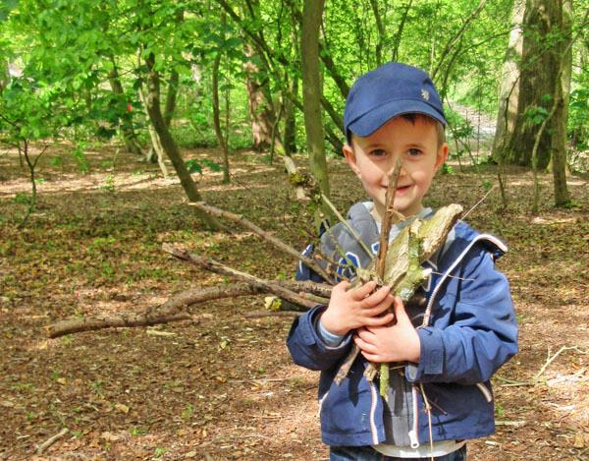
Notes:
Show this slide while reading Marshfield Dreams, “School”

Slide 12
The Power of
DIALOG

Slide 13
A dialog (or dialogue) is a conversation between two or more characters.
British English – “dialogue”
American English – “dialog”

Slide 14
In a story, words spoken aloud are surrounded by quotation marks.

Slide 15
Adding dialog to your memoir will make it even more interesting.
Dialog reveals a character’s personality.
Dialog helps the reader understand character relationships in the story.
Dialog reveals conflicts and causes a reaction.
Dialogue increases the story’s pace and makes it more dynamic.

Slide 16
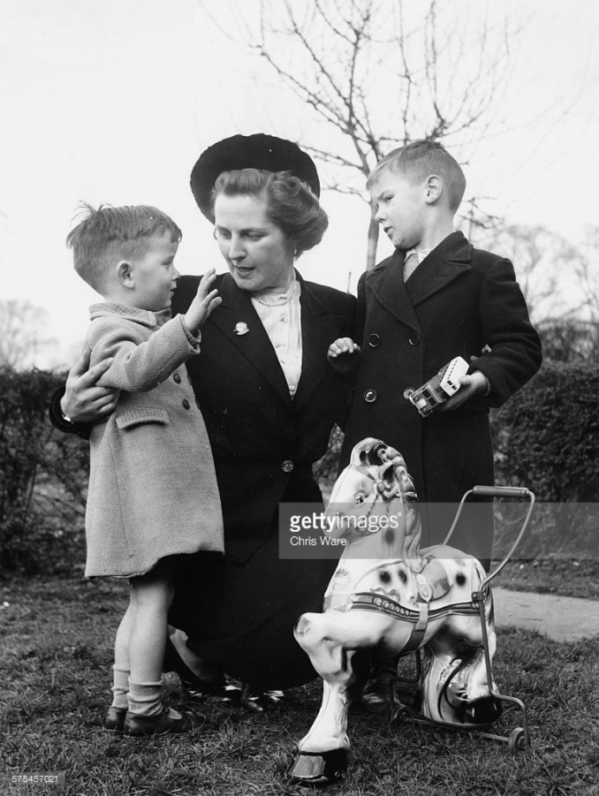
It was time for me to start first grade. Jimmy stood with me at the bus stop. Mom waited with us.
“What are you going to do in school?” Jimmy asked, frowning.
“I don't know,” I said. “Learn stuff.”
“Why can’t I come too?
“You’re not old enough,” I told him.
“Next year,” Mom said.

Slide 17
“Rules for Adding
DIALOG to your story!”

Slide 18
Always indent when a new
character speaks.
“Look,” cried Bambi, “see that piece of grass jumping. Look how high it can jump!”
“That’s not grass,” his mother explained, “that’s a nice grasshopper.”
“Oh,” said Bambi politely, “you don’t have to be afraid. We won’t hurt you.”
“Not at all,” the grasshopper quavered.

Slide 19
“I think there should be a rule that everyone in the world should get a standing ovation at least once in their lives,” Auggie exhaled.
Words spoken aloud are surrounded by quotation marks.

Slide 20
“I think there should be a rule that everyone in the world should get a standing ovation at least once in their lives,” Auggie exhaled.
Every quotation begins with a capital letter.

Slide 21
When writing dialog, punctuation goes inside the quotation marks.
“My favorite subject is science.”

Slide 22
If you are going to tell who is talking use a comma instead of a period before the quotation mark.
“My favorite subject is science.”
“My favorite subject is science,” she announced.

Slide 23
Then, add a period at the very end of the sentence.
“My favorite subject is science.”
“My favorite subject is science,” she announced.
a period is added at the very end

Slide 24
NOTE: Only periods get changed to commas.
? and ! remain the same.
“Would you like some ice cream?” Naomi asked.
“Of course!” Mrs. Sol bellowed.
a period is still added at the very end

Slide 25
Instead of always using the word
said in your dialog, choose words that describe the characters feelings about what is being said.
“I just finished Diary of a Wimpy Kid,” Andrew snickered.
“This movie is really scary,” Shelby shuddered.
“Ramona, clean up your room!” Mrs. Quimby demanded.

Slide 26
Instead of always using the word
said in your dialog, choose words that describe the characters feelings about what is being said.
“I just finished Diary of a Wimpy Kid,” Andrew snickered.
“This movie is really scary,” Shelby shuddered.
“Ramona, clean up your room!” Mrs. Quimby demanded.

Slide 27
other words for
“SAID”
Notes:
Brainstorm words you can use instead of “said” when you write your memoir.

Slide 28
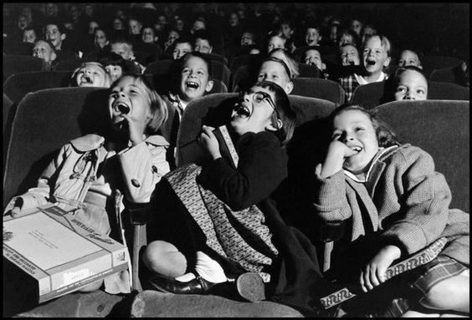
“It’s time for a movie about dialog,” Mrs. Sol announced.
http://safeshare.tv/x/54262361
Notes:
http://safeshare.tv/x/54262361

Slide 29
When you write your memoir, you may not remember all of the exact details and dialog…

Slide 30
When you write your memoir, you may not remember all of the exact details and dialog…
…so it’s okay to improvise.
(a little bit)

Slide 31
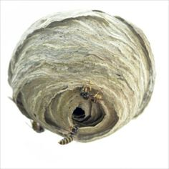
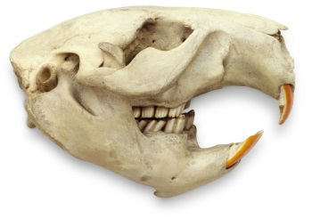
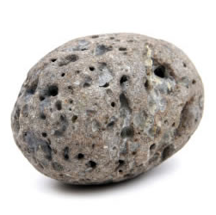
You shouldn’t altar the main parts of the event, but you can make up small particulars if you don’t remember.
Notes:
Ralph Fletcher couldn’t remember exactly what Jimmy gave him when he got off the bus, so he added details about type of items Jimmy might have given him after a day in the woods.

Slide 32
“If you stay true to the spirit of the story, and invent details that fit with the characters, they will help your story come alive.”
- Ralph Fletcher

Slide 33
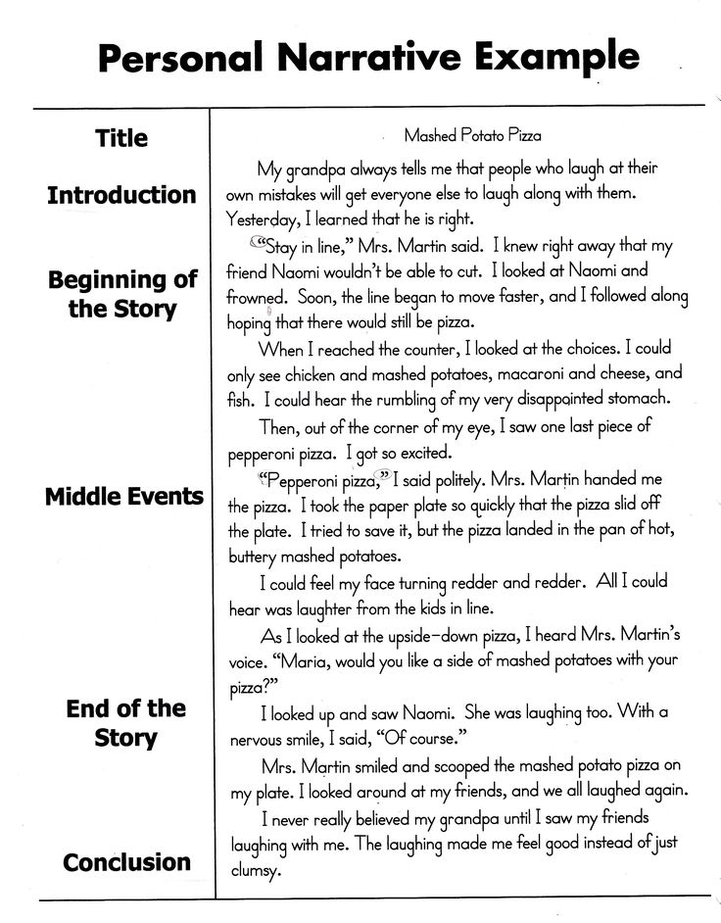
Memoir
Assignment
Continue working on the rough draft of your memoir. (do Comp lessons on OLS)
Add dialog between the characters.
Show, Don’t Tell!
Make sure you are using imagery.
Show the reader what is happening by adding descriptive language.
Use words other than “said” to further describe the characters, mood and conversations.
Have someone read your draft and give you feedback.

Slide 34
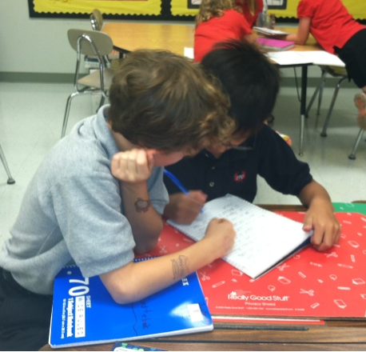
Bring your memoir to
Class Connect next week!
You will share your rough draft with a partner!

Slide 35
Log into Google and record your memoir progress before our next class.
Notes:
Create Google Form with general questions about progress, theme, characters, plot, setting, favorite line, etc.

Slide 36
ANY QUESTIONS?

Slide 37
See you next week!
Thanks

