Slide 1
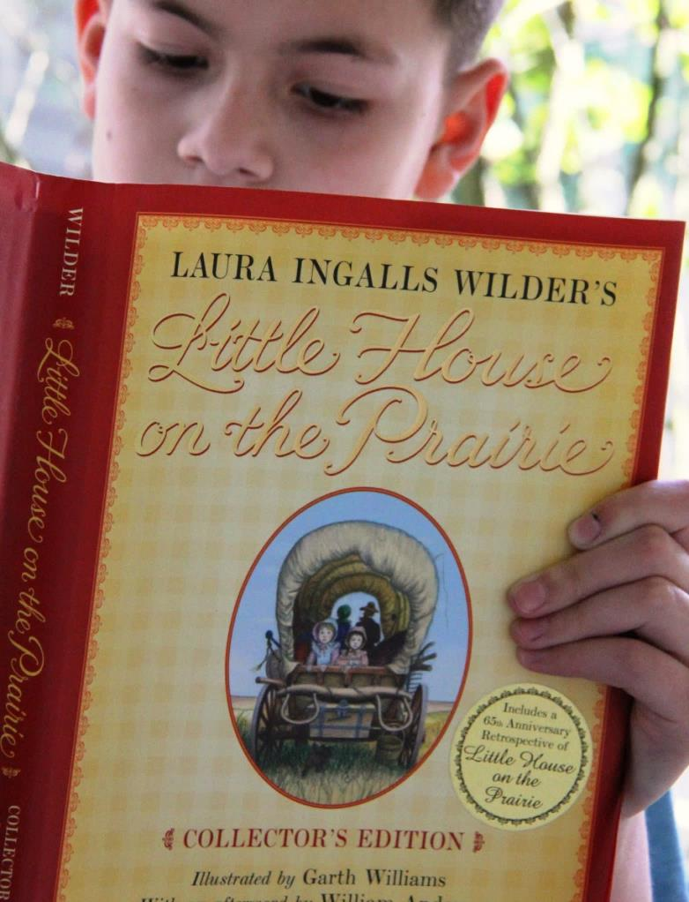
Little House on the
Prairie
By
Laura Ingalls Wilder

Slide 2
What is a memoir?

Slide 3
What is a memoir?
A memoir is an account of the author’s
personal life and experiences.

Slide 4
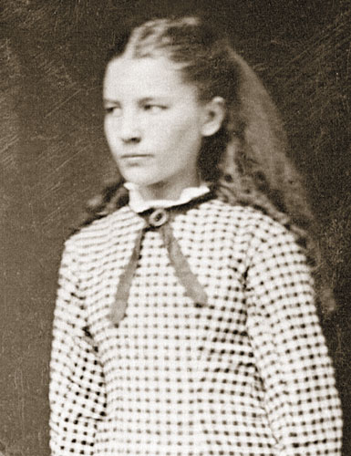
Little House on the Prairie
is a memoir…

Slide 5
by
Laura Ingalls Wilder

Slide 6
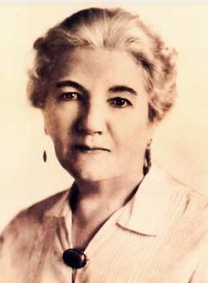
Meet the Author!
Laura Ingalls Wilder

Slide 7
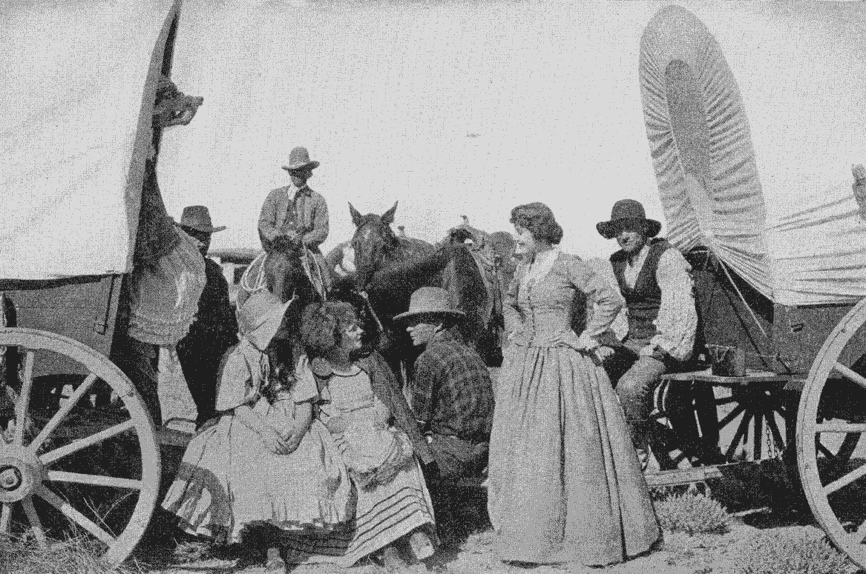
Laura Ingalls Wilder’s books are based on her life experiences. She once said, “I have lived everything that happened in my books. It is a long story filled with sunshine and shadow.”

Slide 8
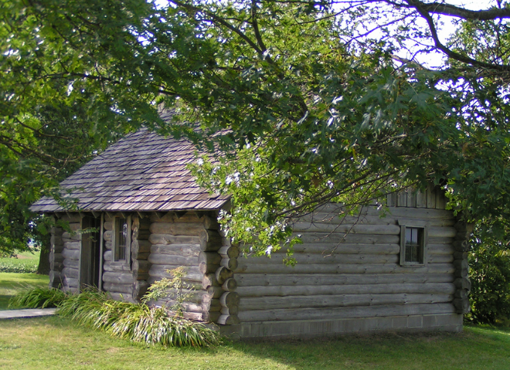
Laura Ingalls was born in “the little house in the big woods” in Pepin, Wisconsin on February 7th, 1867.
This is a reconstruction of her house

Slide 9
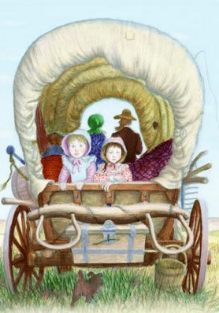
In the 1870’s the family moved several times, traveling by covered wagon from Wisconsin to Kansas to Minnesota and finally to the Dakota Territory.
Think about what life was like living out of a covered wagon!

Slide 10
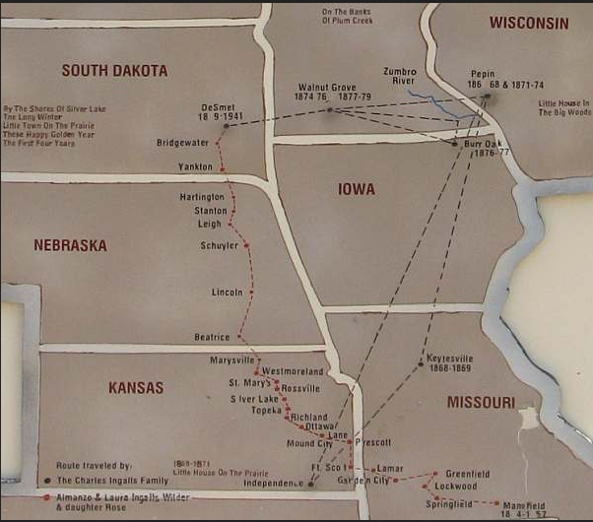
Map of Laura Ingalls Wilder’s Travels

Slide 11
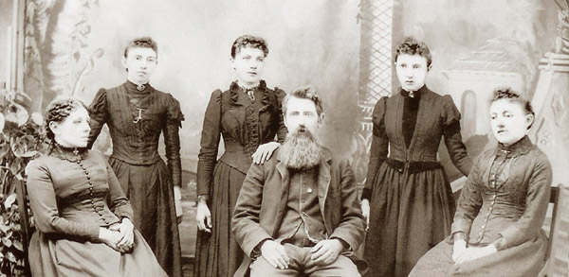
The Ingalls' Family
Caroline, Carrie, Laura, Charles, Grace and Mary

Slide 12
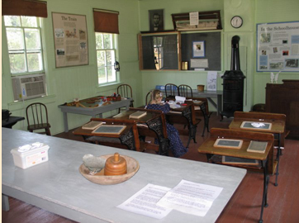
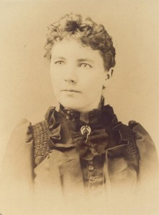
At age 15, Laura Ingalls started teaching at a county school in DeSmet, South Dakota.
A peek inside the schoolhouse!

Slide 13
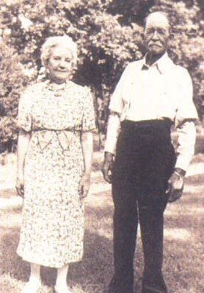
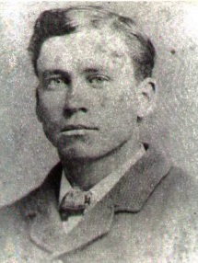
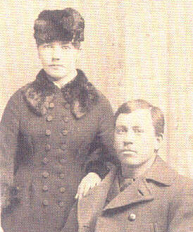
She married Almanzo Wilder in 1885 and her daughter Rose, also an author, was born in 1886.
Laura and Almanzo in 1940
Almanzo
Laura and Almanzo in 1885

Slide 14
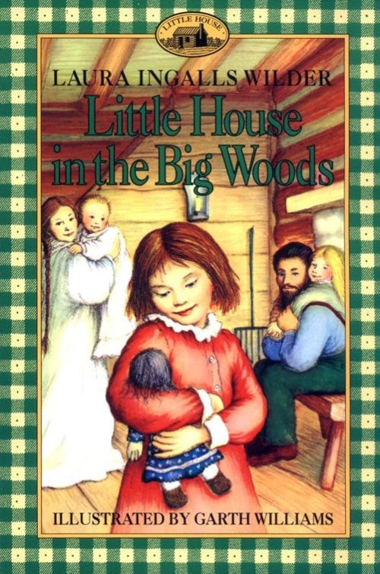
The first “Little House book,” Little House in the Big Woods, was published in 1932 when Laura Ingalls Wilder was 65.

Slide 15
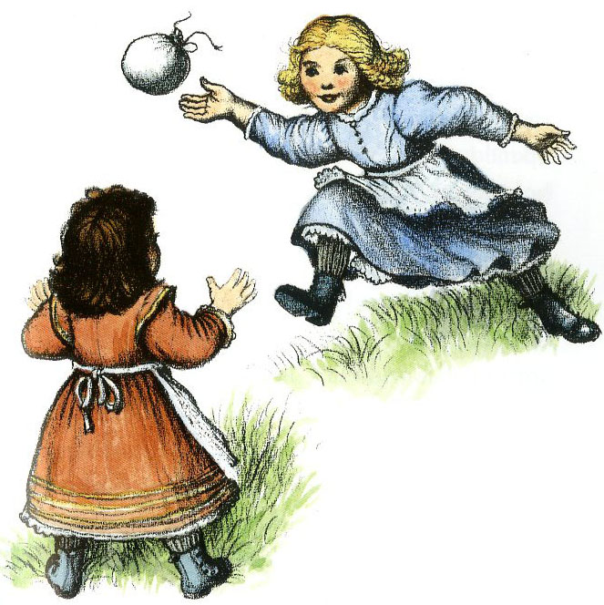
Quotable Quote
“When to my surprise the book made such a success and children from all over the U. S. wrote me begging for more stories. I began to think what wonderful childhood I had. How I had seen the whole frontier, the woods, the Indian country of the great plains, the frontier towns, the building of railroads on the wild unsettled country, homesteading and farmers coming in to take possession. I realized that I had seen and lived it all.”
– Laura Ingalls Wilder

Slide 16
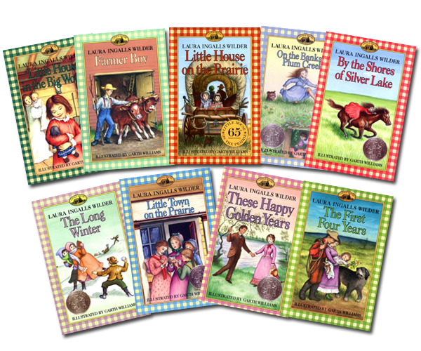
From 1932-1943, Laura Ingalls Wilder wrote nine “Little House” books in order to share her experiences with modern children.

Slide 17
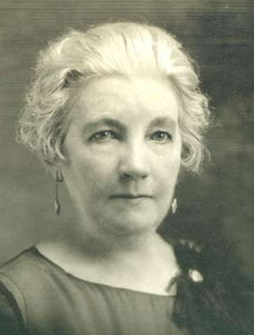
“I wanted children now to understand more about the beginning of things, to know what is behind the things they see - What it is that made America as they know it.”

Slide 18
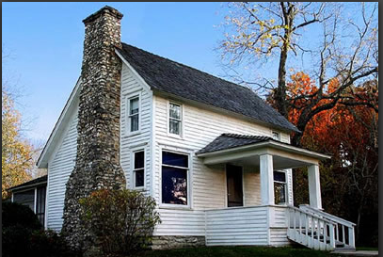
Laura Ingalls Wilder lived to be 90 years old. She died at Rocky Ridge Farm in Mansfield. Missouri on February 10, 1957.
Laura’s home in Mansfield.

Slide 19
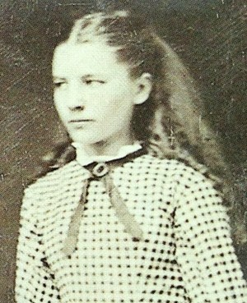
1867 – 1957
Think about the changes Laura
saw in her lifetime!

Slide 20
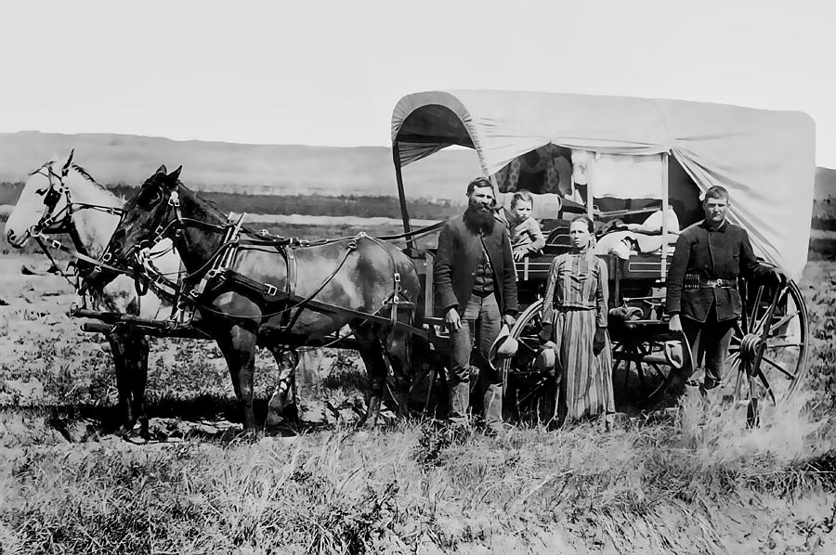
Why move west?

Slide 21
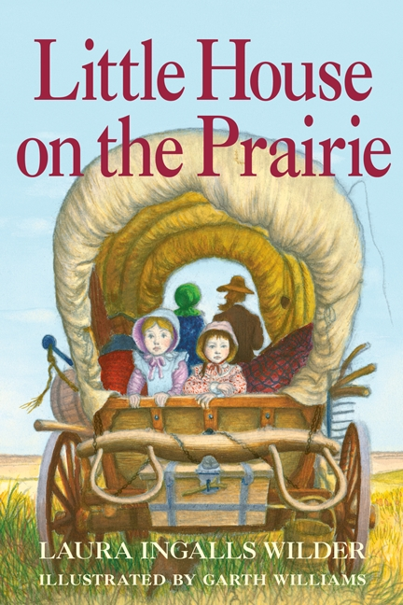
Look closely at the cover. What do you think will happen in this book?
Share on your mic, webcam or in chat!

Slide 22
Do you think there will be a problem in the story? Why?
Share on your mic, webcam or in chat!

Slide 23
What are you curious to find out about in this book?
Share on your mic, webcam or in chat!

Slide 24
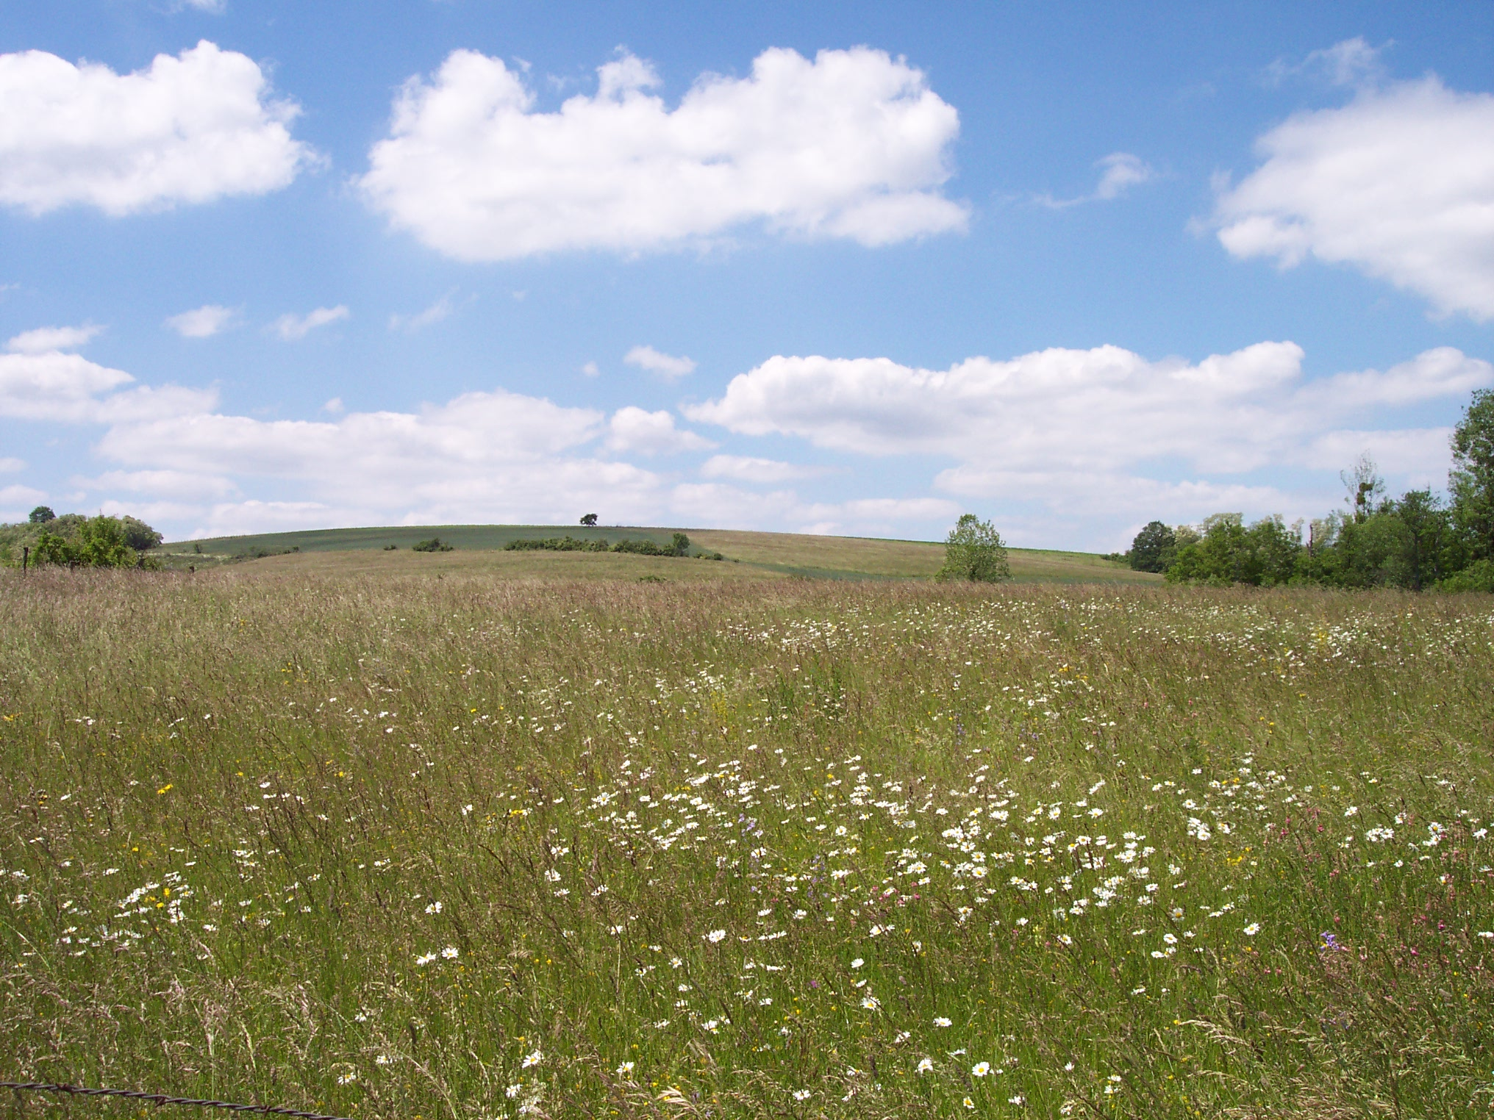

Slide 25
prairie

Slide 26
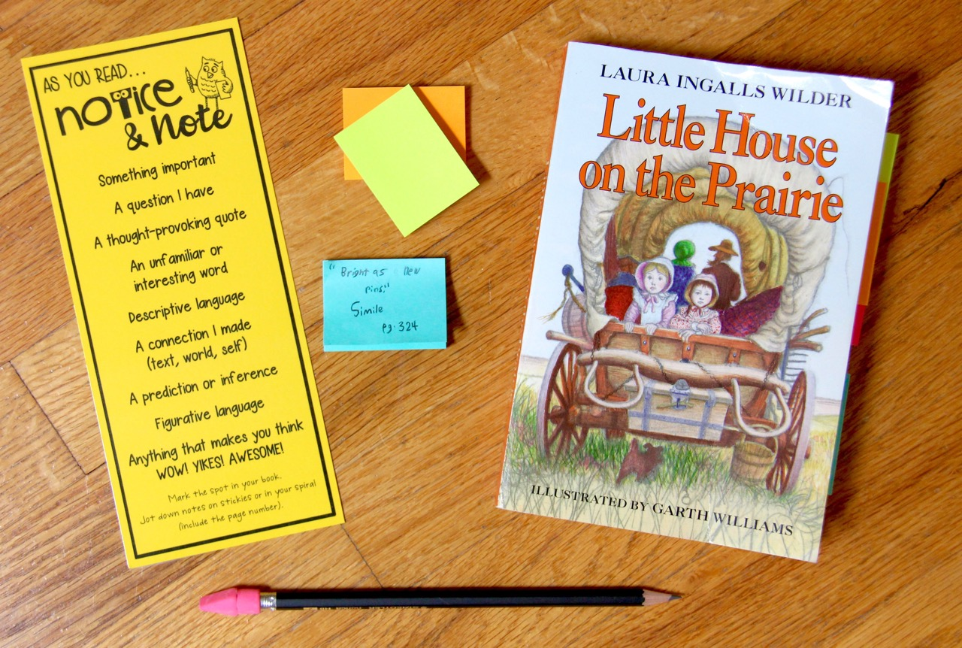
Novel Study Materials
novel
sticky
notes
Notice & Note bookmark
pencil

Slide 27
Every week, you will read
3-4 chapters of Little House.
Notice & Note as you read (mark your book, use sticky notes, and/or write notes in your spiral).
Then, complete the assignment that goes along with the reading.

Slide 28
Do your best work!

Slide 29
READ ALOUD!

Slide 30
Chapter 1: Going West
“Oh, Charles, must we go now?” Ma said. The weather was so cold and the snug house was so comfortable.
“If we are going this year, we must go now,” said Pa. “We can’t get across the Mississippi after the ice breaks.”
So Pa sold the little house. He sold the cow and calf. He made hickory bows and fastened them upright to the wagon-box. Ma helped him stretch white canvas over them.

Slide 31
In the thin dark before morning Ma gently shook Mary and Laura till they got up. In firelight and candlelight she washed and combed them and dressed them warmly. Over their long re-flannel underwear she put wool petticoats and wool dresses and long wool stockings. She put their coats on them, and their rabbit-skin hoods and their red yarn mittens.

Slide 32
Everything from the little house was in the wagon, except the beds and tables and chairs. They did not need to take these, because Pa could always make new ones.
There was thin snow on the ground. The air was still and cold and dark. The bare trees stood up against the frosty stars. But in the east sky was pale and through the gray woods came lanterns with wagons and horses bringing Grandpa and Grandma and aunts and uncles an cousins.
Mary and Laura clung tight to their rag dolls and did not say anything. The cousins stood around and looked at them. Grandma and all the aunts hugged and kissed them and hugged kissed them again, saying good-bye.

Slide 34
TO DO:
Read Chapters 1-3.
Notice & Note as you read (mark your book, use sticky notes, and/or write notes in your spiral).
Complete the weekly assignment (Google Form) before our next Class Connect.
Be prepared to share your thoughts, assignment responses, and notes with the class!

Slide 35
