Slide 1
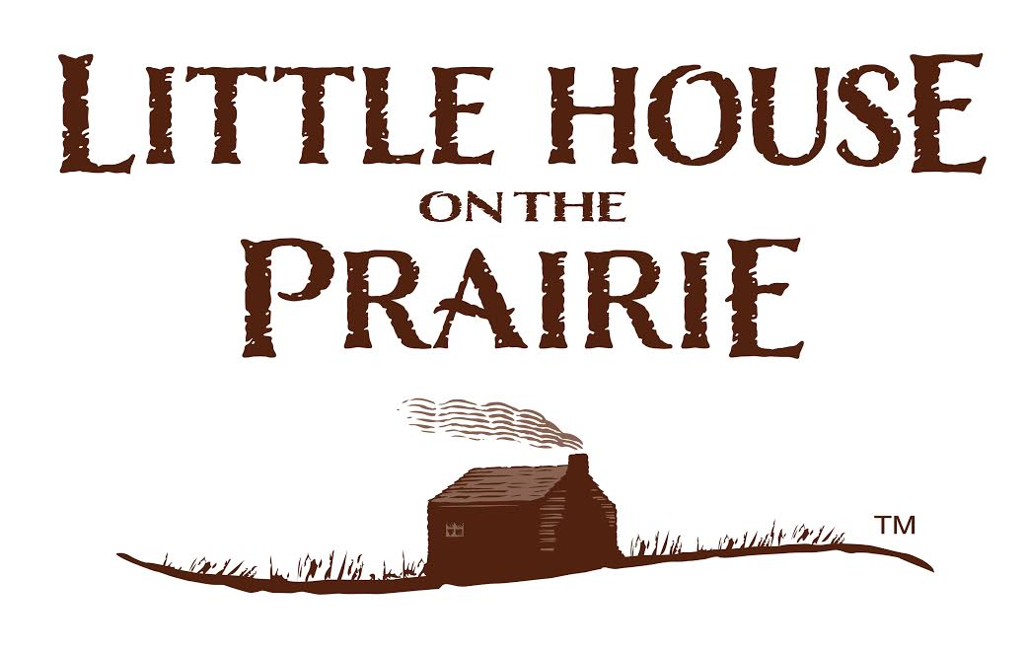
Chapters 19-21

Slide 2
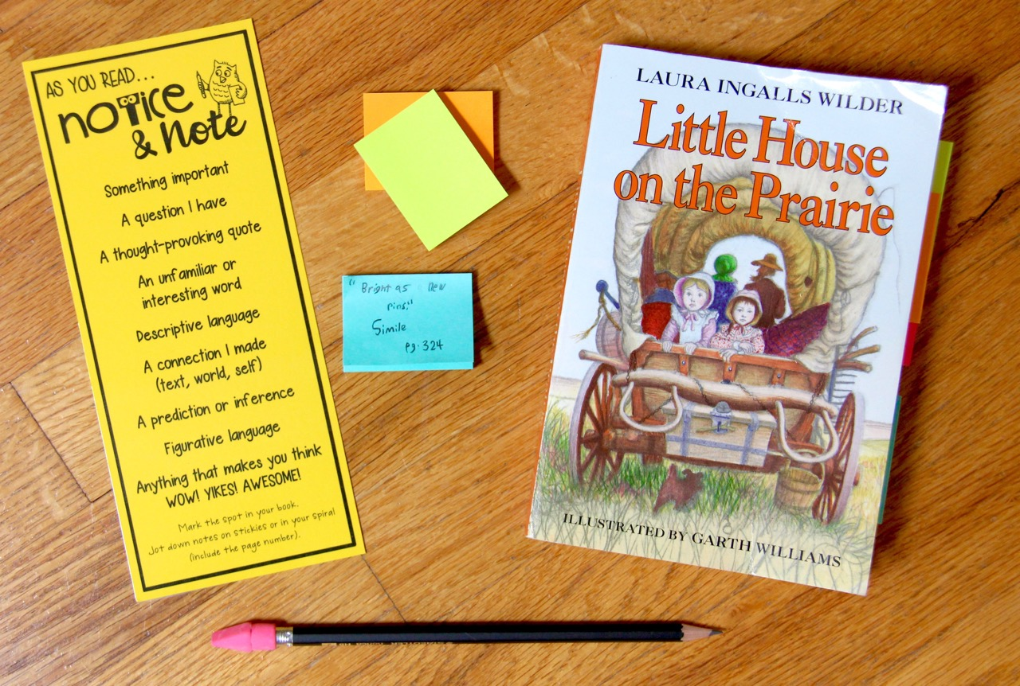
Novel Study Materials
novel
sticky
notes
Notice & Note bookmark
pencil

Slide 3
Does your family celebrate a winter holiday?
Share on your mic, webcam or in chat!

Slide 4
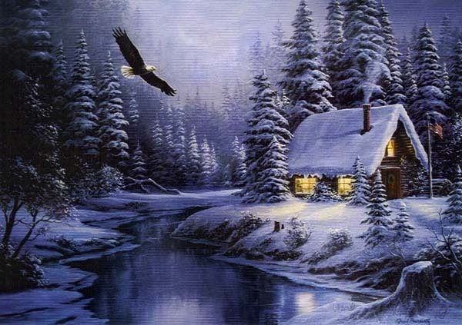
Let’s learn more about the Pioneer Christmas!

Slide 5
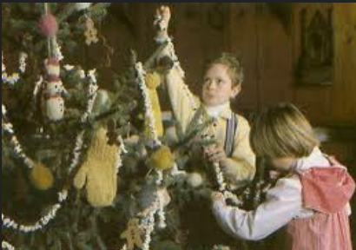
Did you know…
In the pioneer days, the home was decorated with green branches and homemade decorations. They did not have a big Christmas tree because there was no room for a large tree in their small homes. Pine cones, nuts, berries and popcorn chains were hung on the tree.
Figures or dolls out of straw
or yarn were made. Cookie
dough ornaments and
gingerbread men were also
hung on the tree.

Slide 6
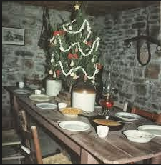
The Christmas dinner was planned and preparation of the food began weeks ahead of time. The Christmas goose was fattened up and the plum pudding was left to age in the pot until Christmas day.

Slide 7
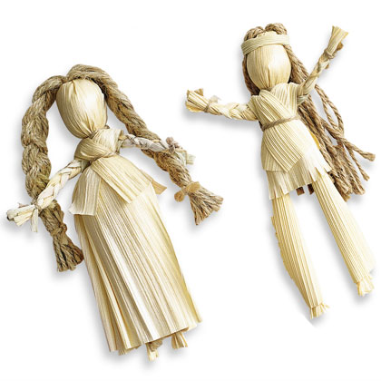
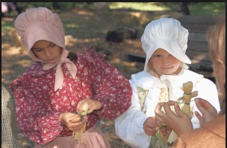
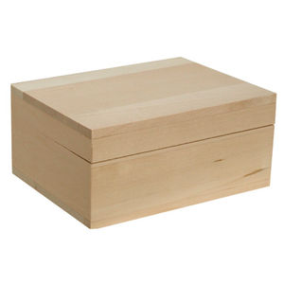
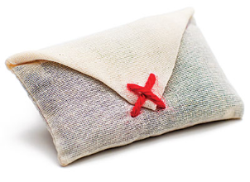
There were chores that
began months before
Christmas - such as making
the gifts for the family members ( corn husk dolls, sachets, carved wooden toys, pillows, footstools and embroidered hankies ). Scarves, hats, mitts and socks had to be knitted. Girls were able to knit before they were six years old. Boys would make boxes for presents.

Slide 8
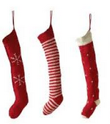
Did you know…
If there had been a good harvest that year, presents were placed inside stockings . The stockings were hung on the fireplace . Cookies and fruit might also be found in the stockings.

Slide 9
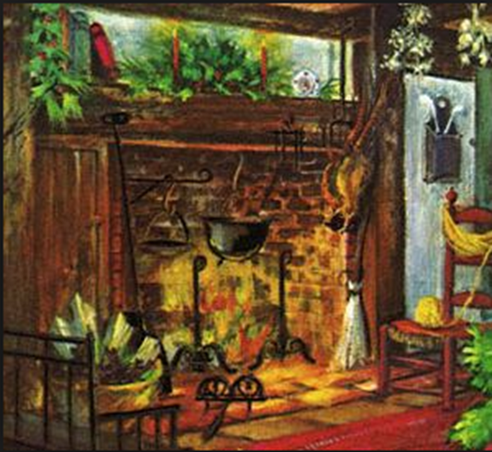
Christmas Eve was a night for singing carols and telling stories around the fireplace. Christmas Day the whole family attended church and returned home to a Christmas meal. Then it was time to visit friends and neighbors.

Slide 10
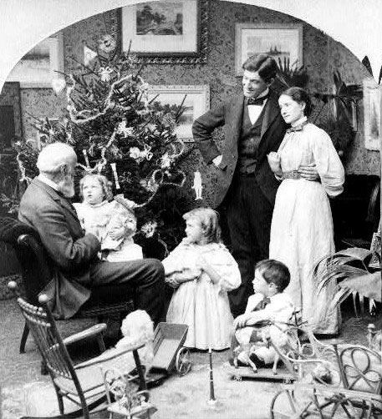
Did you know…
The fun-loving Dutch colonists who settled New Amsterdam (now New York) brought
their customs with them.
Their name for St. Nicholas became abbreviated to
Sint Klaas, or Sant Klaus which eventually turned in
to Santa Claus.

Slide 11
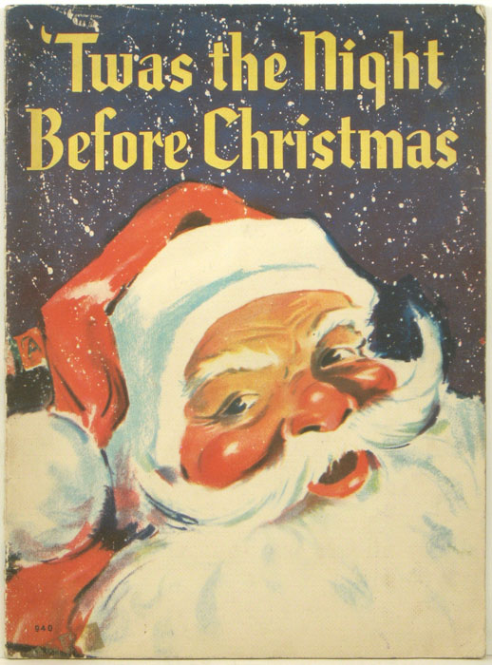
In 1822, Clement Clarke Moore wrote his famous poem. A Visit From St. Nicholas, which begins with "Twas the night before Christmas. " There is no mention of Santa Claus or a Christmas tree but it describes St. Nick and told of his coming in a sleigh drawn by eight reindeer named Dasher, Dancer, Prancer and Vixen, Comet, Cupid, Donner and Blitzen.

Slide 12
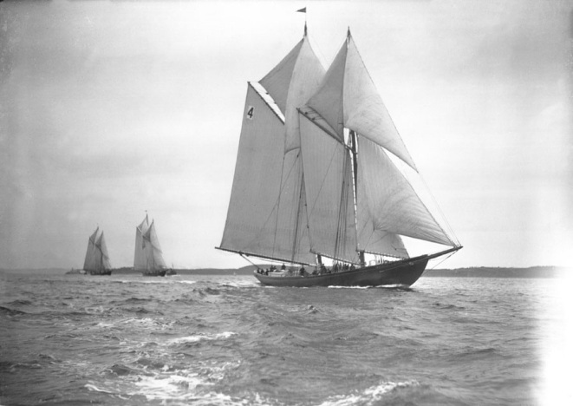
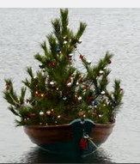
Christmas trees were hard to come by in the pioneer days because pines and firs were not native trees in all parts of the country.
In Chicago, a Christmas tree business started in December, 1887, when Herman and August Schuenemann sailed their fishing schooner into the Chicago river and tied up at the Clark St. bridge with a load of young spruce trees from the Michigan forests. After that, year after year, Chicago folks would come to select and carry home a tree from the "Christmas Ship. "

Slide 13
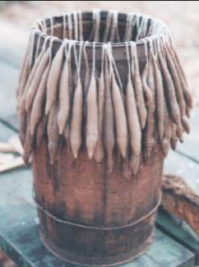
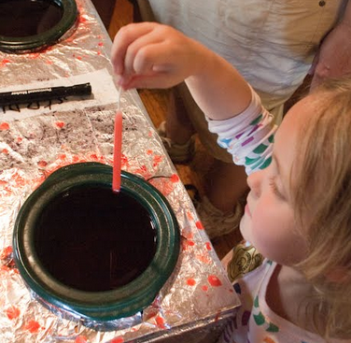
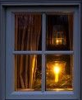
Instead of Christmas lights, pioneers would place hand-dipped candles in the window. This let travelers or soldiers know that they could stop in to get a warm meal and to rest by the fire.

Slide 14
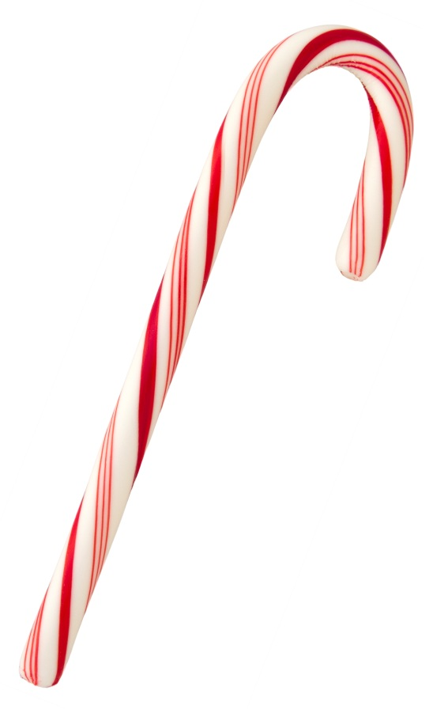
During pioneer times in the Middle West, according to letters and diaries, Christmas did not amount to much.
Gifts to children, if any, were homemade and mostly practical. Laura Ingalls was delighted to find a shiny new tin cup, a peppermint candy, a heart shaped cake, and a brand new penny in her stocking. For in those days, these four small gifts in her stocking were a wealth of gifts.

Slide 15
CHRISTMAS COMPARISON!
PIONEER DAYS
2016
BOTH
Use the information you know from this lesson, stories and movies you’ve seen,
and personal experience to complete this Venn Diagram.

Slide 16
ASSIGNMENT
Chapters 19-21

Slide 17
Share your answers.
2. What Christmas gifts did Laura and Mary receive in Chapter 19: Mr. Edwards Meets Santa Claus?
Write your answers on the whiteboard.

Slide 18
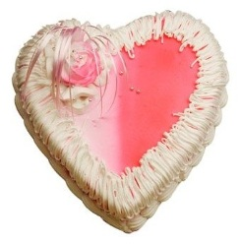
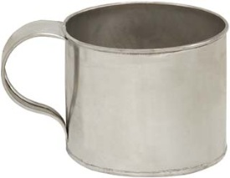
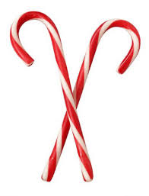
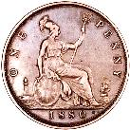
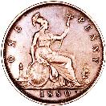
Share your answers.
2. What Christmas gifts did Laura and Mary receive in Chapter 19: Mr. Edwards Meets Santa Claus?
tin cups
sticks of peppermint candy
heart-shaped cakes
shiny new pennies

Slide 19
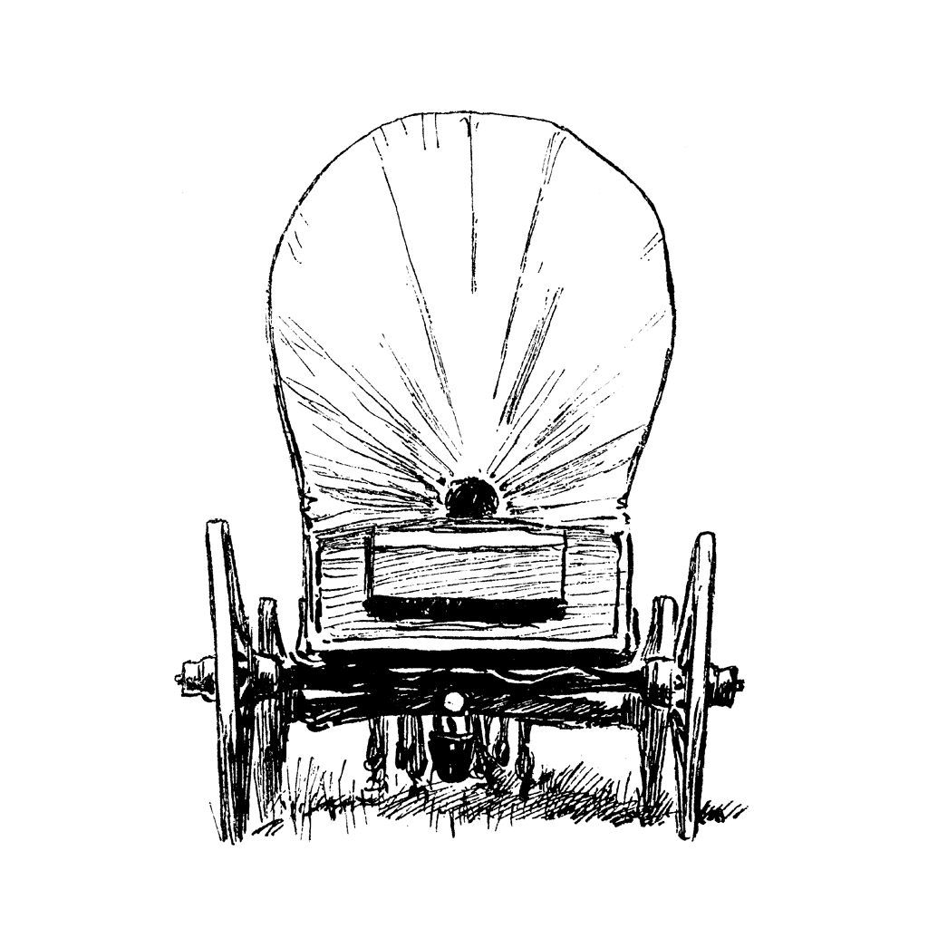
What was the source of the scream in Chapter 20: A Scream in the Night?
A. Mrs. Scott
B. an eagle
C. a panther
D. Ma Ingalls

Slide 20
What was the source of the scream in Chapter 20: A Scream in the Night?
C. a panther

Slide 21
Chapter 20: A Scream in the Night
"Charles! What was it?" Ma says.
"It's a woman screaming," Pa said. "Sounded like it came from Scott's"
Pa puts on his boots, his heavy coat, and his fur cap. He lights the candle in the lantern, grabs his rifle, and heads out the door. He is going to make sure that the Scotts are alright.
Ma and the girls are left alone in the cabin. Ma tells the girls to go back to sleep, but they are not sleepy. Laura imagines Pa walking along the top of the bluff, the candle shining here and there through the holes cut in the lantern.

Slide 22
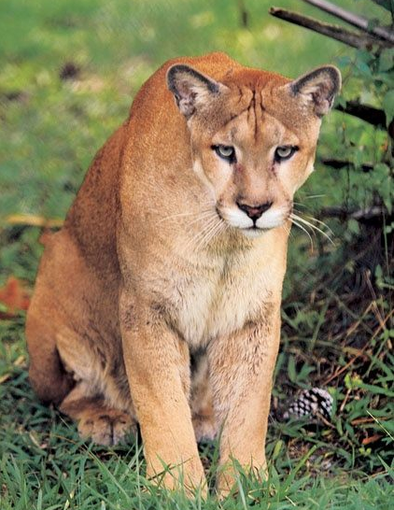
It seems like hours go by, and then they hear the terrible screaming again. It seems very close to the house. Ma jumps up to put more wood on the fire. Laura jumps up, too, but Ma tells her to go back to bed. Laura begs so hard to stay up that Ma lets her and they stand together by the fire, listening.
Suddenly, they hear fists pounding hard on the door and Pa's voice shouting, "Let me in!"
Ma opens the door and Pa slams it quickly behind him. He is breathing hard from running. "Whew! I'm scared yet," he says.
"What was it, Charles?" Ma asks him.
"A panther," Pa answers.

Slide 23
Share your answers.
What does Pa want to buy with the money he receives from selling his furs in Independence? Use evidence from the text to support your claim. (RACE)
Notes:
Pa wants to buy a plow and seeds.

Slide 25
Super Student Sample!
copy/paste student response here
estated the question
nswered the question
ited evidence
xplained
Notes:
Paste a student response sample from last week’s open-ended question on this slide. Read aloud and find all parts of RACE in the response.

Slide 26
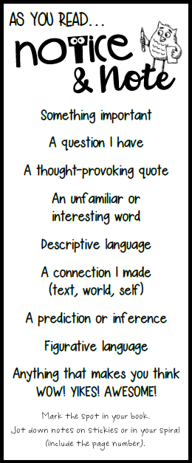
What did you Notice & Note
in chapters 19-21?
Share on your mic, webcam or in chat!

Slide 27
Point of View

Slide 28
I CAN…
determine the point of view from which different stories are narrated, including the difference between first and third-person narrations.
Notes:
CCSS I Can Statement

Slide 29
POINT OF VIEW
the narrator's position in relation to the story being told.
Who is telling the story?
Notes:
Literary Lesson

Slide 30
FIRST PERSON
I me my us we
A character is telling the story.
“I went to the store to get cheese.”
(told from a first-hand account)
Notes:
Literary Lesson

Slide 31
Notes:
Literary Lesson

Slide 32
Notes:
Literary Lesson

Slide 33
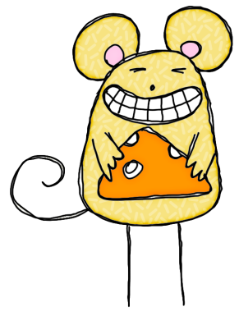
The narrator's
point of view influences how events are described.
CLUE:
What pronouns are used in the text?
Notes:
Literary Lesson

Slide 34
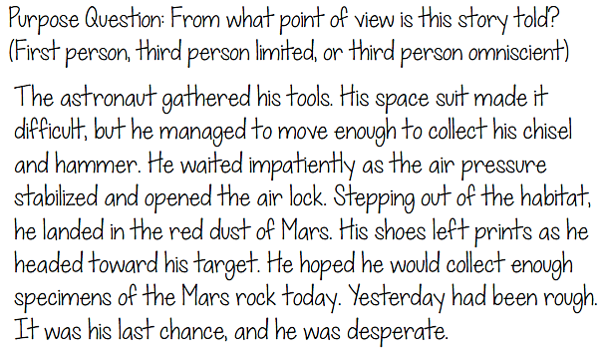
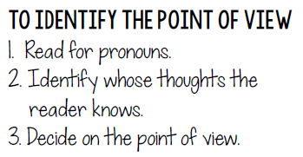
POV:
Notes:
Literary Lesson

Slide 35
POV:
Notes:
Literary Lesson

Slide 36
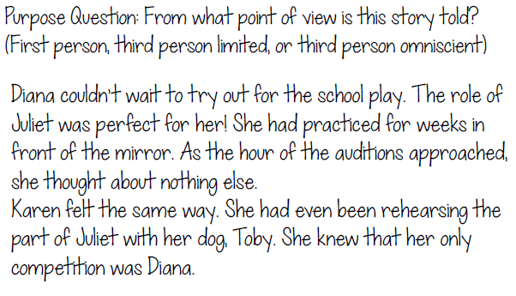
POV:
Notes:
Literary Lesson

Slide 37
POV:
Notes:
Literary Lesson

Slide 38
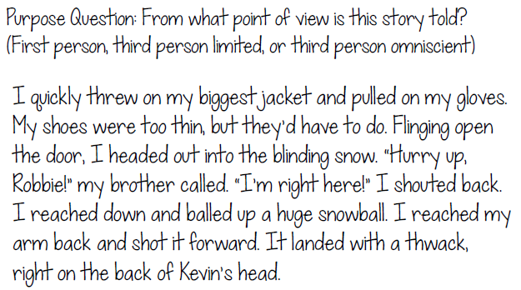
POV:
Notes:
Literary Lesson

Slide 39
POV:
Notes:
Literary Lesson

Slide 40
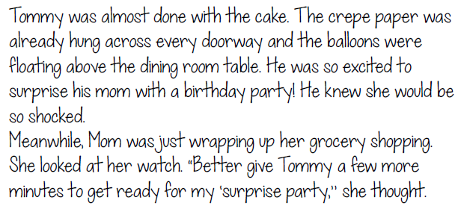
Think Group Share
Names:_______________________
POV:
___________________________________
How do you know?
Notes:
OPTIONAL: Group Work

Slide 41
TO DO:
Read Chapters 22-24.
Notice & Note as you read
(mark your book, use sticky notes, and/or write notes in your spiral).
Complete the weekly assignment before our next Class Connect:
Be prepared to share your thoughts, assignment responses, and notes with the class!

Slide 42
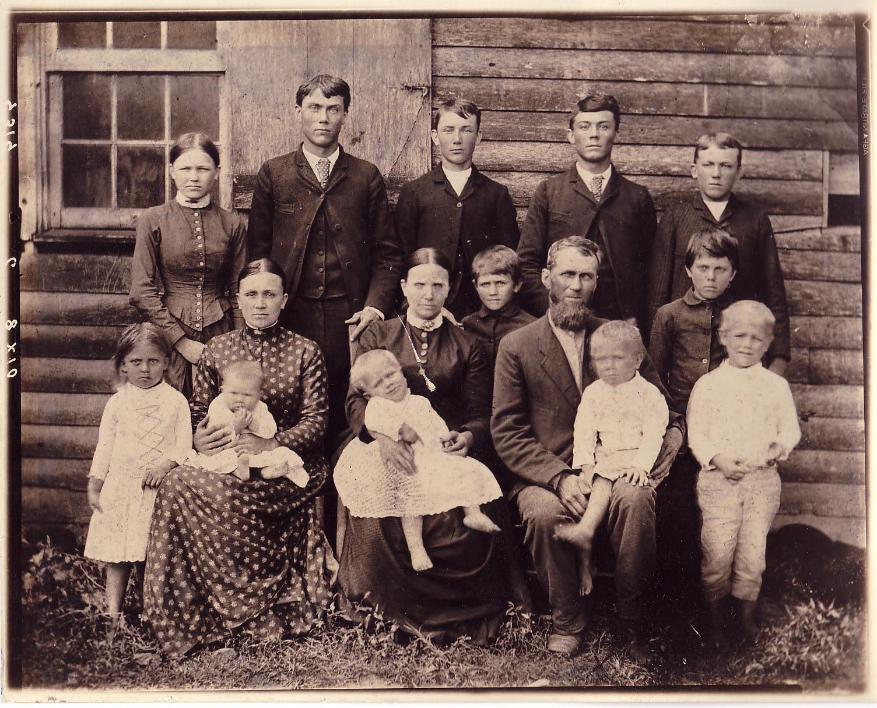

Slide 43
MOVIE TIME!
Everybody wants to know my POV.
Give a when you are finished watching!
Notes:
https://www.flocabulary.com/unit/point-of-view/video/

