Slide 1
Chapters 10-12

Slide 2
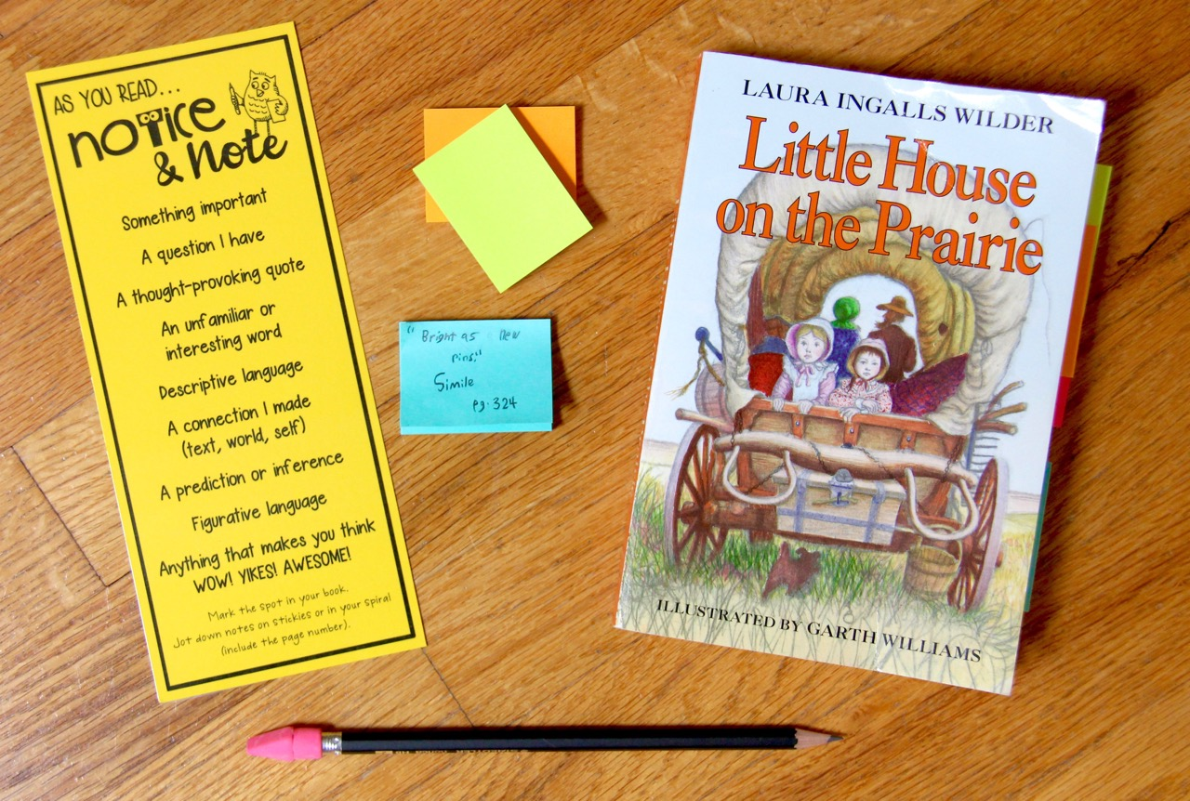
Novel Study Materials
novel
sticky
notes
Notice & Note bookmark
pencil

Slide 3
Why do you think the Ingalls family was afraid of
the Indians?
Share on your mic, webcam or in chat!

Slide 4
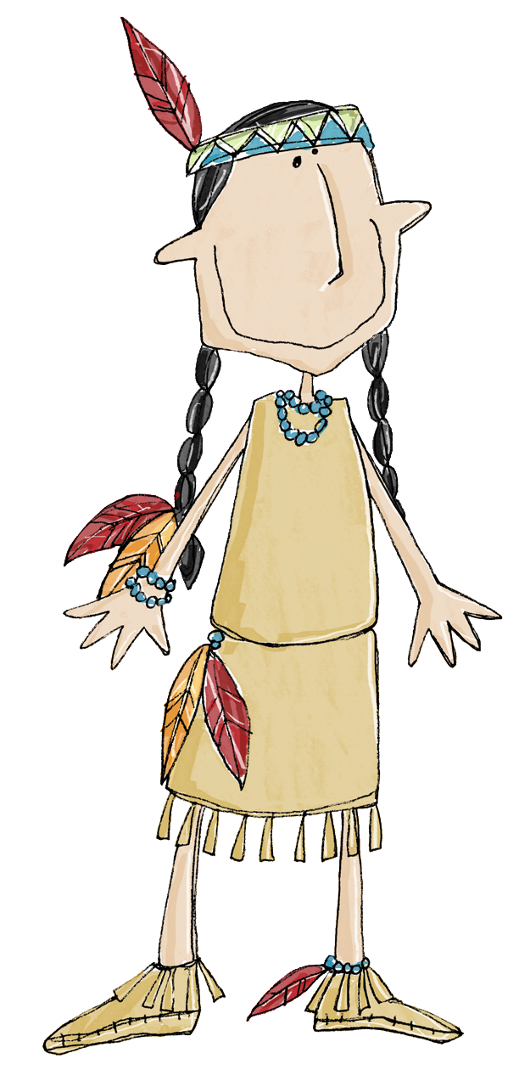
Let’s learn more about
Native Americans!

Slide 5
Did you know…
The first people to live
in a land are called
indigenous people.
This means they were the original settlers.
Native Americans are the indigenous people of the United States.

Slide 6
Native Americans lived throughout North and South America. In the United States there were Native Americans in Alaska, Hawaii, and the mainland of the United States.
Different tribes lived in different areas.

Slide 8
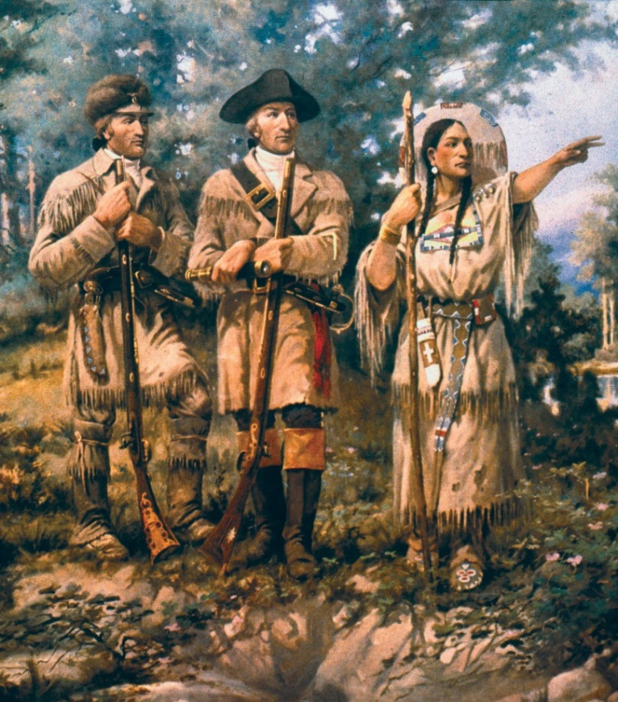
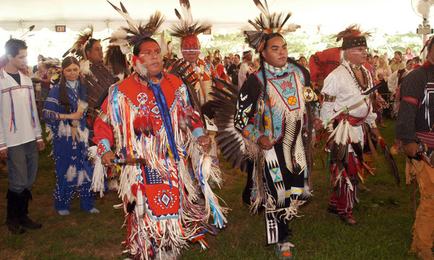
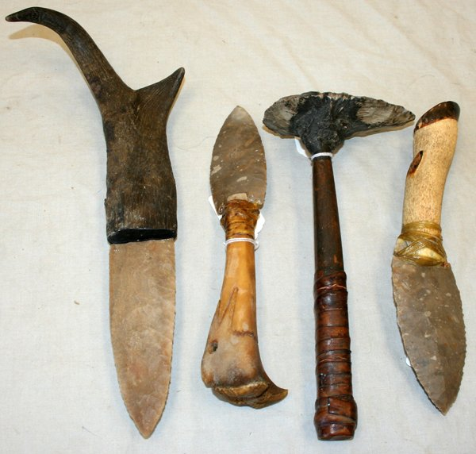
Much of what we know comes from the recordings of the first Europeans to arrive. We also learn from traditions and stories
that have been passed down within the tribes from generation to generation.
Archeologists study past cultures by digging up artifacts such as tools and weapons.

Slide 9
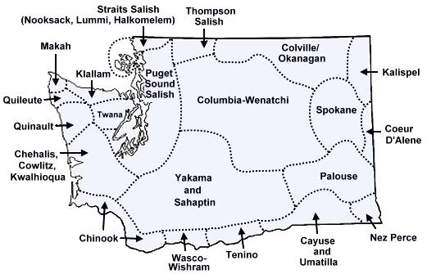
There are many Native American tribes who played a part in the history of our state and whose tribal territories and homelands are located in the present-day state of Washington.

Slide 10
Colville, Spokane, and Yakima are a few of the tribes who lived in Washington’s river valleys and on high-desert plateaus.
These people relied on salmon for survival, catching thousands as the fish made their annual journey up the Columbia River and its tributaries.

Slide 11
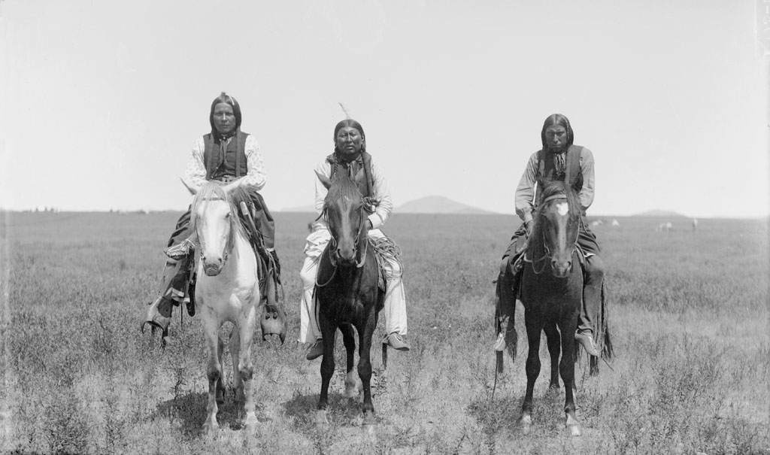
The Ingalls Family encountered the Plains Indians, who lived in the area between the Mississippi and the Rocky Mountains. Tribes in this area included the Sioux, Cheyenne, and Comanche (pictured above).

Slide 12
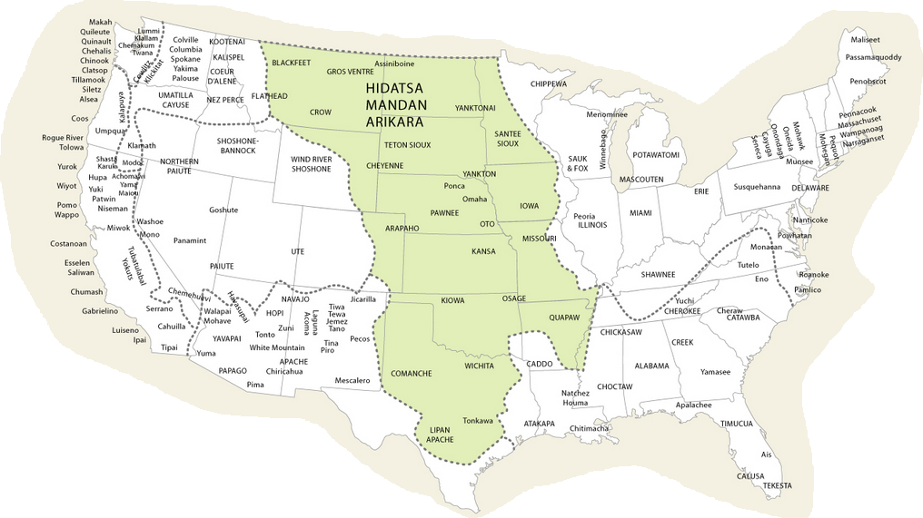
The shaded area on this map shows the territories occupied by various Plains Indian tribes during the middle of the 19th century.

Slide 13
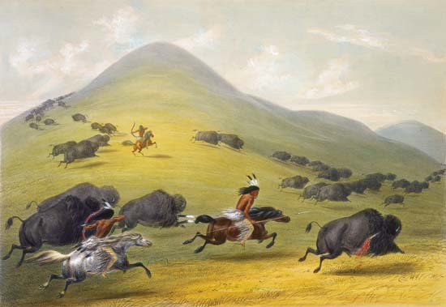
Although they hunted other animals, such as elk or antelope, buffalo was the Plain Indian’s primary game food source.

Slide 14
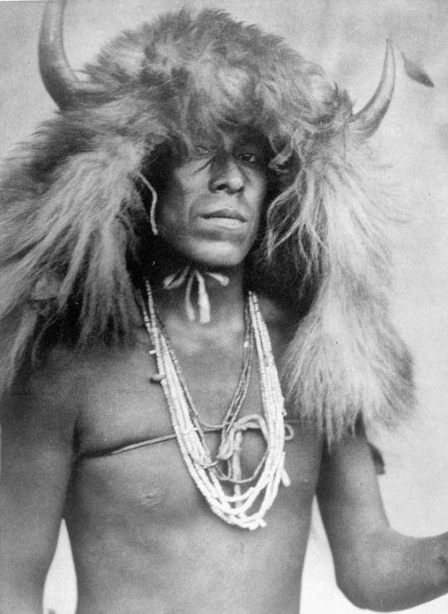
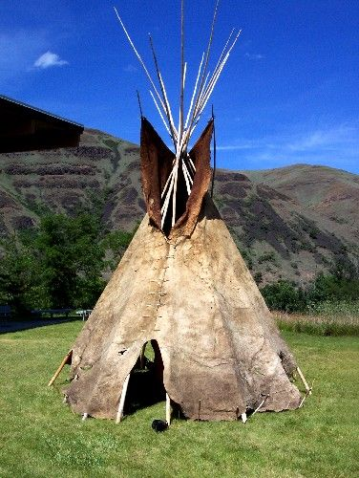
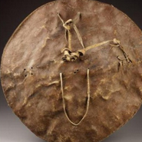
To the Plains Indians, buffalo meant life. It provided them with food, shelter, tools and clothing. Before the introduction of horses to these tribes, they followed the migration of buffalo herds by foot.
For the Plains Indians, hunting was not a choice, but a way of life, a strategy for survival.

Slide 15
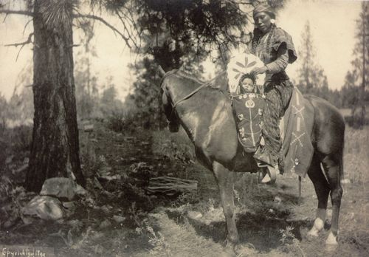
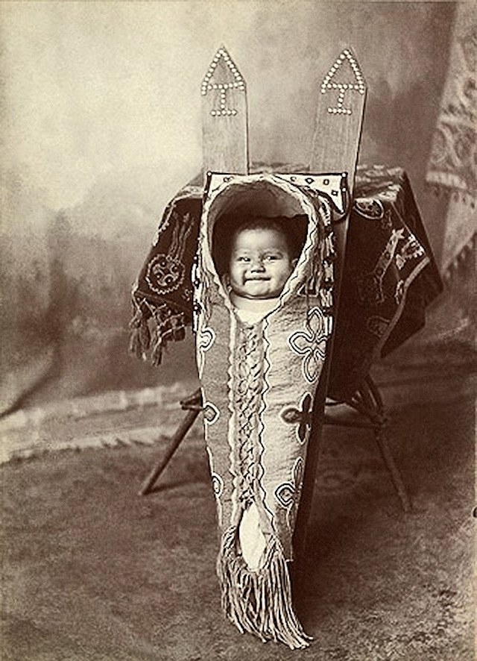
“Papoose” from the Algonquin word papoos, refers to a North American Indian baby or young child.
A “cradleboard” is a traditional kind of Native American baby carrier.

Slide 16
How do you think the “Indians” or native people felt about the Ingalls and the other pioneer families? Why?
Share on your mic, webcam or in chat!

Slide 17
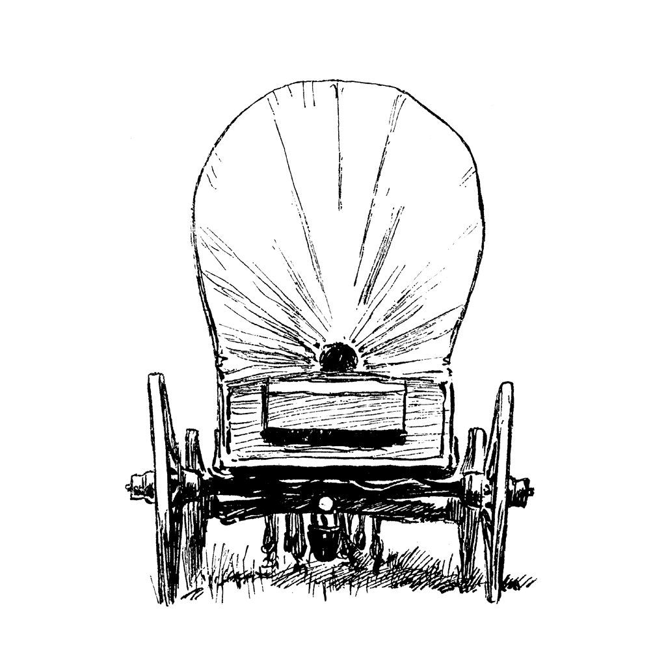
Why didn’t Mary and Laura let Jack off the chain when the Indians came?
A. Pa told the girls not to “let him loose.”
B. The knot was too tight.
C. They didn’t want him to run away.
D. He was too busy “eating his kibbles.”

Slide 18
Why didn’t Mary and Laura let Jack off the chain when the Indians came?
A. Pa told the girls not to “let him loose.”

Slide 19
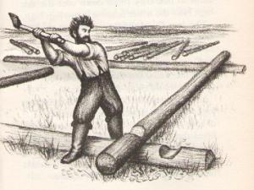
Share your answers.
Based on the information in Little House on the Prairie, would you describe Pa as hardworking? Use at least two details from the story to support your answer.
Share in chat, on your mic, or on webcam!

Slide 21
Super Student Sample!
copy/paste student response here
estated the question
nswered the question
ited evidence
xplained
Notes:
Paste a student response sample from last week’s open-ended question on this slide. Read aloud and find all parts of RACE in the response.

Slide 22
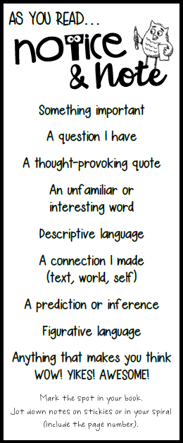
What did you Notice & Note
in chapters 10-12?
Share on your mic, webcam or in chat!

Slide 23
Personification

Slide 24
Personification is when you give
human qualities to an object or animal.
Notes:
Literary Lesson

Slide 25
personification
person
Notes:
Literary Lesson

Slide 26
The tea kettle whistled impatiently.
Notes:
Literary Lesson

Slide 27
The tea kettle whistled impatiently.
Notes:
Literary Lesson

Slide 28
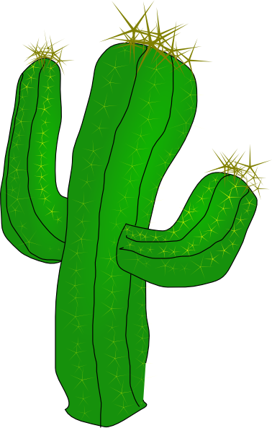
The cactus waved at us as we drove past.
Notes:
Literary Lesson

Slide 29
The cactus waved at us as we drove past.
Notes:
Literary Lesson

Slide 30
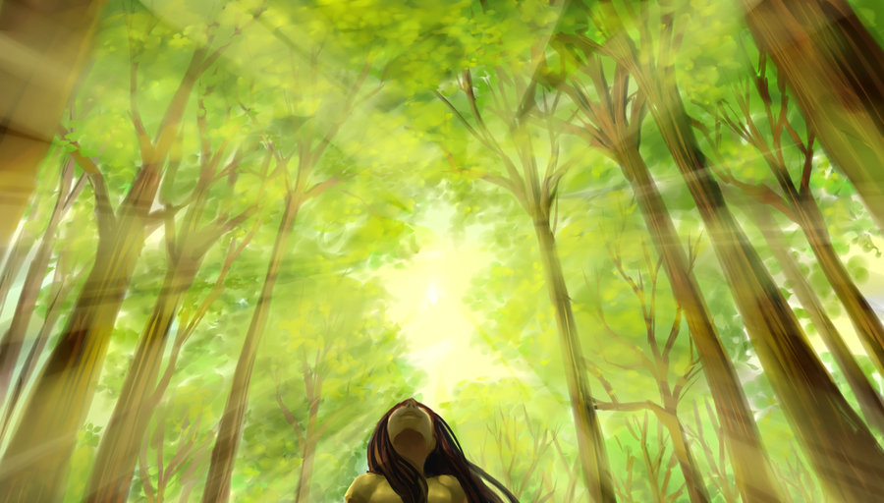
A forest of trees stretched their arms to reach the sun.
Notes:
Literary Lesson

Slide 31
A forest of trees stretched their arms to reach the sun.
Notes:
Literary Lesson

Slide 32
Our vacuum hums a happy tune while it cleans.
Notes:
Literary Lesson

Slide 33
Our vacuum hums a happy tune while it cleans.
Notes:
Literary Lesson

Slide 34
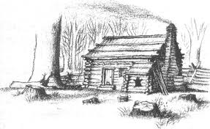
“The shutters were over the windows so the little house could not see them go.”
Little House on the Prairie, Chapter 1
Notes:
Literary Lesson

Slide 35
“The shutters were over the windows so the little house could not see them go.”
Little House on the Prairie, Chapter 1
Notes:
Literary Lesson

Slide 36
Notes:
Literary Lesson

Slide 37
Complete the sentence so that it uses personification.
Notes:
Literary Lesson

Slide 38
THIS STINKS!
Complete the sentence so that it uses personification.
Notes:
Literary Lesson

Slide 39
Complete the sentence so that it uses personification.
Notes:
Literary Lesson

Slide 40
Complete the sentence so that it uses personification.
Notes:
Literary Lesson

Slide 41
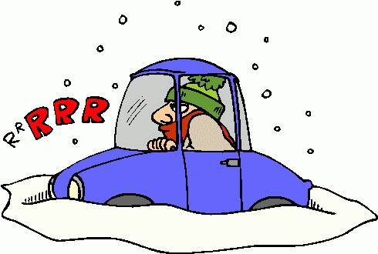
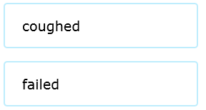
Complete the sentence so that it uses personification.
Notes:
Literary Lesson

Slide 42
COUGH!
Complete the sentence so that it uses personification.
Notes:
Literary Lesson

Slide 43
Complete the sentence so that it uses personification.
Notes:
Literary Lesson

Slide 44
I CAUGHT YOU!
Complete the sentence so that it uses personification.
Notes:
Literary Lesson

Slide 45
Mister Sun
by J. Patrick Lewis
Mister Sun wakes up at dawn,
puts his golden slippers on,
climbs the summer sky at noon,
trading places with the moon.
Mister Sun runs away
with the blue tag end of the day,
switching off the globe lamplight,
pulling down the shades of night.
Notes:
How does J. Patrick Lewis use personification in his poem?
Find examples of personification in the poem.

Slide 46
Are you noticing examples of PERSONIFICATION
as you read?
MAKE A NOTE!
Notes:
New ELA concept/lesson

Slide 47
TO DO:
Read Chapters 13-15.
Notice & Note as you read
(mark your book, use sticky notes, and/or write notes in your spiral).
Complete the weekly assignment before our next Class Connect:
Be prepared to share your thoughts, assignment responses, and notes with the class!

Slide 48
