Slide 1
Chapters 1-3

Slide 2
Say hello to someone who is here today.

Slide 3
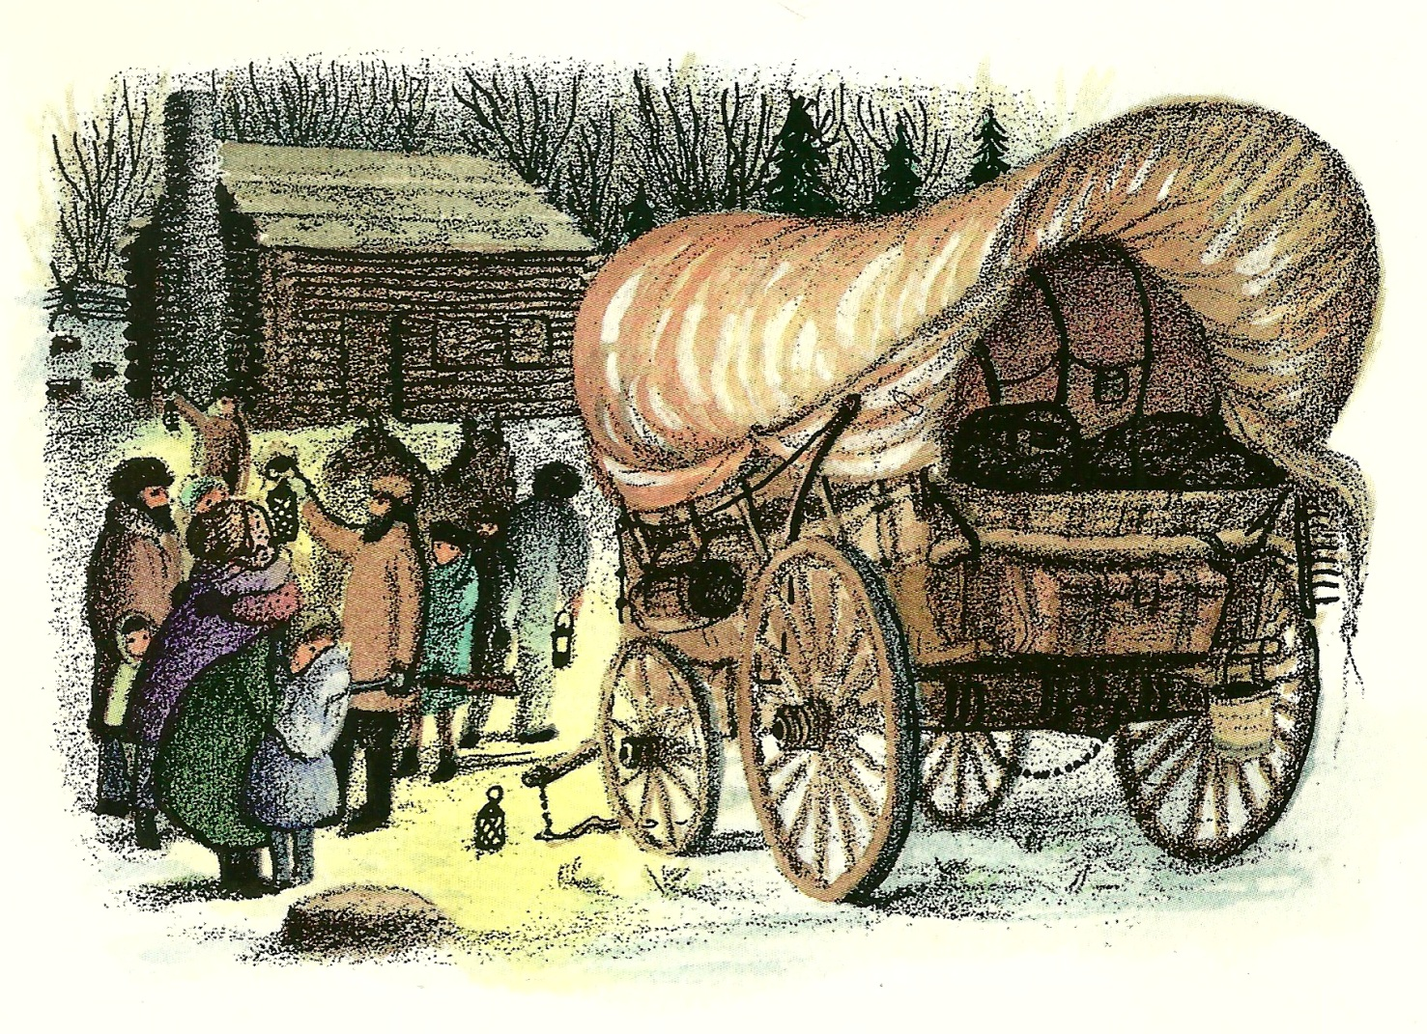
How do you think the Ingalls felt when they had to say goodbye to their family and friends in the Big Woods?
Share on your mic, webcam or in chat!

Slide 4
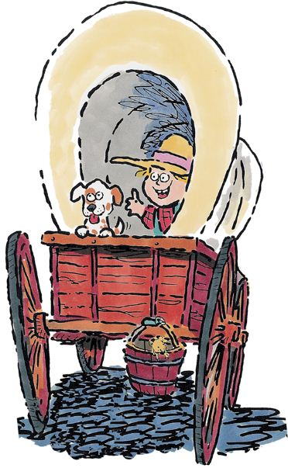
Let’s learn more about
Westward Expansion!

Slide 5
In 1700 there were around 250,000 colonists living in the American colonies. By 1775, this number had grown to 2.5 million. Many people wanted new land to farm and hunt. They began to move west of the Appalachians.

Slide 6
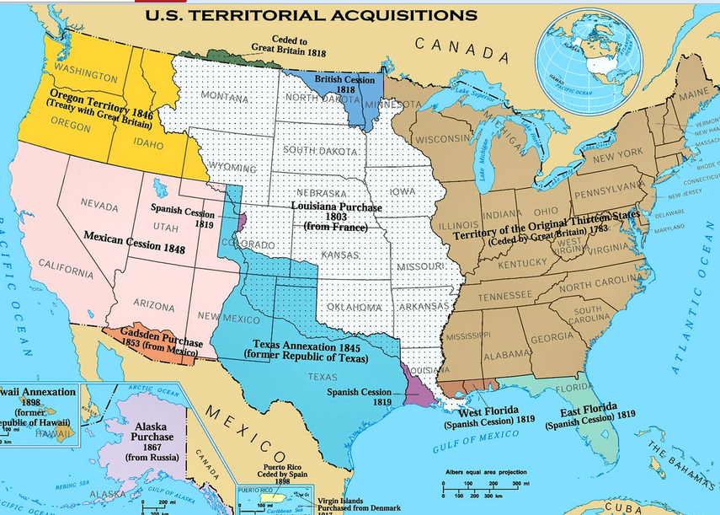

Slide 7
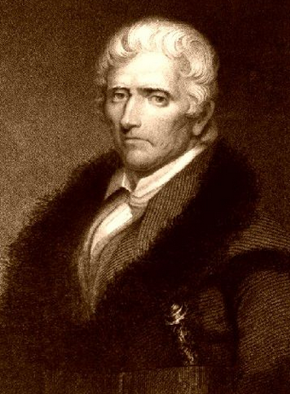
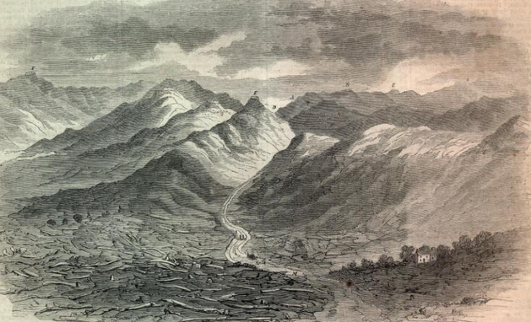
One of the first areas settled was the Northwest Territory. This area today makes up the states of Indiana, Ohio, Michigan, Wisconsin, and Illinois. Daniel Boone led settlers across the Cumberland Gap and into Kentucky.
The Treacherous Cumberland Gap!
Daniel Boone

Slide 8
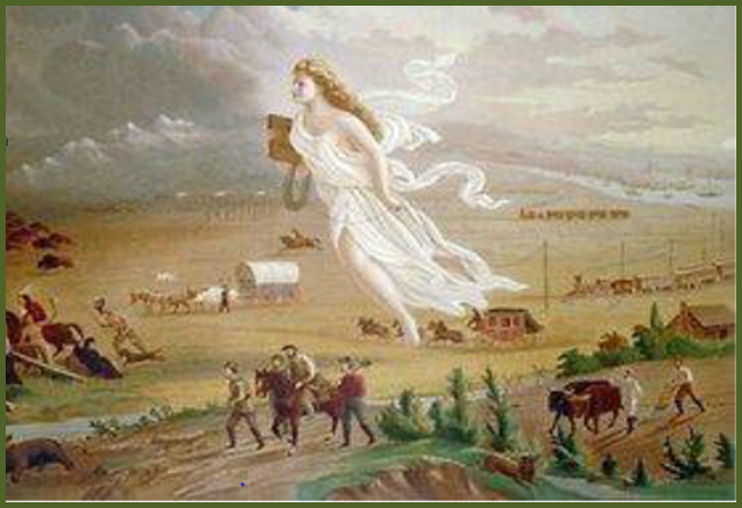
Many people in the United States believed it was the country's destiny to expand westward all the way to the Pacific Ocean. This belief became known as the Manifest Destiny.

Slide 9
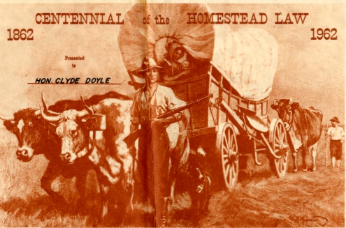
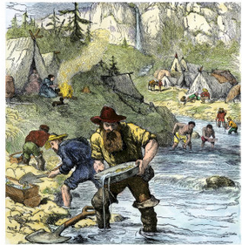
Pioneers and settlers moved out west for different reasons. Some of them wanted to claim free land for ranching and farming from the government through the Homestead Act. Others came to California during the gold rush to strike it rich.
Panning for gold in California

Slide 10
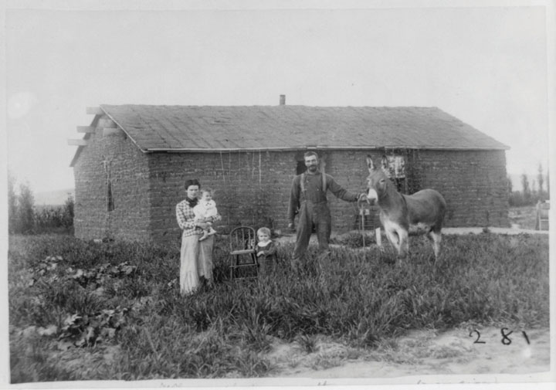
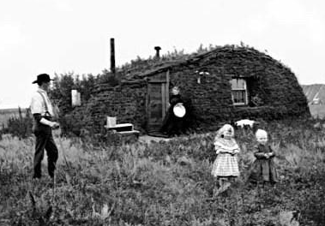
The Homestead Act became law in 1862 when it was signed by President Abraham Lincoln. Under the new law a U.S. Citizen could get 160 acres of unoccupied land west of the Mississippi River and east of the Rocky Mountains. They could keep the land if they
lived on the land for five years and made improvements to the
land.

Slide 11
All you had to pay was and $18 Application Fee
and the land was yours!

Slide 12
Covered wagons were called “Prairie Schooners” because they were the 10 foot boats gliding over dry land that carried you to your destiny. They were made of wood with iron around the wheels and had waterproof cotton or canvas covers.

Slide 13
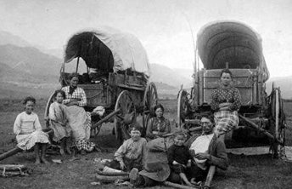
Pioneers brought very little with them on their journey. Their covered wagons were mostly filled with food. They took preserved foods such as hard tack, coffee, bacon, rice, beans, and flour. They also took a few basic cooking utensils such as a coffee pot, some buckets, and an iron skillet.
Relaxing on the prairie

Slide 14
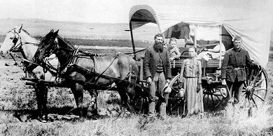
They only had room to pack two or three sets of tough clothing. They packed candles for lighting and a rifle to hunt with along the way. Other items included tents, bedding, and basic tools such as an axe and a shovel.

Slide 15
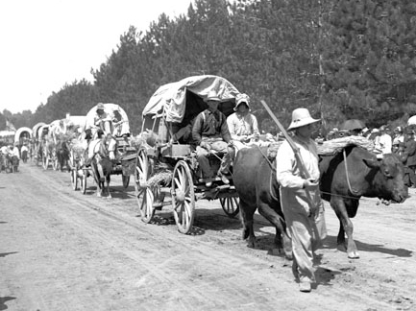
There were many dangers along the way. The real
danger was a disease called cholera that killed
many settlers. Other dangers included bad weather and accidents. Despite what movies might say, Native Americans and wild animals were not as much of a threat on the trail.

Slide 16
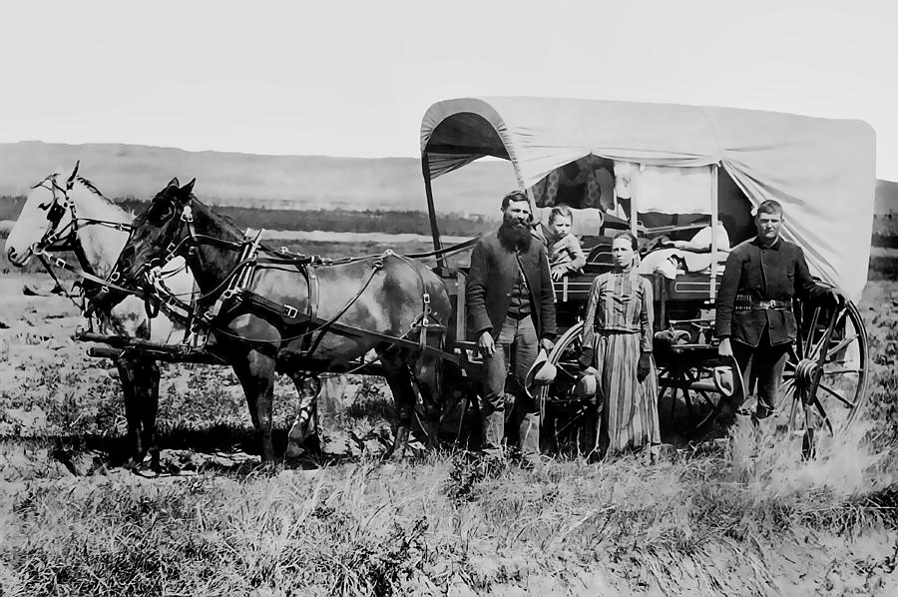
Moving West

Slide 17
Would you move?
Share on your mic, webcam or in chat!

Slide 18
Read the chart below. Provide another detail from Chapter 3 that tells how Pa carefully made the fire.
Pa was careful when preparing to make a fire.
He pulled all the grass from a large space of ground.
He brought an armful of twigs and dead wood.
A. Pa sat down and had a cup of coffee.
B. Pa laid small twigs and a handful of grass on top and lit the fire.
C. Pa played with the horses for awhile.
D. Pa looked for Jack one more time before lighting the fire.

Slide 19
Read the chart below. Provide another detail from Chapter 3 that tells how Pa carefully made the fire.
Pa was careful when preparing to make a fire.
He pulled all the grass from a large space of ground.
He brought an armful of twigs and dead wood.
B. Pa laid small twigs and a handful of grass on top and lit the fire.

Slide 20
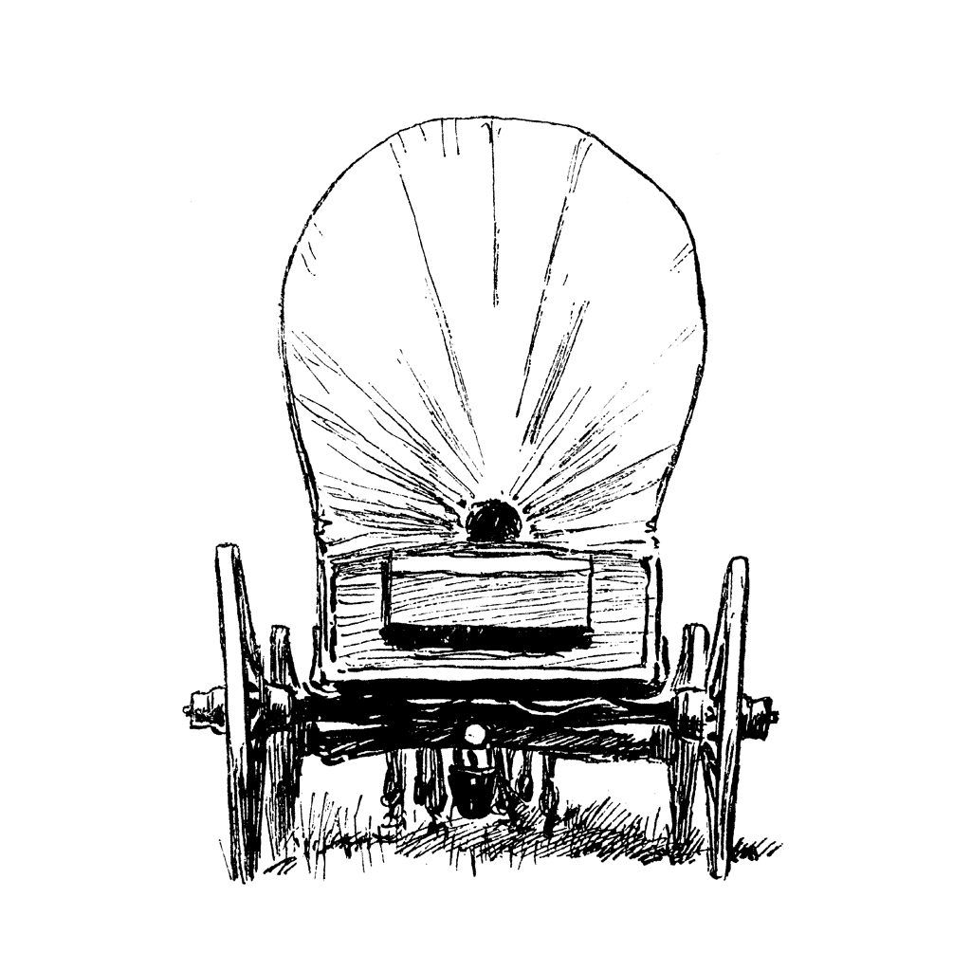
Why is Laura’s family moving away from The Big Woods of Wisconsin?
A. The Ingalls family was afraid of coyotes in the area.
B. Baby Carrie was sick and they went in search of a hospital.
C. Pa said there were too many people in The Big Woods.
D. Road trip!

Slide 21
Why is Laura’s family moving away from The Big Woods of Wisconsin?
C. Pa said there were too many people in The Big Woods.

Slide 22
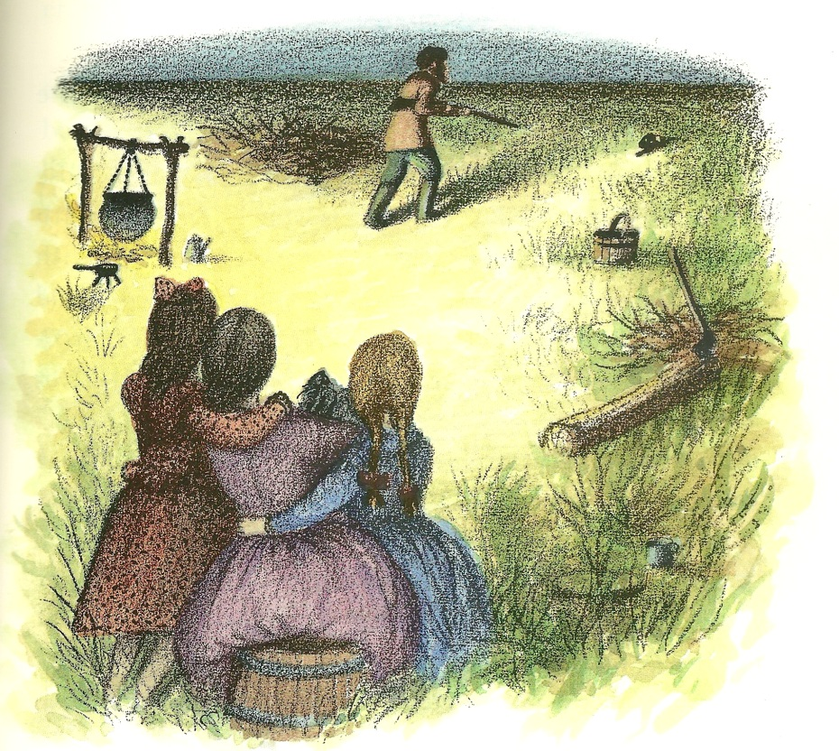
Share your answers.
In Chapter 3, what animal finds its way to the Ingalls’s camp the first night on the prairie?
Share in chat, on your mic, or on webcam!

Slide 23
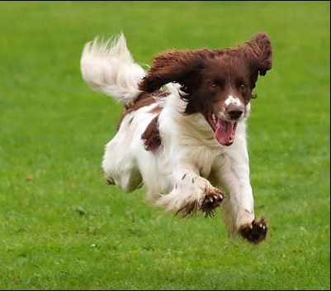
Share your answers.
In Chapter 3, what animal finds its way to the Ingalls’s camp the first night on the prairie?
Jack finds his way to the Ingalls’s camp!
(Yaaaaay!)

Slide 24
Share your answers.
Would you like to live in the time that Laura lived? Why or why not? Give examples from the text to support your answer.
Share on your mic, webcam or in chat!

Slide 25
What did you Notice & Note
in chapters 1-3?
Share on your mic, webcam or in chat!

Slide 26
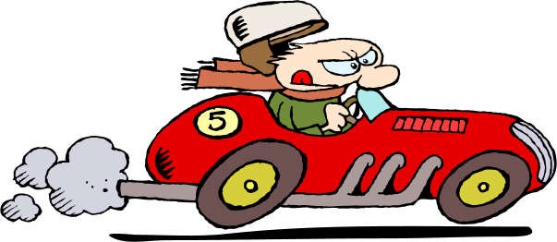
Are you ready to
?

Slide 27
When answering questions about the story, use evidence to prove you are correct!

Slide 28
A complete response contains…

Slide 30
Would you like to live in the time that Laura lived? Why or why not? Give examples from the text to support your answer.
Open-ended Response Question
Restate the question.
Answer the question.
Cite evidence from the story (a “direct quote”).
Explain.
I would not like to live in the time that Laura lived because everything was so hard, especially travelling for such a long time. On page 13-14 Laura wrote, “Day after day they traveled in Kansas and saw nothing but the rippling grass and enormous sky.” and “Next day the land was the same, the sky was the same, the circle did not change. Laura and Mary were tired of them all. There was nothing new to do and nothing new to look at.” I believe it would be uncomfortable and pretty boring to travel by covered wagon for weeks and weeks at a time. According to the story, even Mary and Laura were tired of it!

Slide 31
READ ALOUD!

Slide 32
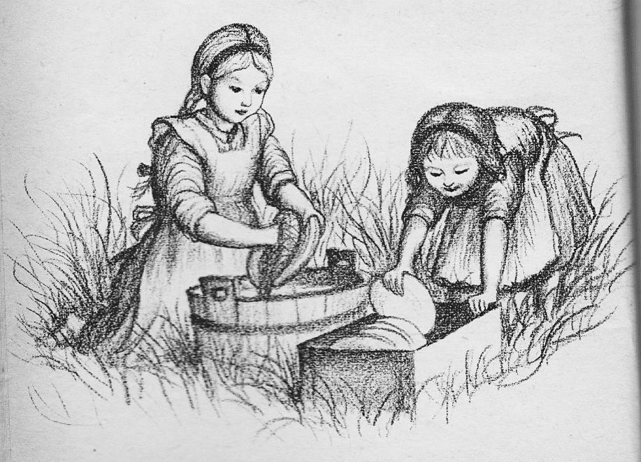
Chapter 5
The House on the Prairie
Laura and Mary were up earlier than the sun. They ate their breakfast of cornmeal mush with prairie-hen gravy, and hurried to help Ma wash the dishes. Pa was loading
everything else into the
wagon and hitching up
Pet and Patty.

Slide 33
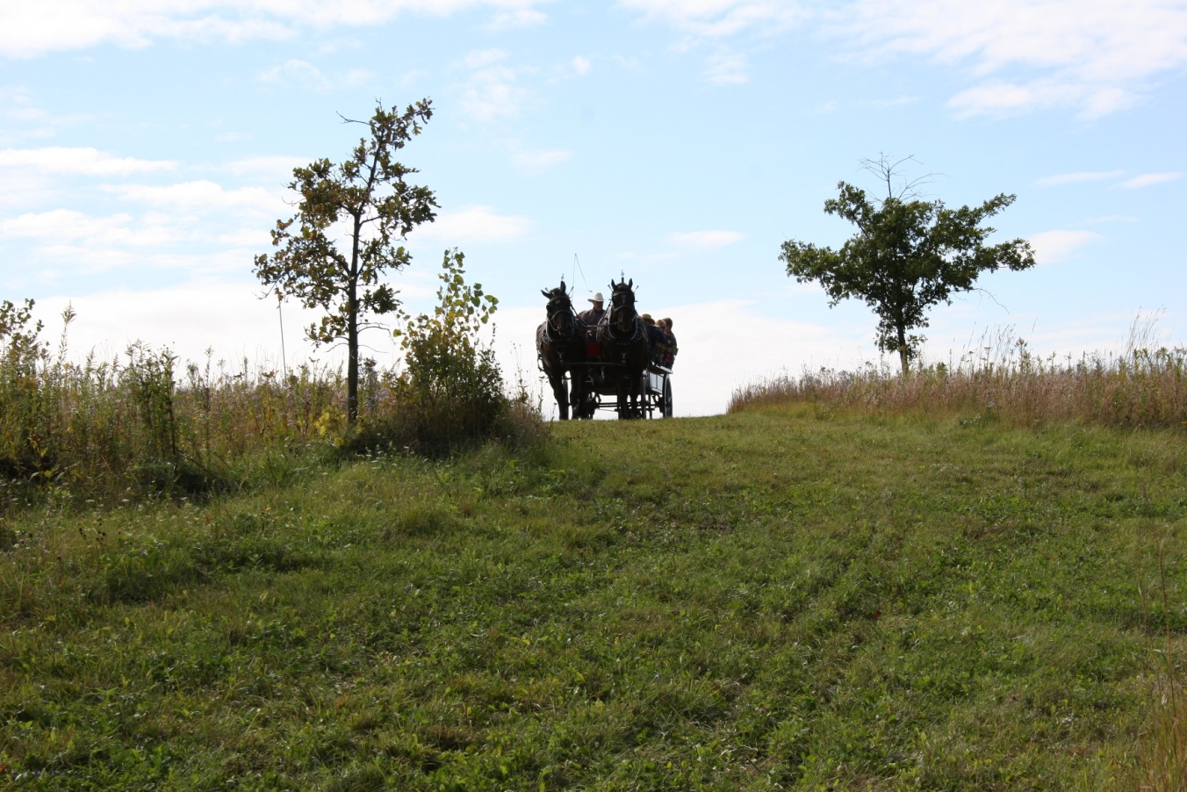
When the sun rose, they were driving on across the prairie. There was no road now. Pet and Patty waded through the grasses, and the wagon left behind it only the tracks of its wheels.

Slide 34
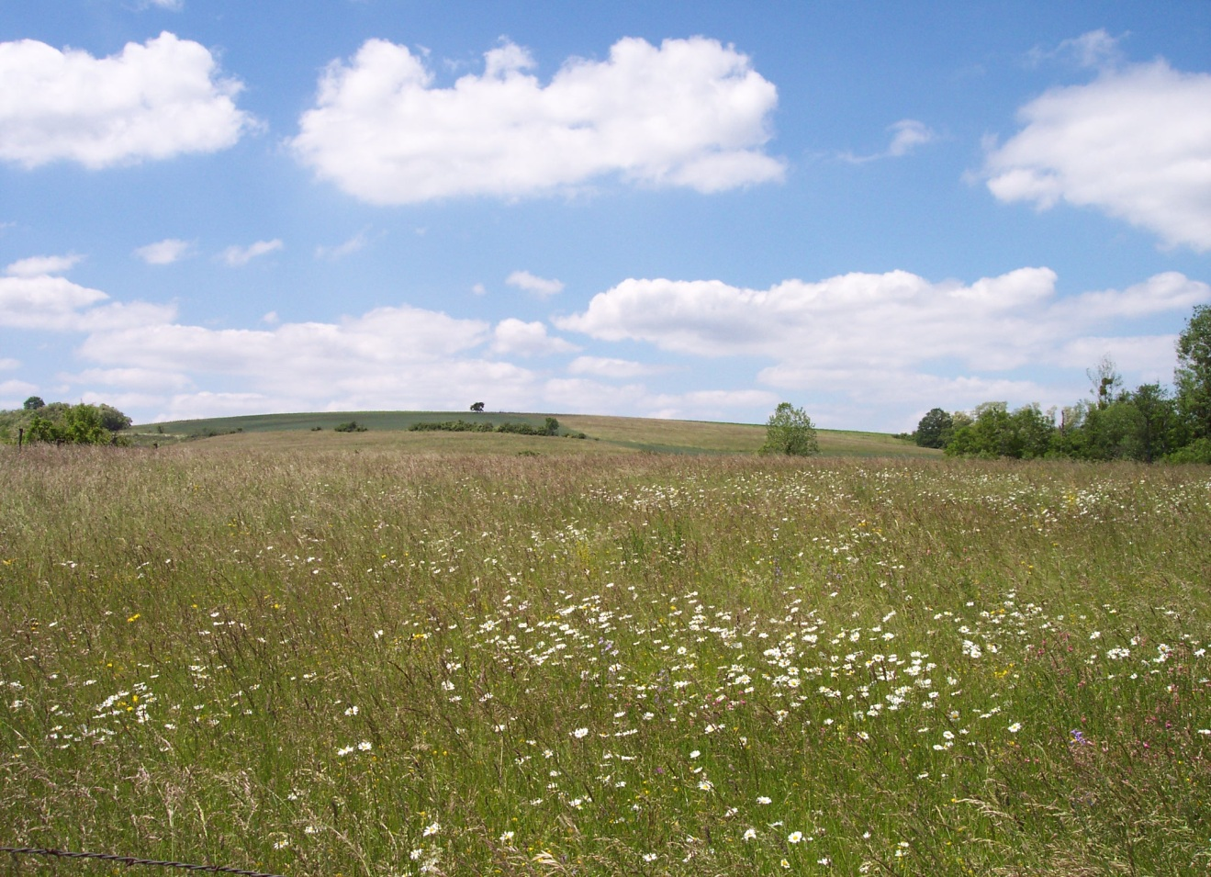
Before noon, Pa said, “Whoa!” The wagon stopped.
“Here we are, Caroline!” he said. “Right here we’ll build our house.”
Laura and Mary scrambled over the feed box and dropped to the ground in a hurry. All around them there was nothing but grassy prairie spreading to the edge of the sky.

Slide 35
TO DO:
Read Chapters 4-6.
Notice & Note as you read
(mark your book, use sticky notes, and/or write notes in your spiral).
Complete the weekly assignment before our next Class Connect.
Be prepared to share your thoughts, assignment responses, and notes with the class!

Slide 36
