Slide 1
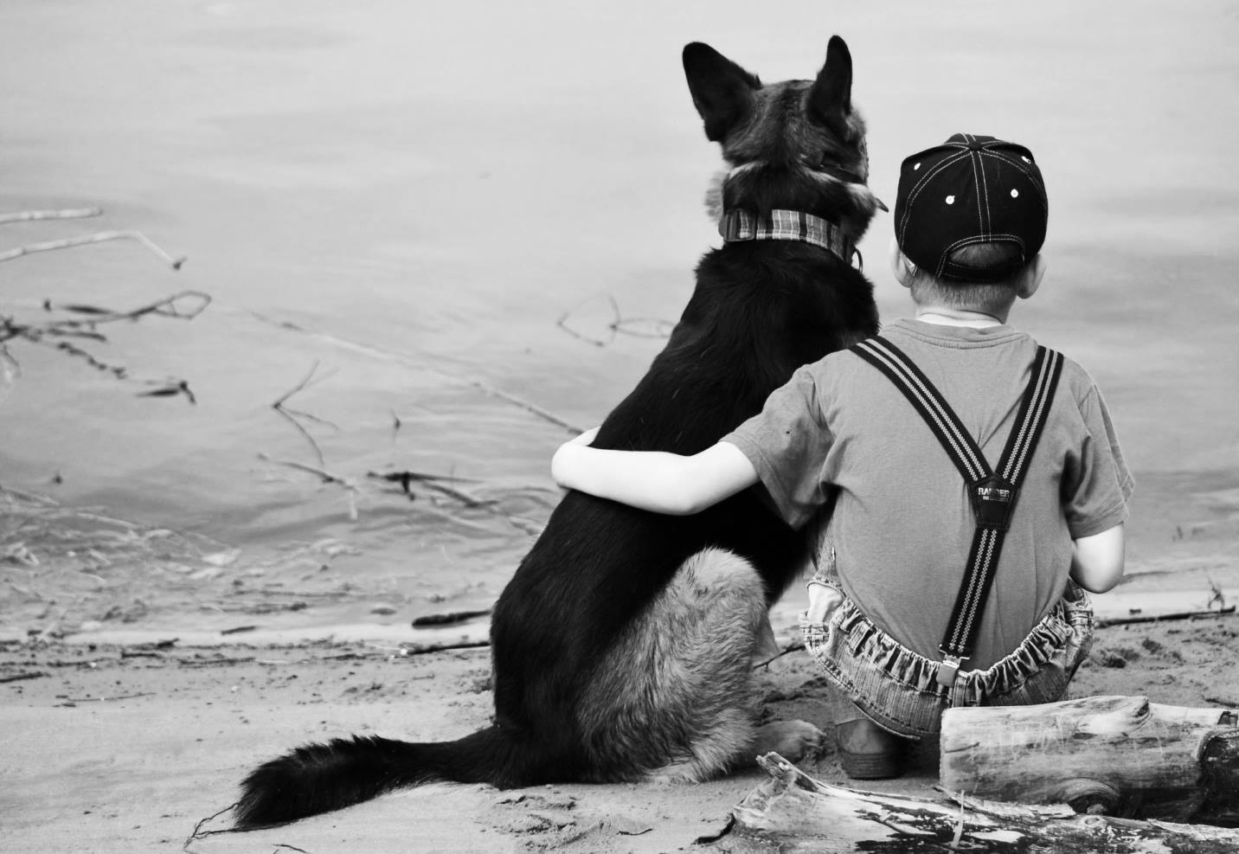
HENRY HUGGINS
by Beverly Cleary
Chapter 5 Review

Slide 2
“I worked with a lively little band of school boys. They were nonreaders, and in those days it was very hard to find books for little boys. There were animal stories, of course, but there weren't any books about what these boys called ‘kids like us.’”
- Beverly Cleary

Slide 3
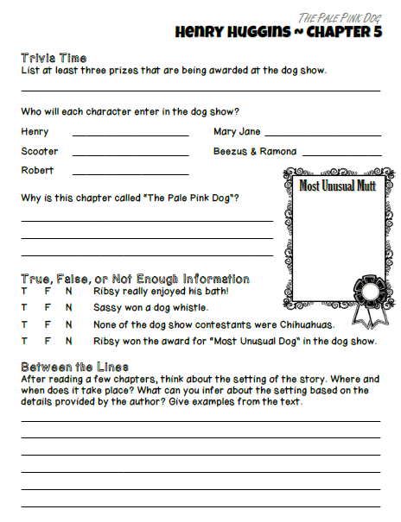
Chapter 5
For today’s class…
make sure you have your completed study guide page and a pen or pencil to correct with.

Slide 4
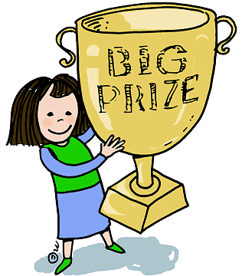
List at least three prizes that are being awarded at the dog show.

Slide 5
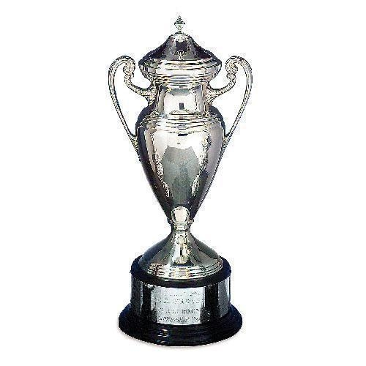
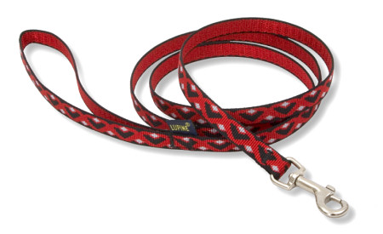
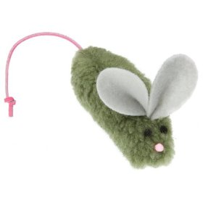
List at least three prizes that are being awarded at the dog show.
"Say, look at the list of prizes!" said Robert. "Woofies Dog Food, squeaking mice, feeding dishes, leashes, movie tickets, beanies, silver loving cups - a whole lot of stuff."

Slide 6
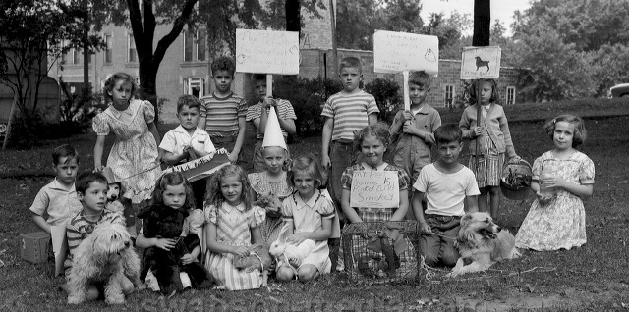
Who will each character enter
in the dog show?
Henry:
Scooter:
Robert:
Mary Jane:
Beezus & Ramona:

Slide 7
Who will each character enter
in the dog show?
Henry: Ribsy
Scooter: Rags
Robert: Sassy
Mary Jane: Princess Patricia of Tarabrook
Beezus & Ramona: Puddles

Slide 8
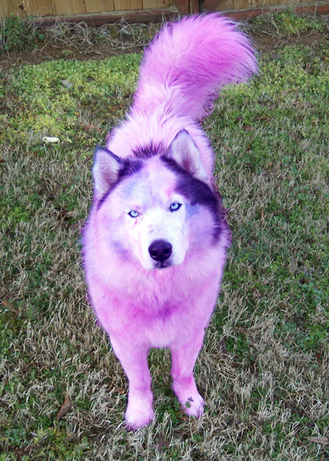
Why is this chapter called
“The Pale Pink Dog”?

Slide 9
The chapter is called “The Pale Pink Dog” because Henry put his mom’s talcum powder on Ribsy and the dog turned pink.
Henry had an idea! If he only had time, he could run home for a can of talcum powder to sprinkle on the white parts of Ribsy! That would cover up the dirt. It didn't matter about the yellow and black and brown parts. The dirt didn't show there much…
Henry was horrified. He could scarcely believe what he saw. The talcum powder wasn't white it was pink! Who ever heard of a dog with pink spots! Quickly he tried to brush the powder off. But Ribsy was still damp and the powder didn't brush off.

Slide 12
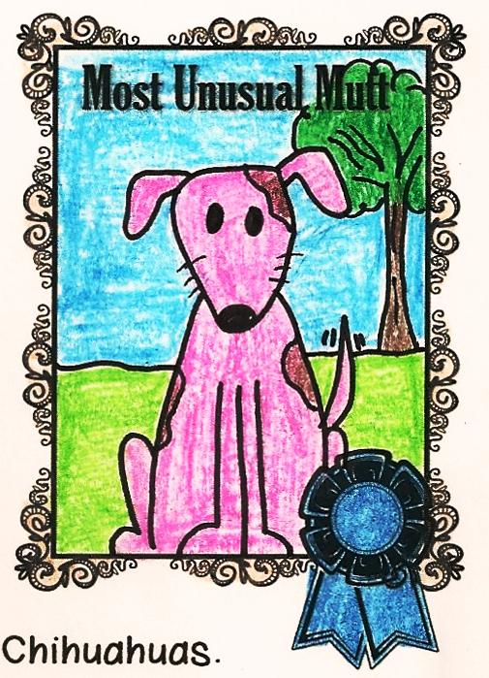
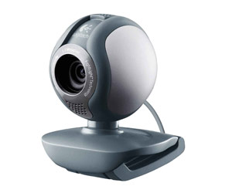
Paste a screenshot on the whiteboard or raise your hand if you would like to share on your webcam.
Notes:
Cut & Paste Student Share

Slide 13
Notice & Note
Is there anything else you’d like to mention about Chapter 5?
Raise your hand if you would like to share on your microphone.

Slide 14
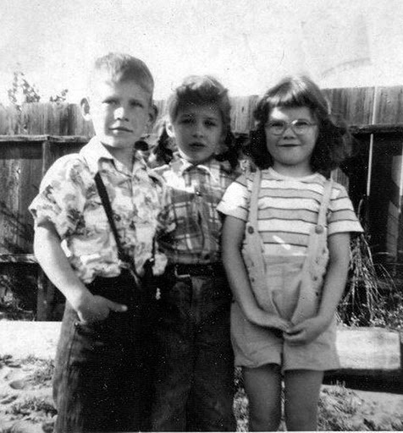
Based on the information in the story, WHEN does Henry Huggins take place?

Slide 15
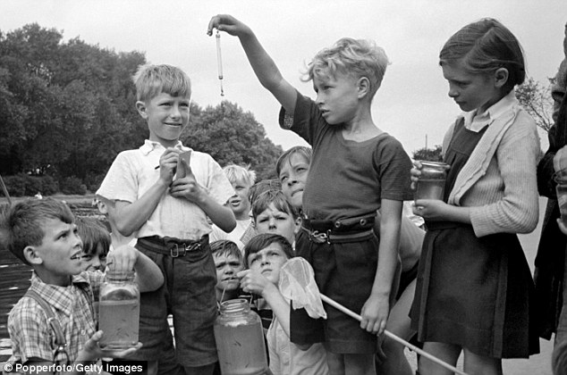
What have you learned about the time period while reading?

Slide 16
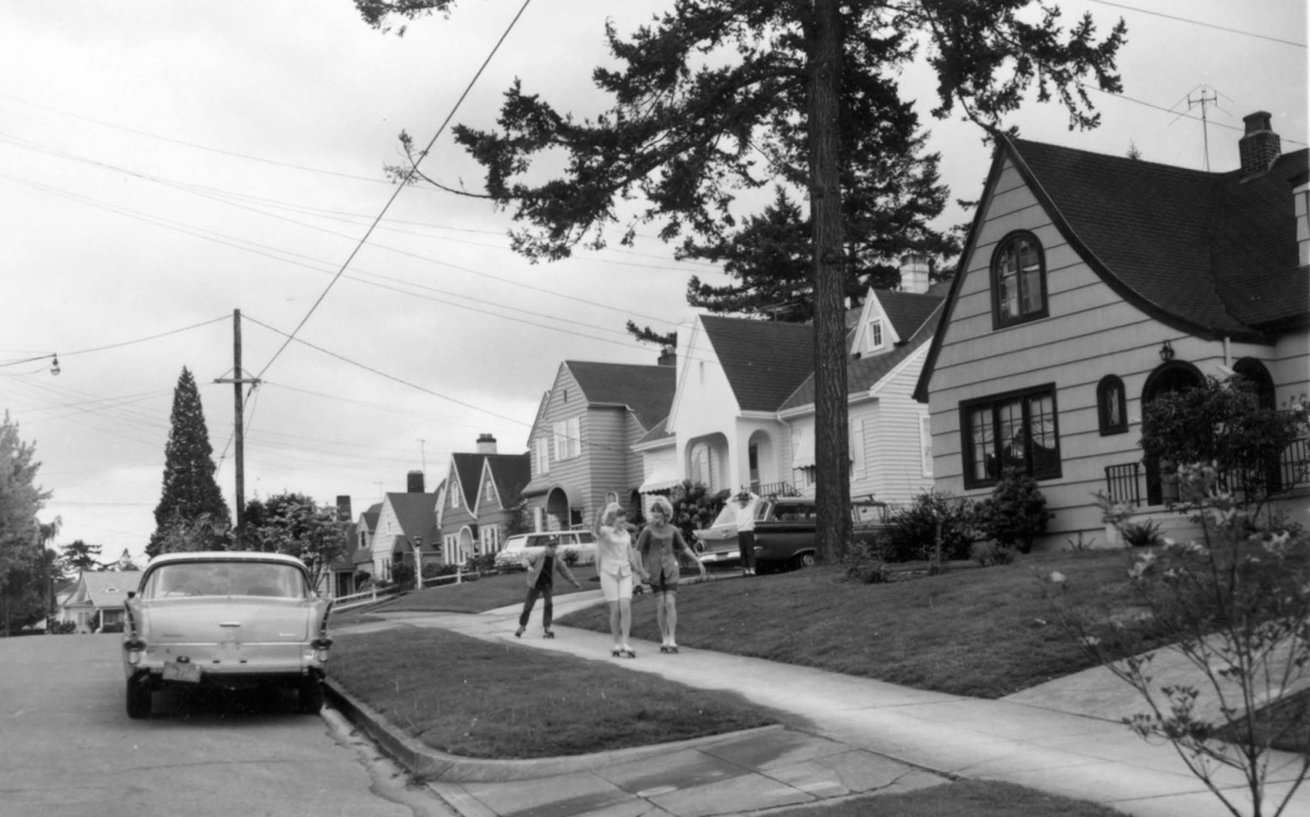
How would the story change if it took place in a different time?

Slide 17
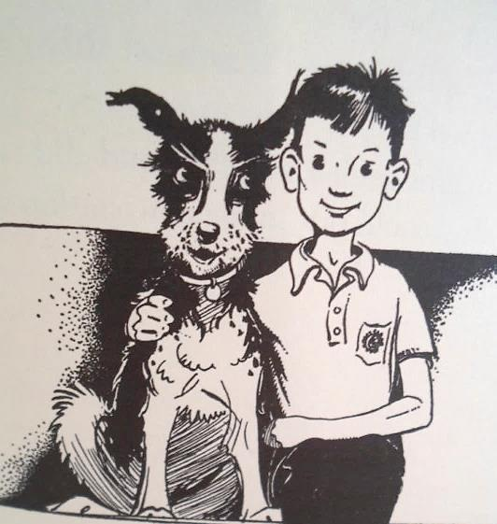
Before reading Chapter 6,
let’s build our

Slide 18
schema: what you know about something; background knowledge.

Slide 19
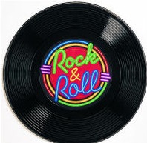
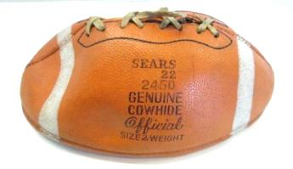
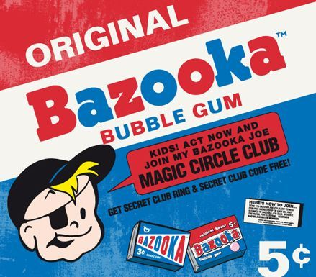
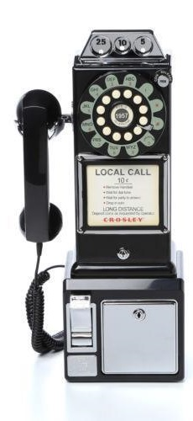
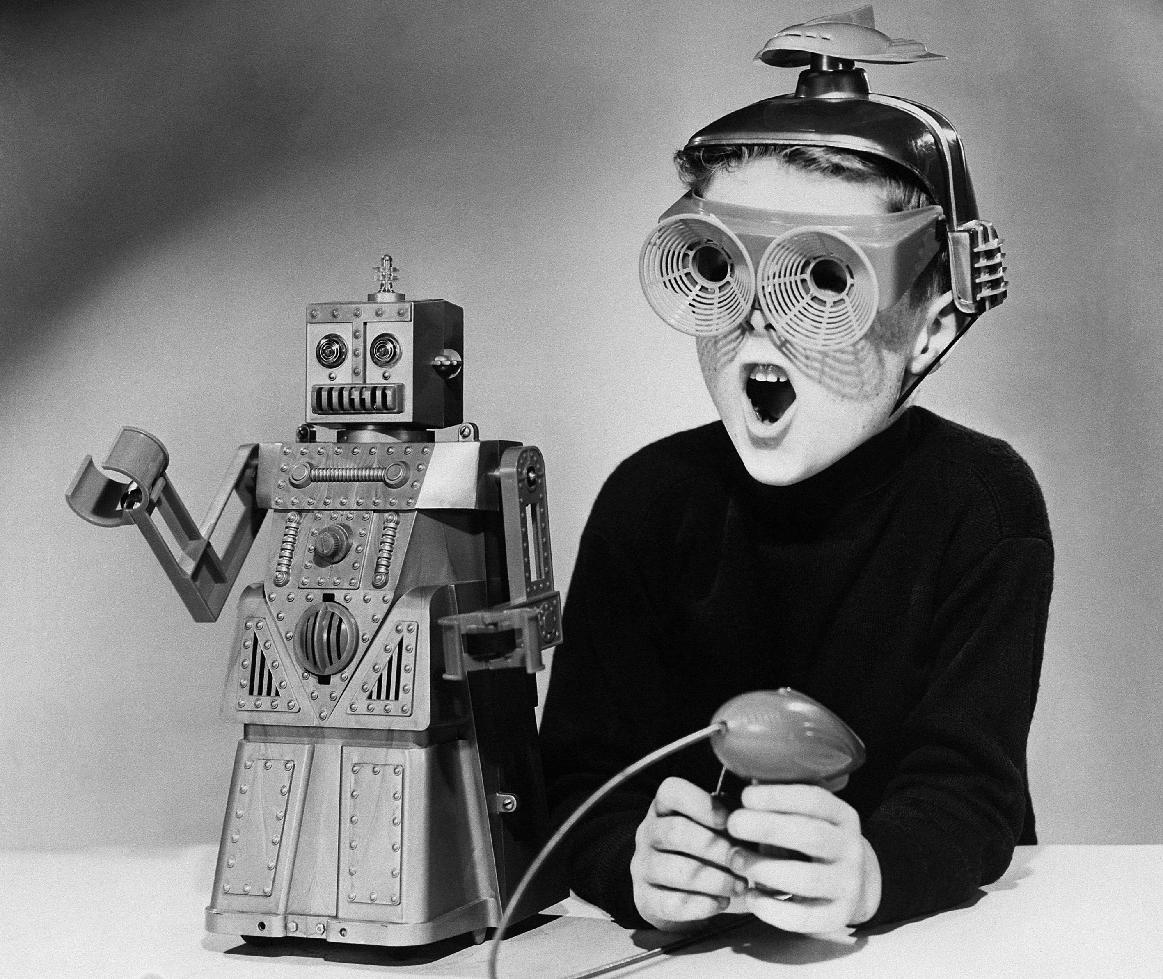
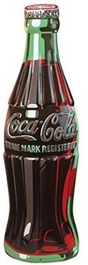
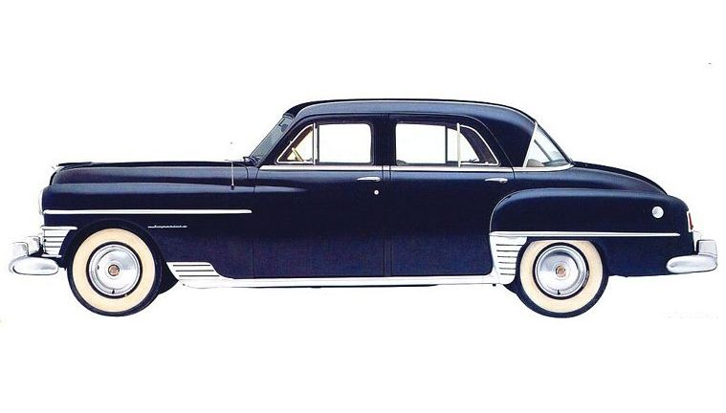
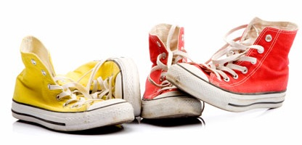
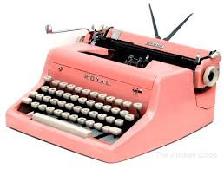
schema:
The 1950s

Slide 20
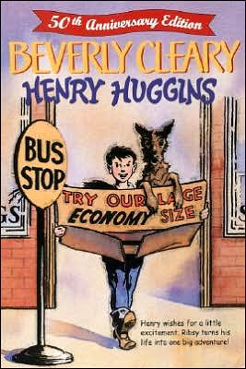
Did you know…
Henry Huggins was originally published in 1950.

Slide 21
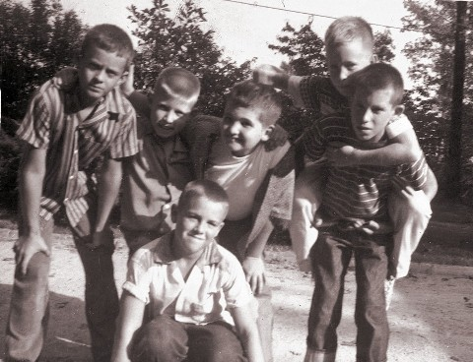
When she worked at the public library, boys asked Beverly Cleary,
“Why aren’t there books about
kids like us?”
So, Beverly wrote books for the boys (and girls) in her neighborhood. The stories took place in the 1950s!

Slide 22
If Henry was 9 years old in 1950.
What year was he born?

Slide 23
If Henry was 9 years old in 1950.
How old was he in 1959?

Slide 24
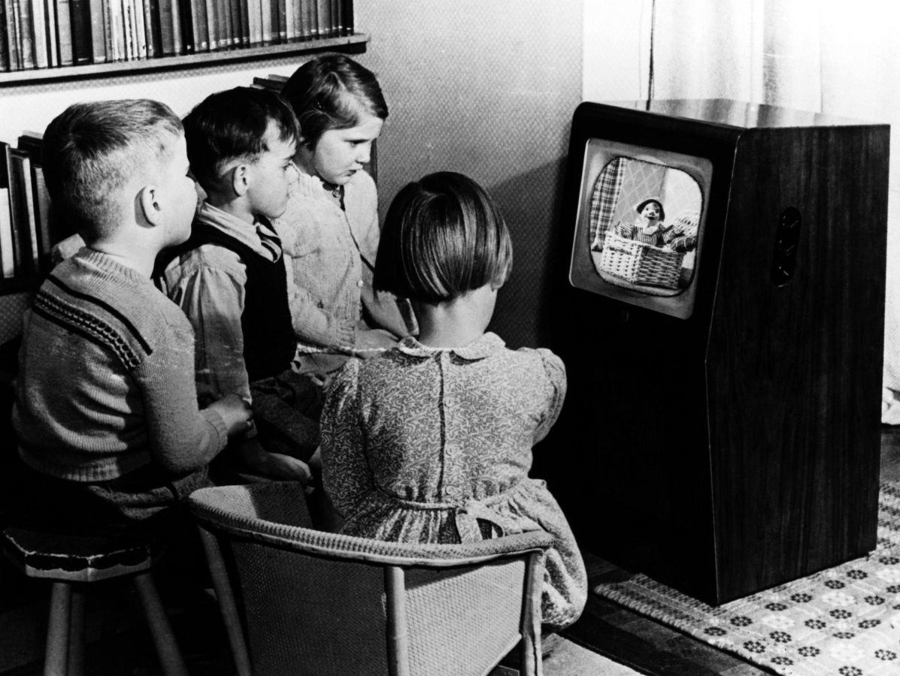
Let’s learn about life in
1950-1959.

Slide 25
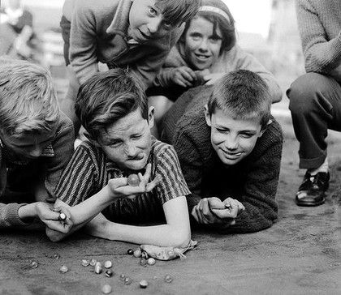
The 1950s
During the 1950s, games, including checkers, marbles and chess as well as card games, such as Go Fish and Old Maid were popular among children.

Slide 26
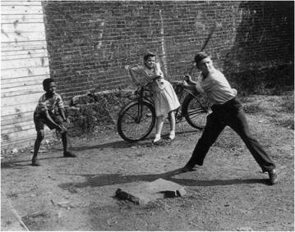
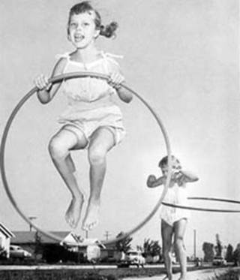
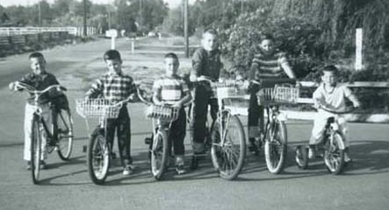
In the 1950s, there were fewer cars on the road, so many children roamed freely on foot. They rode bicycles to the corner store, got muddy exploring neighborhood gullies and played baseball in empty lots.

Slide 27
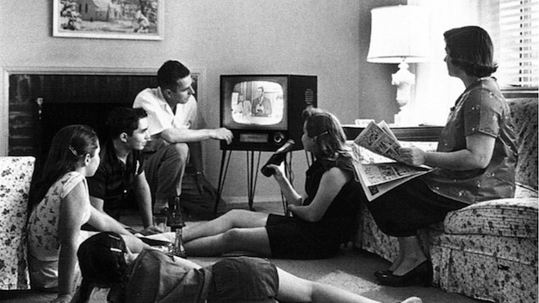
In the evenings after dinner families would listen to radio programs or watch TV for entertainment. The whole family watched the same television show, since there was only one TV in the house (if they had one at all!). There were only three channels, ABC, NBC and CBS.

Slide 28
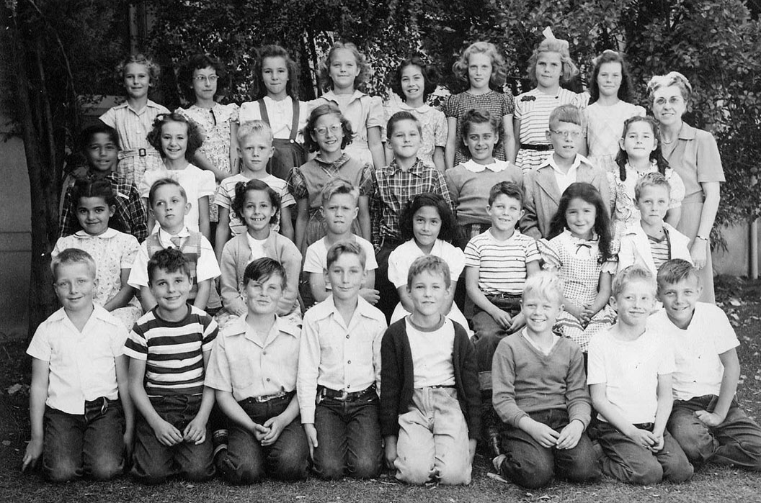
Mrs. Anderson's 3rd Grade Class, 1950.
This is probably what Henry and his classmates looked like!
In the 1950s, students arrived at elementary schools on foot, by bike, by bus, or by car. Like today, elementary school consisted of individual classes for each grade.

Slide 29
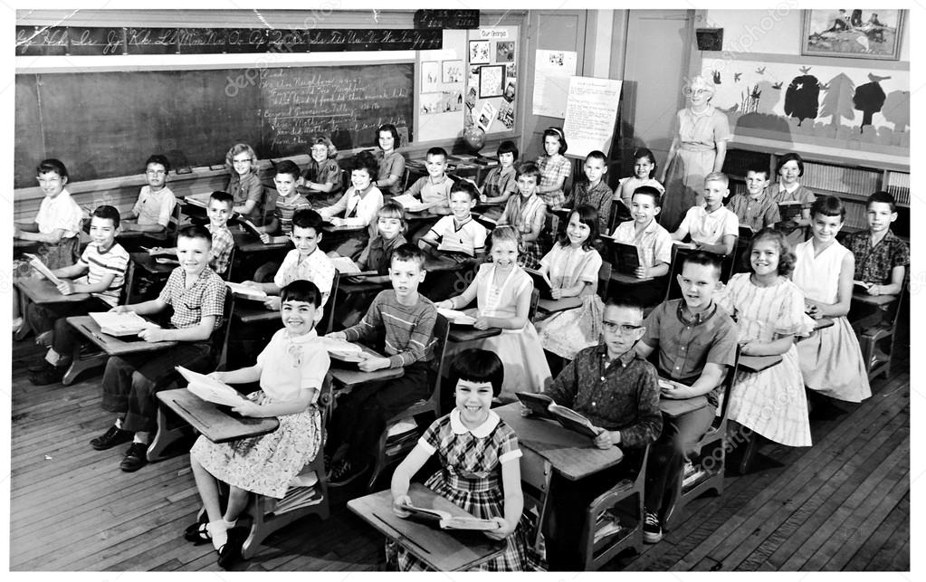
Due to a large increase in the number of school-age children in the United States following the post World War II baby boom, more teachers became necessary,
and more schools were built in the 1950s.

Slide 30
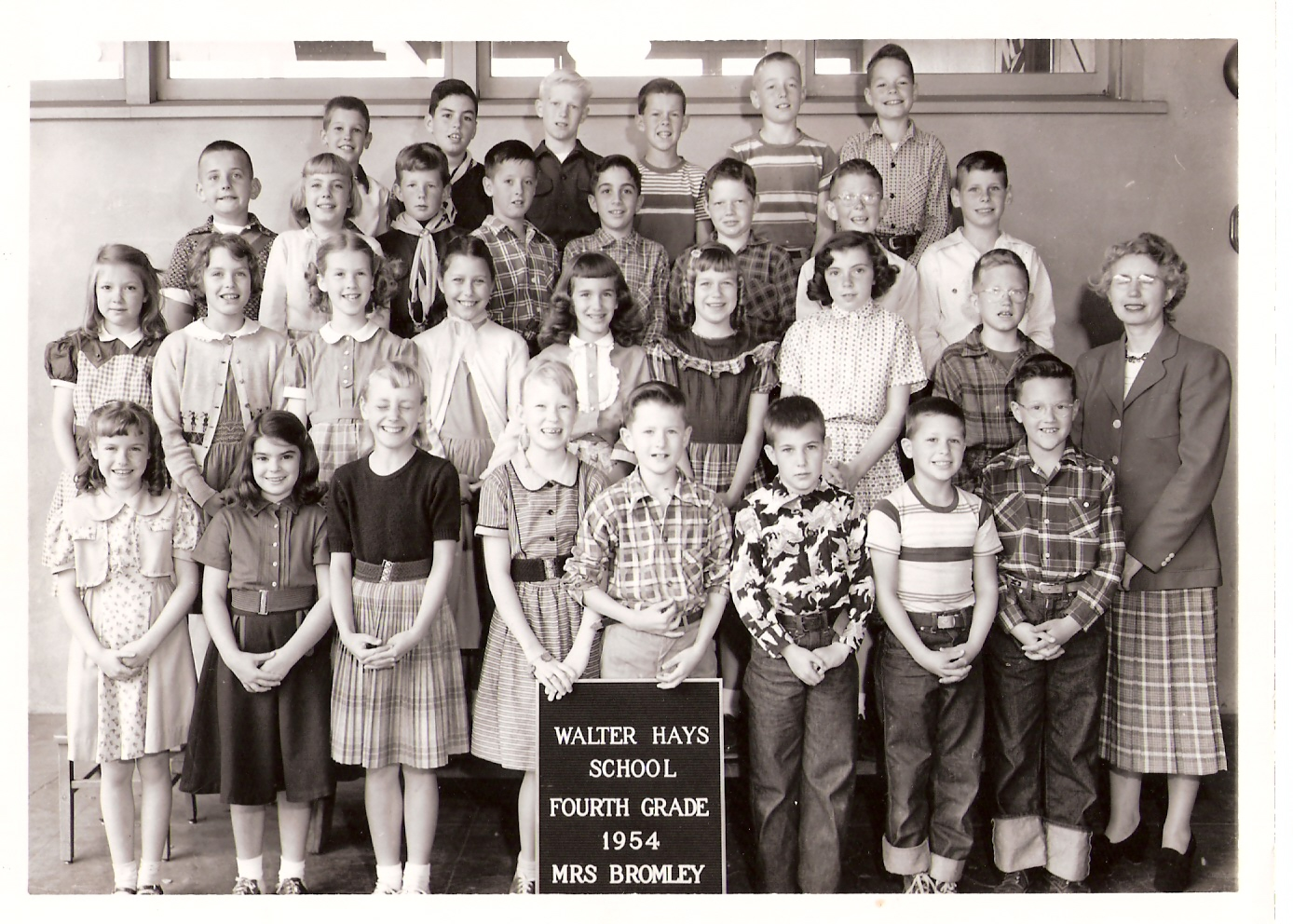
In the 1950s, boys were given permission to wear jeans to school. Girls wore skirts and dresses, since schools frowned upon girls in trousers. Students would change out of their “school clothes” and into their “play clothes” as soon as they got home from school.

Slide 31
Fast Facts
from the
Fifties!

Slide 32
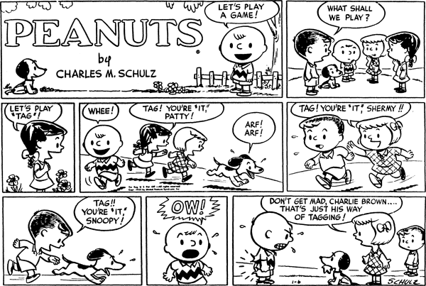
1950
The very first Peanuts comic strip, written by Charles M. Schulz, appeared in seven newspapers on October 2, 1950.

Slide 33
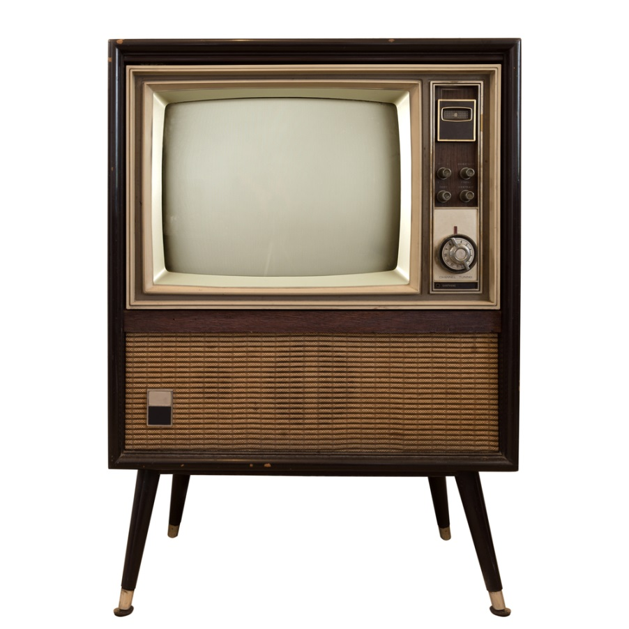
1951
In 1951, the color television was introduced.
On June 25, 1951, CBS broadcast the very first commercial color TV program. Unfortunately, nearly no one could watch it since most people had only black-and-white televisions.

Slide 34
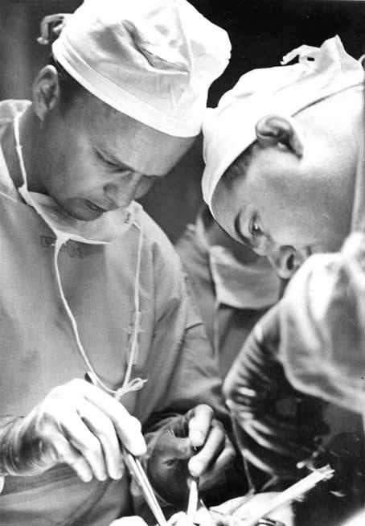
1952
February 6 – In the United States, a mechanical heart is used for the first time in a human patient.
September 2 – Dr. C. Walton Lillehei and Dr. F. John Lewis perform the first open-heart surgery at the University of Minnesota.
December 14 – The first successful surgical separation of Siamese twins is conducted in Mount Sinai Hospital, Cleveland, Ohio.

Slide 35
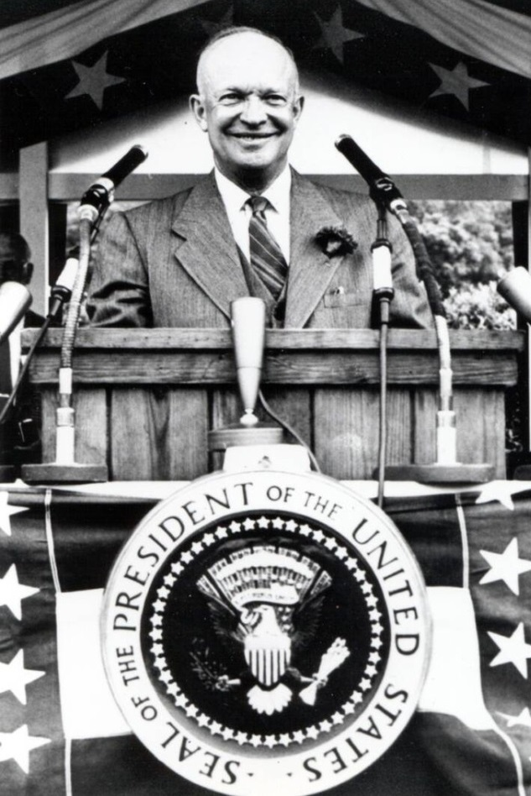
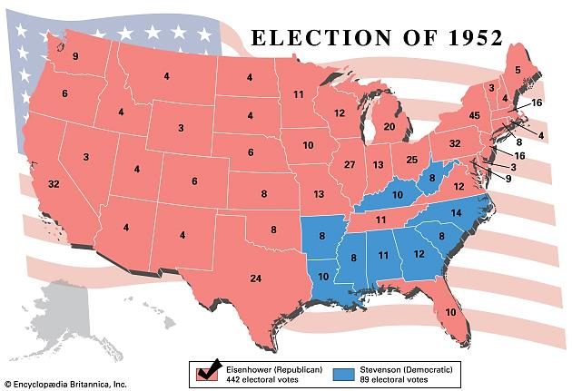
1953
On January 20, 1953, Dwight D. Eisenhower became the 34th U.S. president. This five-star general launched the Space Race and created the federal interstate highway system.

Slide 36
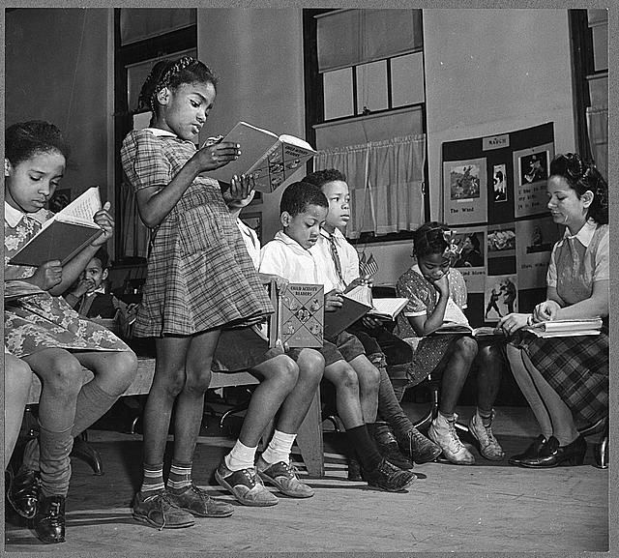
1954
On May 17, 1954, the Supreme Court ruled that segregation was "inherently unequal“ and declared state laws establishing separate public schools for black and white students to be unconstitutional.

Slide 37
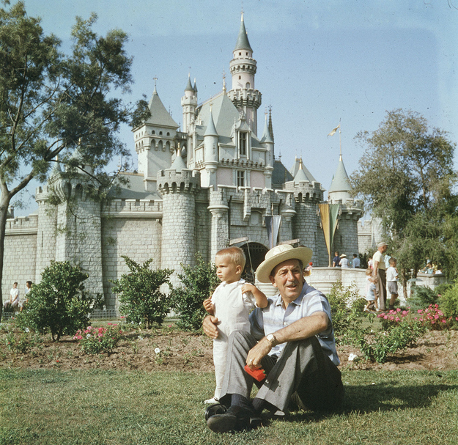
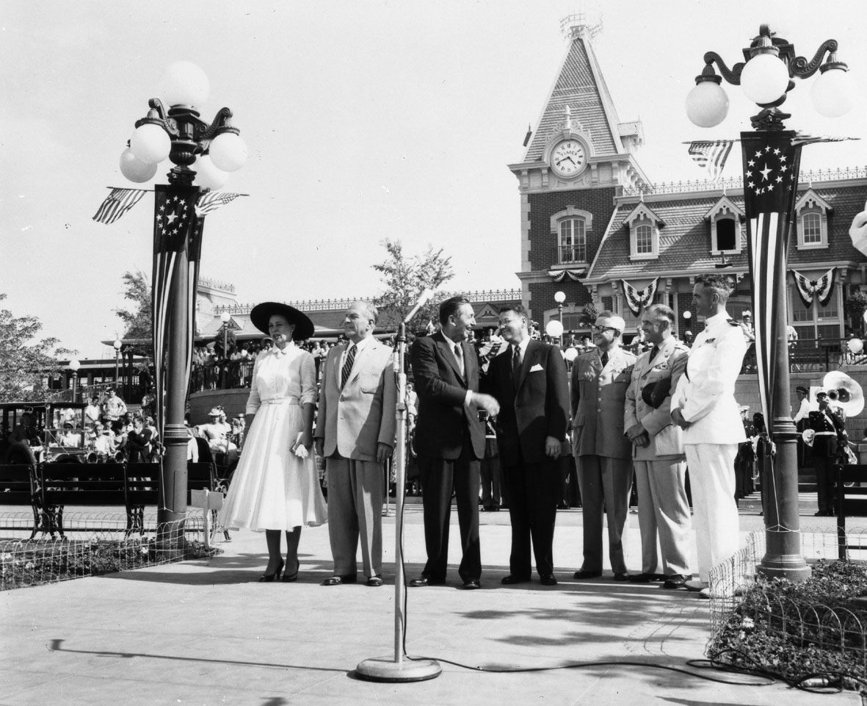
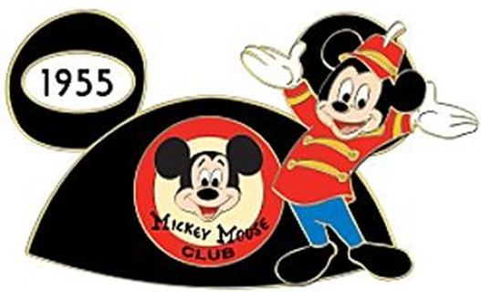
1955
On July 18, 1955, Disneyland officially opened to the public. Disneyland, located in Anaheim, California on what used to be a 160-acre orange orchard, cost $17 million to build.

Slide 38
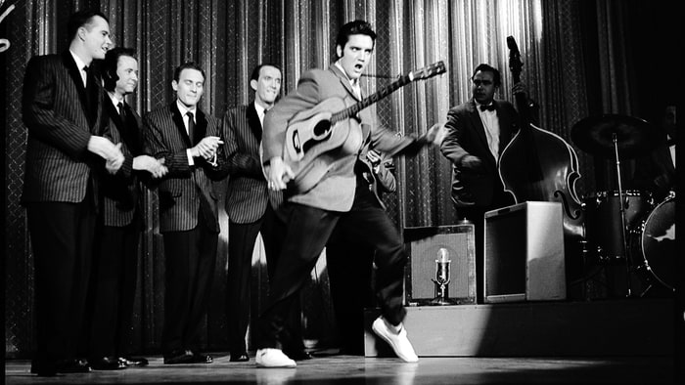
1956
On January 28th, 1956 with his first national appearance television, Elvis Presley shattered viewership records and helped bring rock & roll into American living rooms.

Slide 39
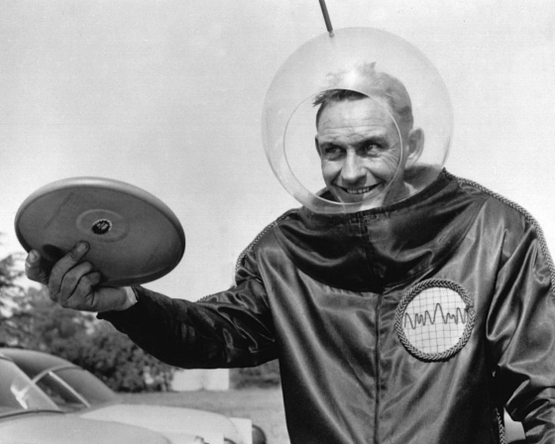
1957
Jan 13, The Wham-O Company produced the 1st Frisbee. This flying disk was originally called the “Pluto Platter” as an attempt to cash in on the public craze over space and Unidentified Flying Objects (UFOs).
Wham-O also created the
Hula-Hoop, the Super Ball
and the Water Wiggle.

Slide 40
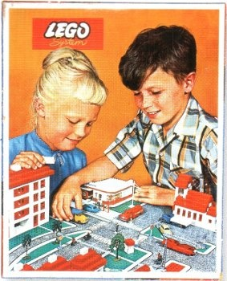
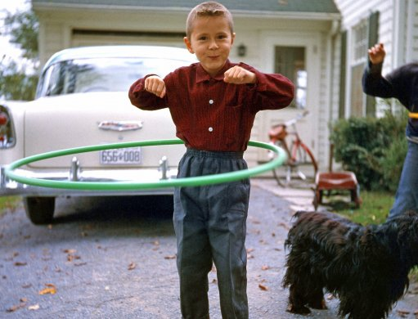
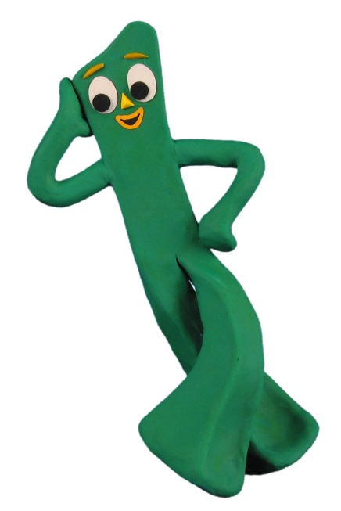
1958
Hula Hoops became a popular toy and Lego Toy Bricks were first introduced to American children in 1958.
Other popular toys
in 1950s included:
Electric train sets
Red Ryder toy guns
Pogo sticks
Silly Putty
Mr. Potato Head
Gumby
Matchbox Cars

Slide 41
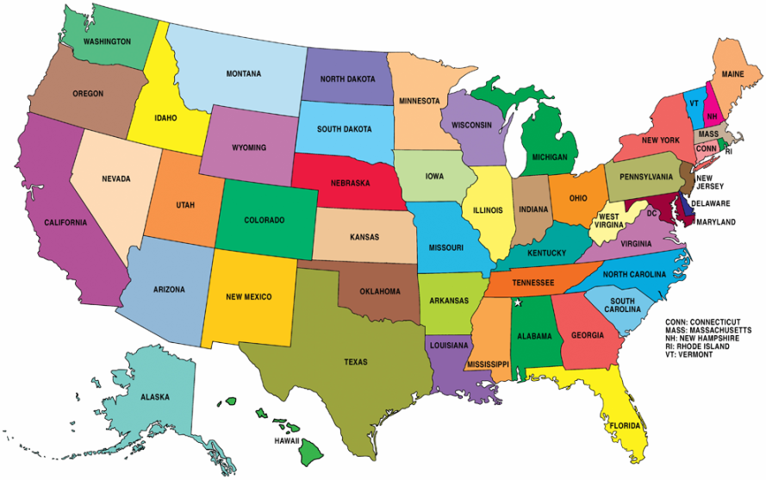
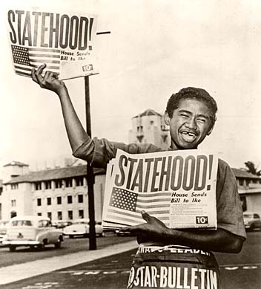
1959
Alaska became the 49th state and Hawaii became the 50th state of the United States in 1959.

Slide 42
Take a look at this diner menu from the 1950s.
How much would a baked ham and cheese sandwich and a milkshake cost at Woolworth’s diner?

Slide 43
One more thing…
In the 1950s, you could see
two movies at the theater for 25¢
(with a cartoon in between).

Slide 44
Compare & Contrast
Student Names: ______________________
1950s
Today
BOTH
Based on the information in Henry Huggins and our schema-building lessons…
How are these two time periods similar?
How are they different?

Slide 45
Compare & Contrast
Student Names: ______________________
1950s
Today
BOTH

Slide 47
Chapter 6 – Finders Keepers
"Hey, you kids!"
It was a strange voice. The children stopped quarreling to see who it was. A strange boy was sitting astride a bicycle by the curb. He was a big boy, big enough to be in the seventh or eighth grade. He didn't belong on Klickitat Street and none of them had ever seen him before.
"I've been yelling at you for five minutes," he said and grinned. "Is one of you Henry Huggins?"
Henry was so surprised he didn't answer. Who was this boy and how did he know his name? Robert nudged Henry, who remembered he hadn't answered.
"Oh yes," he said, "that's me."

Slide 48
The boy reached into the pocket of his jeans and pulled out the newspaper clipping that showed Henry and Ribsy at the dog show. Henry couldn't understand why this strange boy was carrying that picture with him. Just then Ribsy began to bark furiously and Henry saw him running down the street toward them.
"Dizzy!" the boy shouted and sprang from his bicycle. "Here, Dizzy!" Ribsy jumped up on the boy and licked his hands. The boy laughed and patted him and, when Ribsy would stand still long enough, scratched him behind his left ear.
That's funny, thought Henry. How does he know Ribsy likes to be scratched behind his left ear? And why does he call him Dizzy? "His name isn't Dizzy," he said to the boy.

Slide 49
Text Connections !
How does the information in the text relate your to own life, ideas or experiences?
Does this passage remind you of a book you’ve read, a television show or a movie you’ve seen?

Slide 50
Assignment
Read Chapter 6.
Complete the Chapter 6 study guide page before our next class!

Slide 51
Enjoy Chapter 6:
“Finders Keepers”

