Slide 1
Writing an
Editorial
INTRODUCTION
Body Paragraphs
Transitional phrases
Conclusion

Slide 2
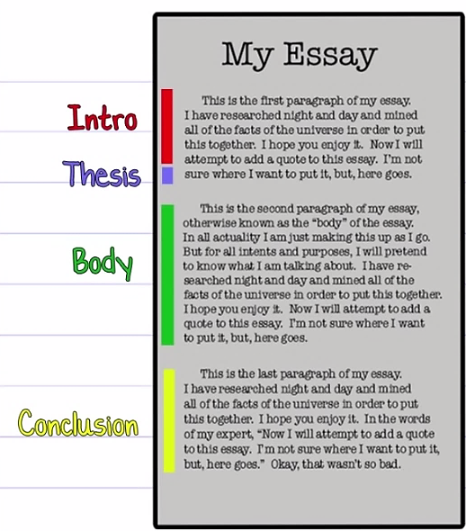
PARTS OF AN EDITORIAL
Introduction: The first paragraph includes a thesis statement explaining what the topic is, and what the editorial writer’s opinion is.
Body: The middle paragraphs give background information about the issue. Even more importantly, they give facts and reasons explaining the writer’s opinion.
Conclusion: The final paragraph often restates the thesis and encourages readers to think in a different way or to take action!

Slide 3
WRITING GOALs: INTRODUCTION
I CAN WRITE A INTRODUCTION PARAGRAPH THAT:
Grabs the reader’s attention WITH a “hook”
GIVES A QUICK OVERVIEW of the essay topic
ENDS with a thesis statement that reveals the position I WILL TAKE ON THE TOPIC

Slide 4
1. Hook the Reader!
Your persuasive essay should start in a way that makes the reader want to keep reading. These gripping introductions are called “hooks” because they hook the fish reader!

Slide 5
Start your essay with…
A Strong statement:
1 out of every 4 car accidents in the United States
is caused by texting and driving.
A Quotation:
Former US Attorney General Loretta Lynch once said, “We all have a responsibility to protect endangered species, both for their sake and for the sake of our own future generations.”
A Question:
Have you ever considered how many
books we'd read if it were not for television?

Slide 6
2. Add a Quick Overview
In1-2 sentences…
Explain the issue you are
concerned about.

Slide 7
3. Add Your Thesis Statement

Slide 8
Sample Introduction Paragraph
Did you know that 90% of the cheetah population has died in the past 100 years? In fact, only 7,000 cheetahs remain worldwide today. This is because cheetahs are being hunted for their fur and they have also suffered habitat loss. Many organizations such as the Cheetah Conservation Fund are dedicated to saving cheetahs and are trying to raise their population. It is important to do what we can to save wild cheetahs because they keep the ecosystem in balance, they prevent overpopulation, and they are amazing mammals that are quickly heading towards extinction.

Slide 9
Sample Introduction Paragraph
Did you know that 90% of the cheetah population has died in the past 100 years? In fact, only 7,000 cheetahs remain worldwide today. This is because cheetahs are being hunted for their fur and they have also suffered habitat loss. Many organizations such as the Cheetah Conservation Fund are dedicated to saving cheetahs and are trying to raise their population. It is important to do what we can to save wild cheetahs because they keep the ecosystem in balance, they prevent overpopulation, and they are amazing mammals that are quickly heading towards extinction.
Grabs the reader’s attention WITH a “hook”
GIVES A QUICK OVERVIEW of the essay topic
ENDS with a
thesis statement that INCLUDES Your Opinion on the issue.

Slide 10
WRITING GOALs: body paragraphs
I CAN Develop 3 body paragraphs, EACH with a topic sentence that is supported by background information, persuasive details, facts and reasons explaining my opinion.
I WILL MAKE SURE ALL OF THE BODY PARAGRAPHS SUPPORT MY THESIS STATEMENT.
I WILL USE TRANSITIONS TO link sentences and transition smoothly from point to point.

Slide 11
Writing the Body
The 3 middle paragraphs
give facts, evidence and reasons that support your opinion.
Write 1 paragraph for each “reason” listed in your thesis statement.
.

Slide 12
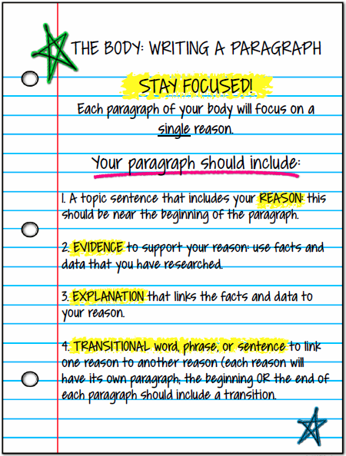
INTRODUCTION
BODY: REASON 1
BODY: REASON 2
BODY: REASON 3
conclusion

Slide 13
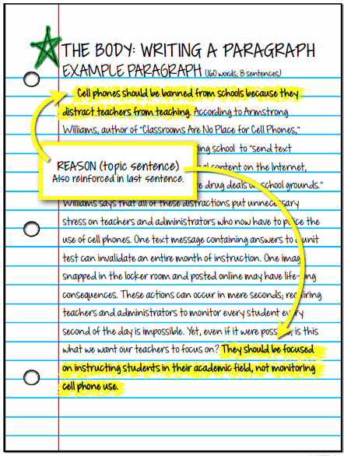
INTRODUCTION
BODY: REASON 1
BODY: REASON 2
BODY: REASON 3
conclusion

Slide 14
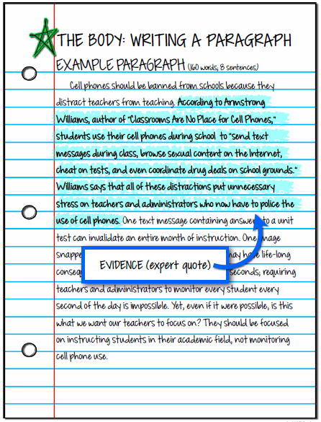
INTRODUCTION
BODY: REASON 1
BODY: REASON 2
BODY: REASON 3
conclusion

Slide 15
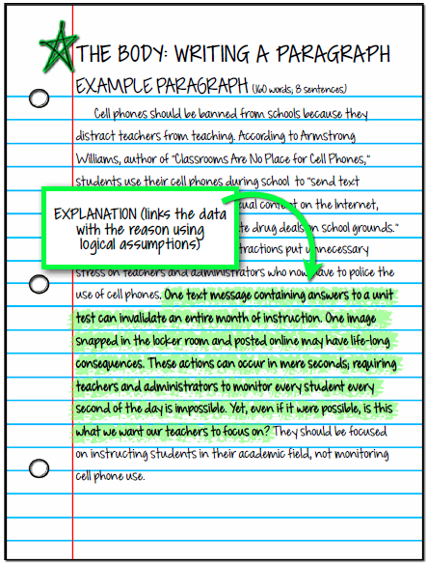
INTRODUCTION
BODY: REASON 1
BODY: REASON 2
BODY: REASON 3
conclusion

Slide 16
INTRODUCTION
BODY: REASON 1
BODY: REASON 2
BODY: REASON 3
conclusion

Slide 17
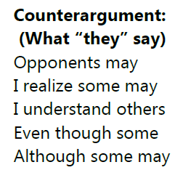
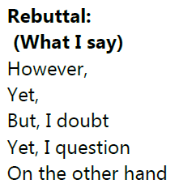
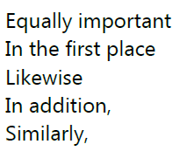
Transitional phrases
link sentences and transition smoothly from point to point.

Slide 18
Sample Body Paragraph 1
Our town needs the Paws and Purrs animal shelter. The facility takes care of injured wild animals as well as giving homes to stray cats and dogs. Keeping the shelter open is important for our community. According to Dr. Moore, a local veterinarian, “The shelter takes care of more than 500 animals a year. Since there is no other shelter in the area, without the Paws and Purrs shelter these animals would likely be destroyed.”

Slide 19
Sample Body Paragraph 1
Our town needs the Paws and Purrs animal shelter. The facility takes care of injured wild animals as well as giving homes to stray cats and dogs. Keeping the shelter open is important for our community. According to Dr. Moore, a local veterinarian, “The shelter takes care of more than 500 animals a year. Since there is no other shelter in the area, without the Paws and Purrs shelter these animals would likely be destroyed.”
Adding a quote from an expert, helps to PERSUADE!

Slide 20
Don’t forget to state the main arguments against your opinion too.
Then show the problems with those arguments!

Slide 21
Sample Body Paragraph 2
I realize some people say that there are more important things to donate their money to. It's true there are many good causes worthy of support, such as the Friends of the Library and the Jefferson Area Food Bank. However, the way a community cares for its most helpless residents, animals as well as people, tells what that community is like. By raising money to help care for animals that have been abandoned, or are wild and injured, we show that we are a caring community.

Slide 22
Sample Body Paragraph 2
I realize some people say that there are more important things to donate their money to. It's true there are many good causes worthy of support, such as the Friends of the Library and the Jefferson Area Food Bank. However, the way a community cares for its most helpless residents, animals as well as people, tells what that community is like. By raising money to help care for animals that have been abandoned, or are wild and injured, we show that we are a caring community.
Other Opinion
My Response

Slide 23
WRITING GOAL: conclusion
I CAN WRITE A CONCLUSION PARAGRAPH THAT:
Restates the main idea of MY EDITORIAL.
SUPPORTS MY thesis statement.
Summarizes the body paragraphs of MY essay.
Issues a call to action!

Slide 24
Writing the Conclusion
The final paragraph wraps up the essay and leaves your reader with something to think about.
.

Slide 25
Writing the Conclusion
The final paragraph wraps up the essay and leaves your reader with something to think about.
In an editorial, the conclusion is your last chance to
persuade your audience!
.

Slide 26
Writing the Conclusion
When your audience is finished reading your editorial, what you want them to do or believe?

Slide 27
Writing the Conclusion
Restate your thesis.
Reaffirm your persuasive arguments (from the body paragraphs).
Issue a call to action!
Leave your audience with something to think about.

Slide 28
Writing the Conclusion
Restate your thesis.
Reaffirm your persuasive arguments (from the body paragraphs).
Issue a call to action!
Leave your audience with something to think about.
Maybe dogs
ARE better companions…

Slide 29
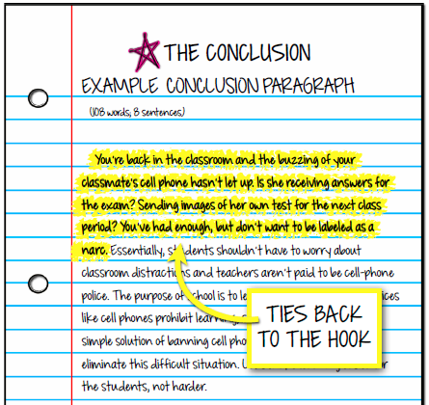
INTRODUCTION
BODY: REASON 1
BODY: REASON 2
BODY: REASON 3
RESTATE THE THESIS
conclusion

Slide 30
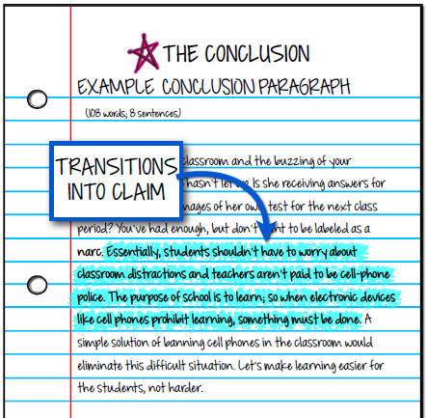
INTRODUCTION
BODY: REASON 1
REAFFIRM YOUR MAIN POINTS
BODY: REASON 2
BODY: REASON 3
conclusion

Slide 31
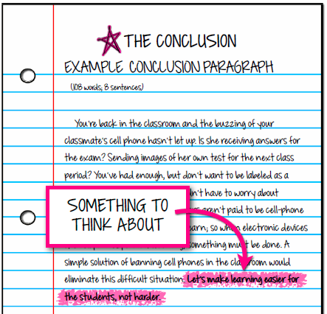
INTRODUCTION
BODY: REASON 1
BODY: REASON 2
BODY: REASON 3
conclusion

Slide 32
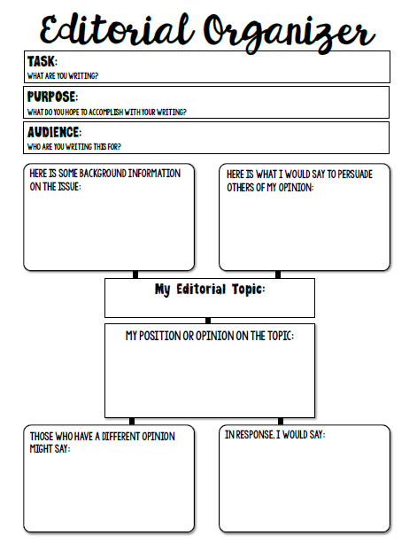
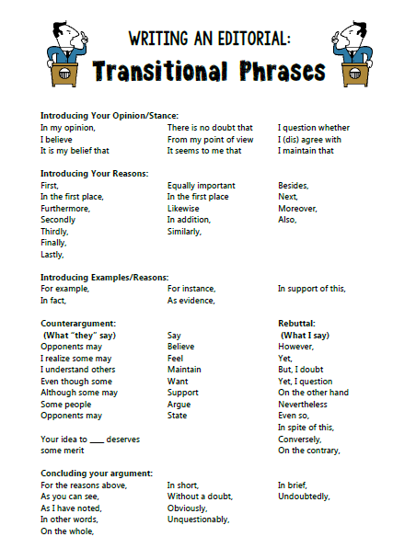
Use Your notebook pages to help
you write your rough draft!

Slide 33
ANY QUESTIONS?

Slide 34
Nice job
today!

