Slide 1
Writing an
Editorial
Editorial Format
Point of View THESIS STATEMENT
RESEARCH

Slide 2
WRITING GOALS:
I can determine my point of view on a topic.
I can include a strong thesis statement within the introduction of the topic when writing an argument.
I can research and provide evidence, facts and details to support my point of view on a topic or issue.

Slide 3
Flashback!
Define these words:
Editorial - An article in which expresses an opinion on a topic or issue.
Persuade – to convince someone.
Opinion - What you think, feel or believe about something.
Fact – A statement that is always true and that can be proven.
Task – The format of A piece of writing. (editorial, narrative, etc.)
Audience - The person, or people, to whom you are writing for.
Purpose - The reason you are writing.
Notes:
Draw a white box over each word or definition and reveal as you go down the list.

Slide 4
Flashback!
Fact:
It takes approximately 400 cacao beans to make one pound of chocolate.
A FACT is a true statement that can be proven with research.
Opinion:
Hershey’s Chocolate kisses are delicious!
An OPINION is something you believe, but not everyone believes.

Slide 5
Flashback!
Before you write, ask yourself…
T
A
P
TASK: What are you writing?
AUDIENCE: Who are you writing this for? Who are you hoping to persuade?
PURPOSE: What do you hope to accomplish with your writing?

Slide 6
Persuasive writing has many names…
Editorial
Persuasive Essay
Opinion Writing
Argument Essay
Debate Writing
.

Slide 7
Persuasive writing has many names…
Editorial
Persuasive Essay
Opinion Writing
Argument Essay
Debate Writing
.
All of these attempt to persuade a reader to adopt a point of view or take a particular action.
My point of view!
No! My point of view!

Slide 8
POINT OF VIEW
a person’s opinion, attitude,
or judgment.
.
The personal computer is the greatest invention of all time!
No!
The airplane is the greatest invention of all time!

Slide 9
What topic or issue
did you choose for your editorial?.
Notes:
Have students type on the whiteboard, in chat or share on mics.

Slide 10
Raise your hand if you would like to share your editorial’s task, purpose & audience.

Slide 11
MOVIE TIME!
How to Write an Argument Essay
https://safeshare.tv/x/ss586fb6e1a31f1
Notes:
https://safeshare.tv/x/ss586fb6e1a31f1

Slide 12
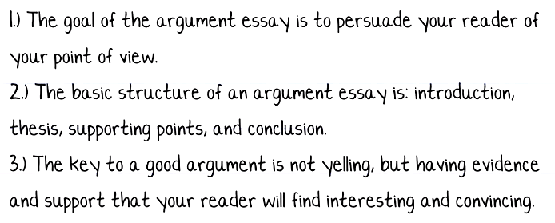
Key Points

Slide 13
Key Points

Slide 14
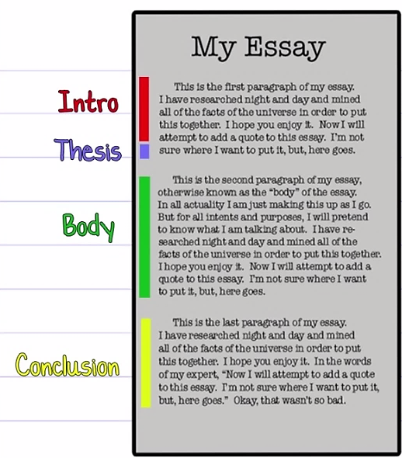
PARTS OF AN EDITORIAL
Introduction: The first paragraph includes a thesis statement explaining what the topic is, and what the editorial writer’s opinion is.
Body: The middle paragraphs give background information about the issue. Even more importantly, they give facts and reasons explaining the writer’s opinion.
Conclusion: The final paragraph often restates the thesis and encourages readers to think in a different way or to take action!

Slide 15
THESIS STATEMENT
A thesis statement presents the topic of your paper and also makes a comment about your position in relation to the topic.
Your thesis statement should tell your reader what the paper is about and also help guide your writing and keep your argument focused.

Slide 16
THESIS STATEMENT
A strong thesis statement is key to writing a persuasive essay.
The thesis statement…
presents your topic to the reader.
provides your opinion on that topic.
summarizes the argument you’ll make in the paper by offering evidence for your opinion.

Slide 19
THESIS STATEMENT
While reading your introduction, you want your audience to think…
“Wow! This is an interesting statement! Let’s see if this author can convince me.”

Slide 20
SAMPLE THESIS STATEMENT
"Cats are better pets for professionals who are not home a lot because they require less hands-on care on a daily basis, they don’t need to be taken on walks, and they are litter box trained."
“You will never convince us.”

Slide 21
SAMPLE THESIS STATEMENT
Dogs are often called “man’s best friend” because they are loyal, they make wonderful companions, and they provide steadfast protection for their owners.
“Utter
Nonsense.”

Slide 22
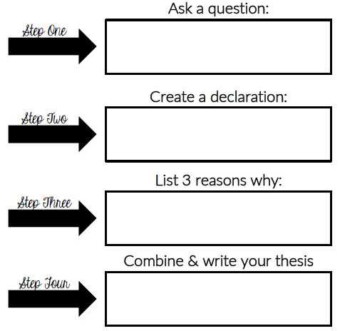
This guide will help you turn your topic and opinion into a strong thesis statement.

Slide 23
Research: Finding Evidence
You will need an informed opinion to persuade your audience.
To find evidence to support your thesis:
Use knowledge from personal experiences
Ask people you know
Interview experts
Research using the internet, books, magazines, newspapers, etc.
“INFORMED” - BACKED BY FACTS that can be proven.

Slide 24
Research: Finding Evidence
When you research information for your editorial, also take notes on facts and opinions that are different from yours.
you’ll want to show that you are aware of the opposing arguments.

Slide 25
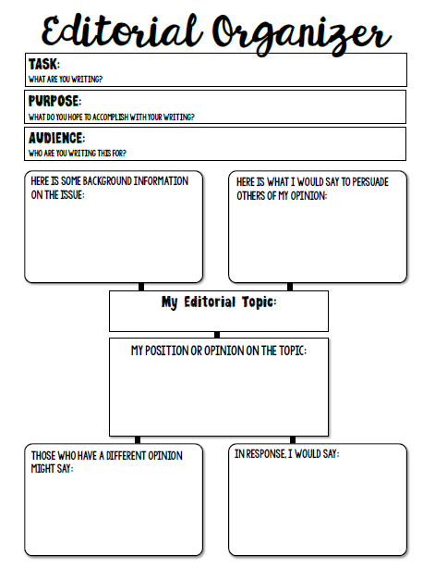
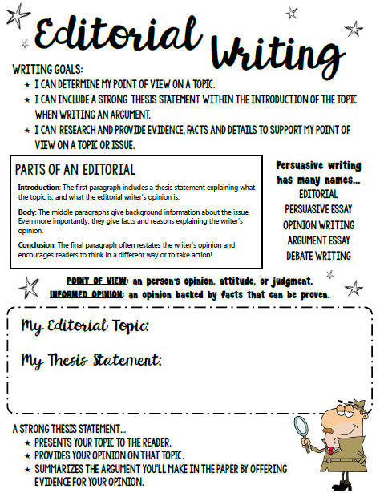
Use Your notebook pages to help you plan your editorial!

Slide 26
To Do:
Continue working on your OLS composition lessons.
Write your thesis statement.
Begin gathering information and taking notes on your topic.
Complete the weekly assignment before our next class.
Notes:
Student will submit their topic via google form. - https://goo.gl/forms/EPuuvfKLETHifYQh1

Slide 27
ANY QUESTIONS?

Slide 28
Nice job
today!

