Slide 2
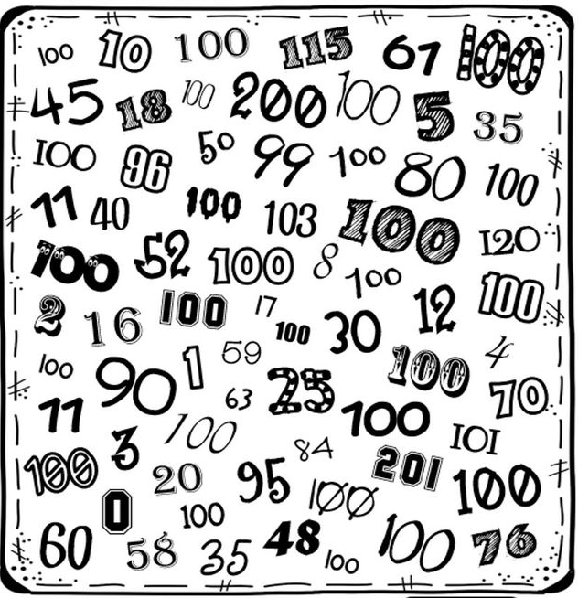
How many 100s can you find?
I found
_______.

Slide 3
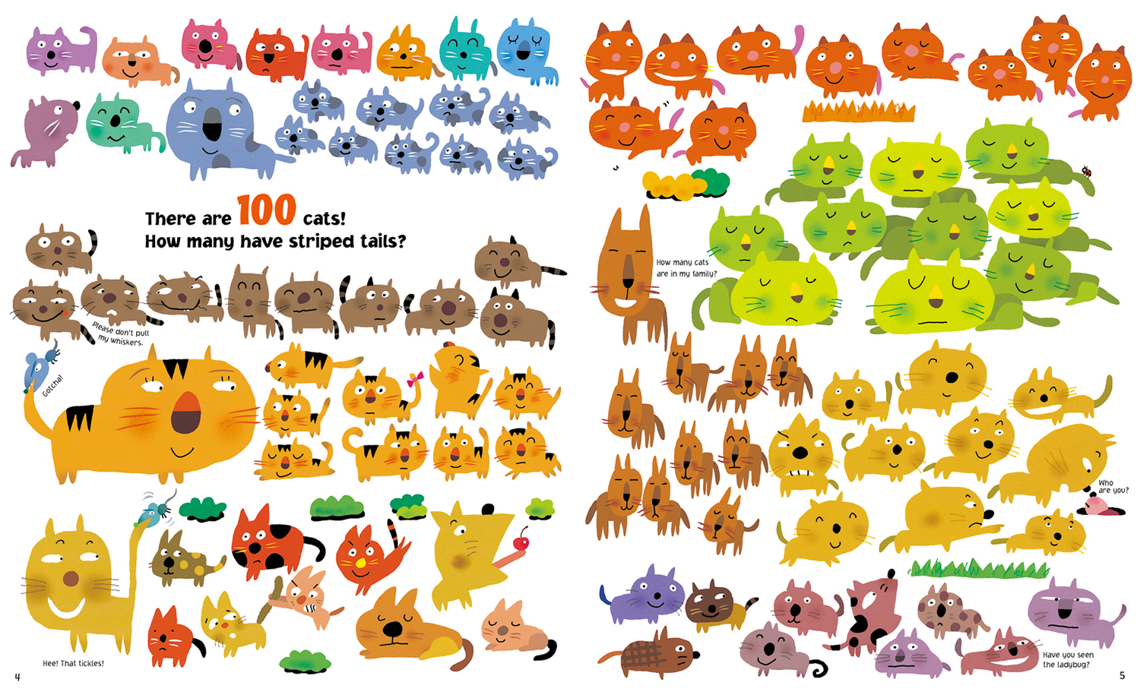

Slide 5
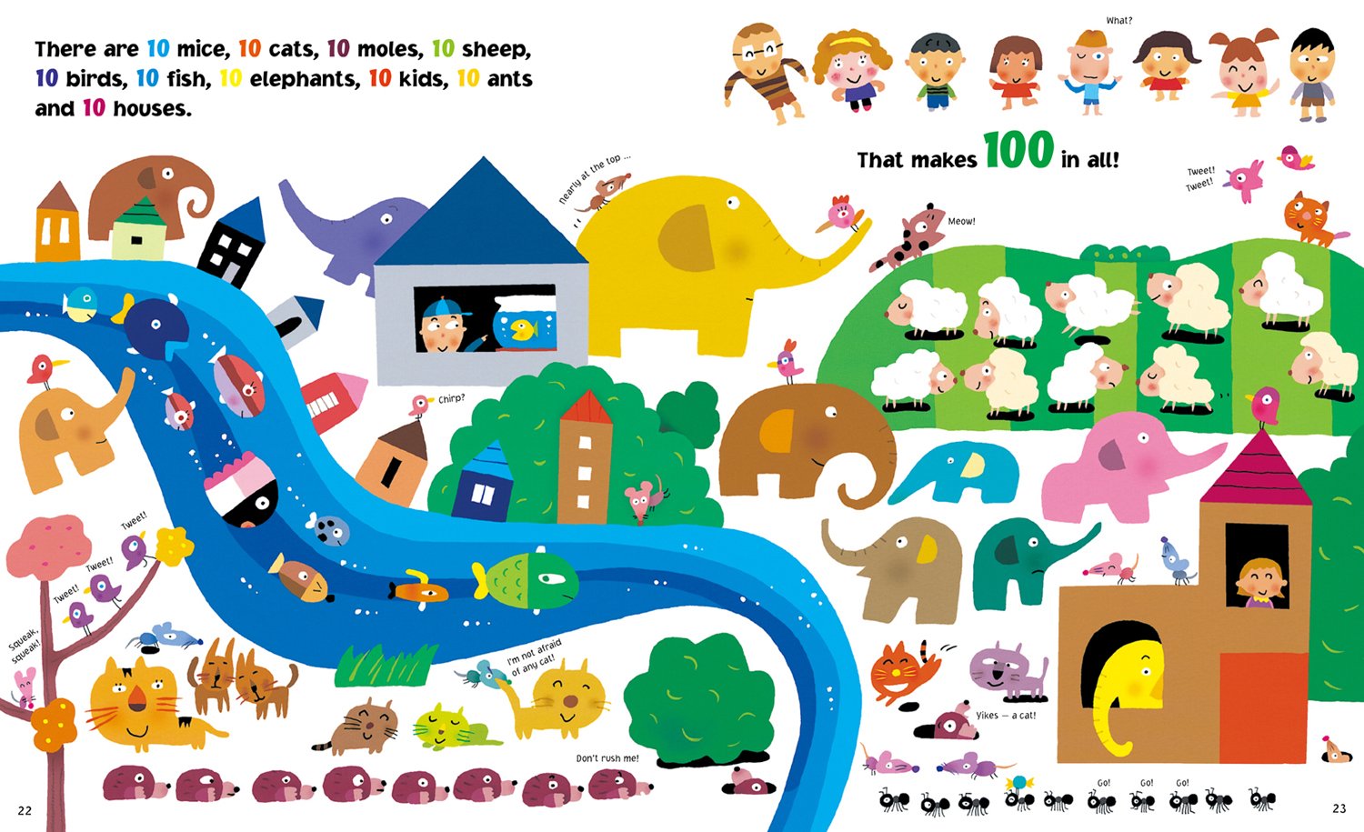

Slide 9
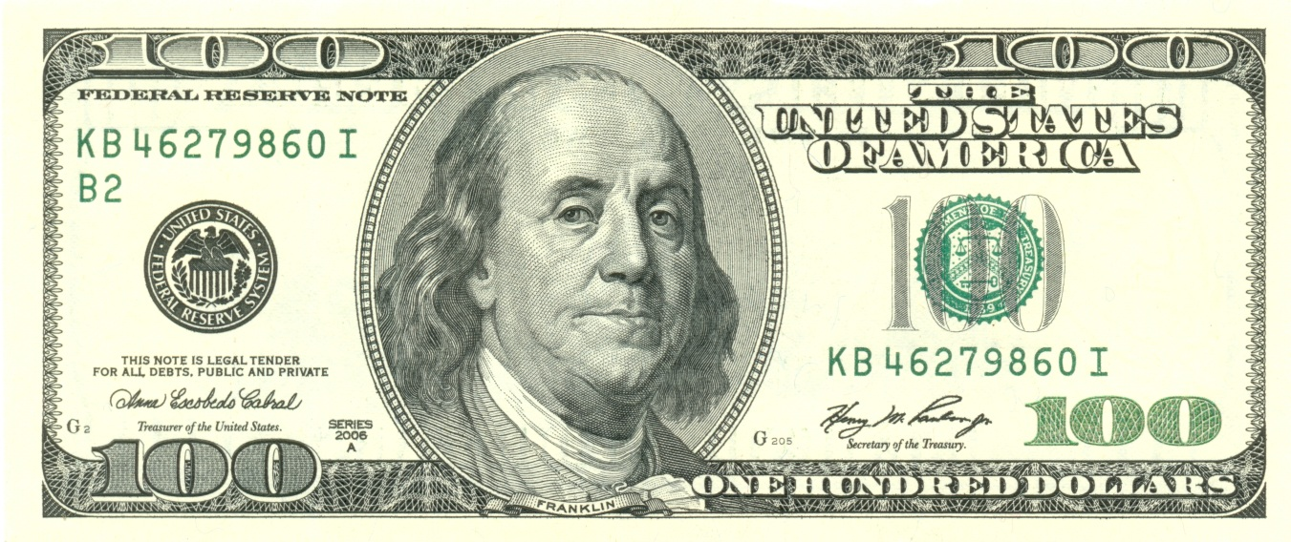

Slide 11
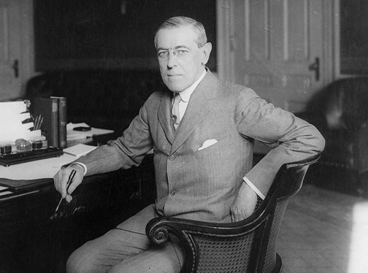
100 years ago, Woodrow Wilson was president of the United States.

Slide 12
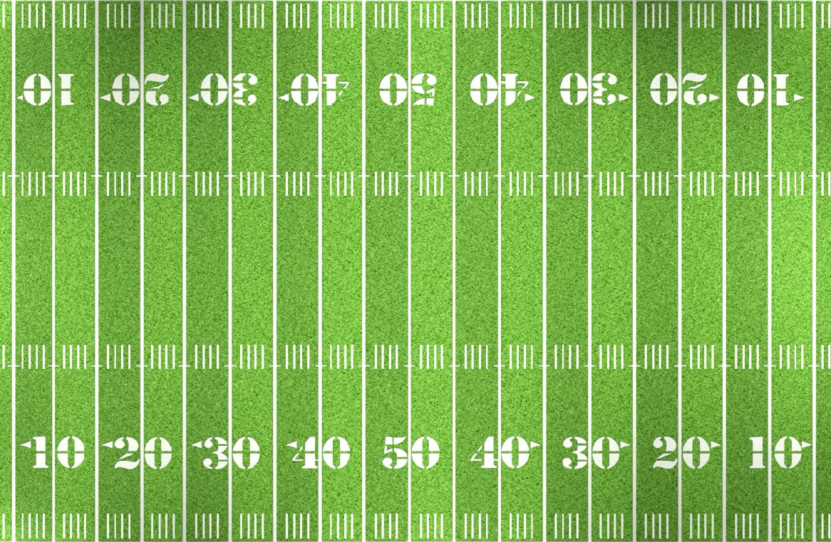
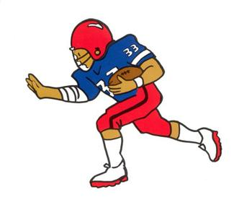
An American football field
is 100 yards long.

Slide 13
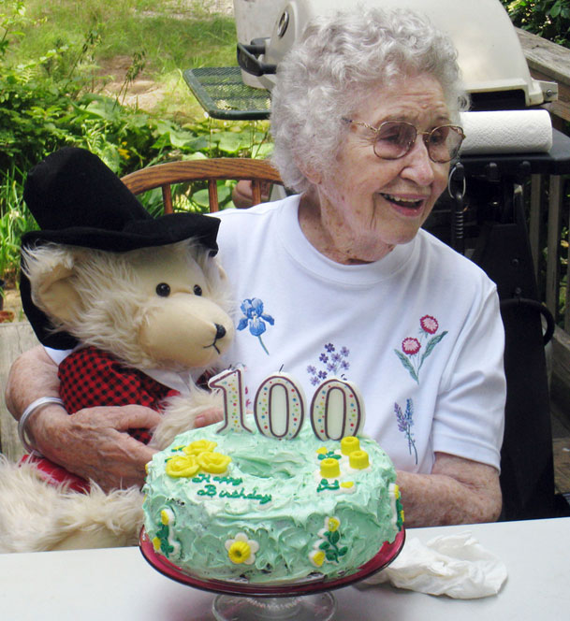
A centenarian is a person
who is 100 years old or older.

Slide 14
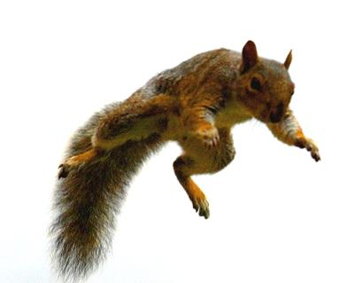
Squirrels can fall
100 feet without hurting themselves.

Slide 15
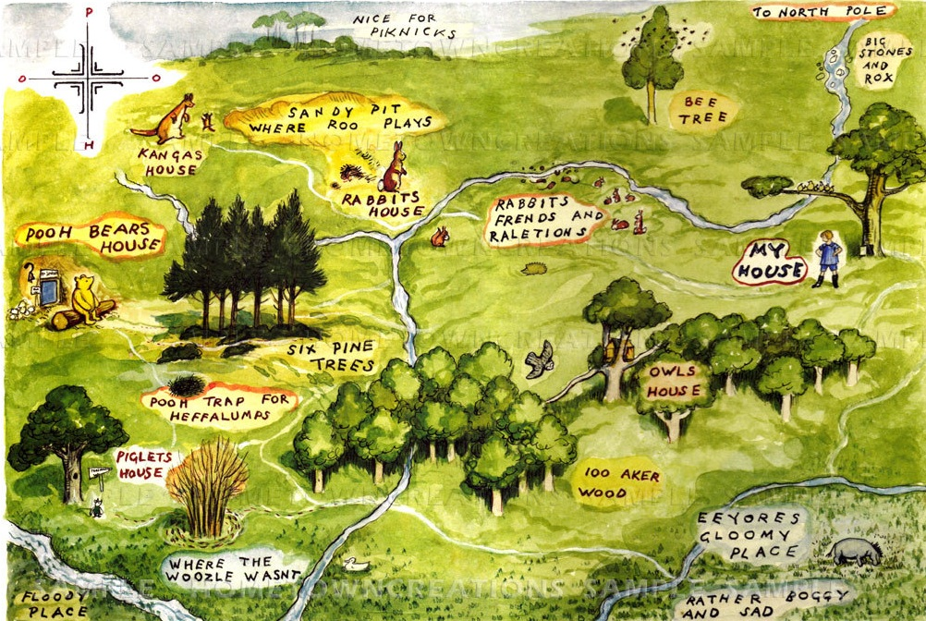
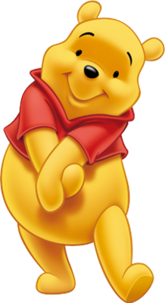
Winnie the Pooh lives in the
Hundred Acre Woods.

Slide 16
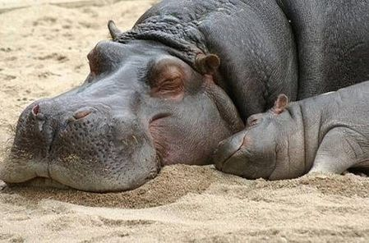
The average hippo weighs
100 pounds at birth.

Slide 17
A centennial is a 100 year anniversary.

Slide 18
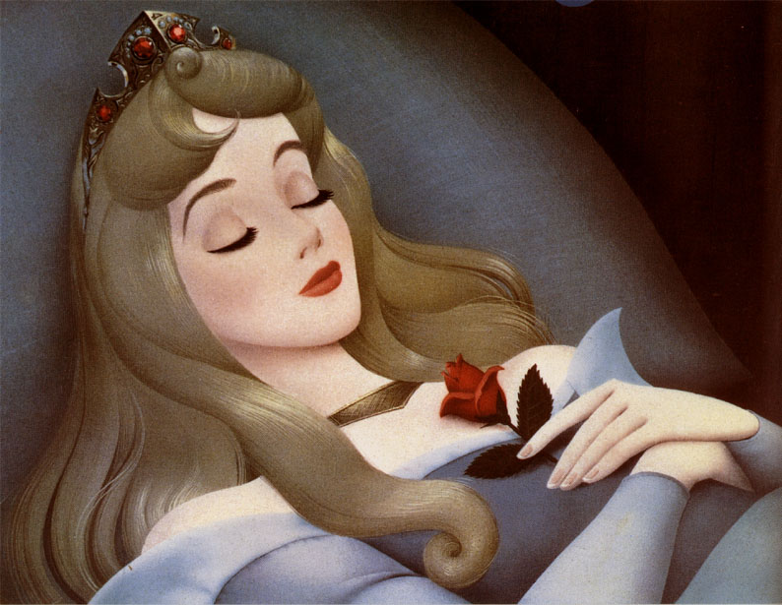
Sleeping Beauty slept for 100 years.

Slide 19
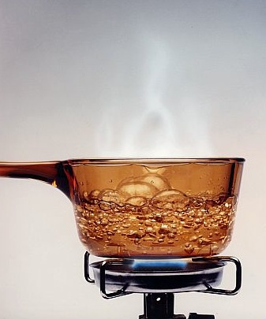
100 degrees Celsius is the boiling point
of water.

Slide 20
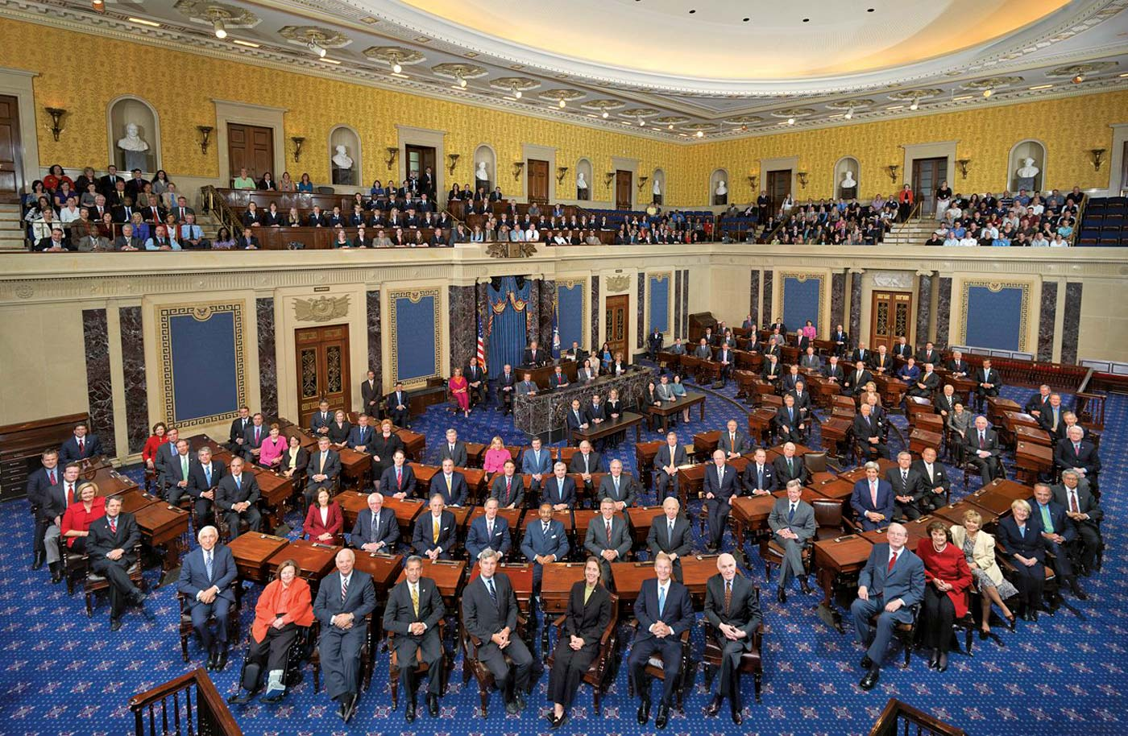
The US Congress has 100 senators.

